Slide 1
Trustworthy Reuse in the Machine Learning Model Supply Chain
Doctoral Thesis Defense
Wenxin Jiang, PhD Candidate
April 23, 2025
Advisor: Dr. James C. Davis
Committee: Dr. David I. Inouye, Dr. Xiaokang Qiu, Dr. Yung-Hsiang Lu, Dr. Zahra Ghodsi
1
Notes:
Hello thank you all for coming this morning
As Dr. Davis said, I am here to defend my phd thesis: Trustworthy reuse in the ML model supply chain
Thanks
Committee members
Dr. Davis
Family &Friends
April

Slide 2
Talk Outline
Thesis Summary
Outcomes
Background
Part 1: Characterizing Trustworthiness of AI Model Reuse
Topic 1: Challenges and Practices of Deep Learning Reengineering
Topic 2: Trustworthy Reuse of PTMs
Topic 3: Datasets of PTMs in Open-Source Software
Part 2: Improving Trustworthy Reuse in AI Model Supply Chain
Topic 4: Enhancing PTM Naming Practices and Consistency
Topic 5: Adapting Package Confusion Detection System to AI Model Supply Chain
Discussion and Conclusion
Included in Prelim
New content
2

Slide 3
Thesis Summary
3

Slide 4
Thesis Statement
The software engineering community faces a foundational gap in understanding
challenges and best practices for reuse activities in the AI model supply chain.
This thesis addresses this gap by understanding and improving the trustworthiness and reusability of open-source Pre-Trained AI Models (PTMs) through:
Characterizing the open problems of trustworthy PTM reuse
Developing tools to improve PTM trustworthiness and reusability
Publishing datasets for the larger research community
Background
Characterization
Enhancement
Notes:
Research Methods:
Empirical research
Software repository analysis ("mining software repositories")
Automated tool development

Slide 5
Outcomes
5

Slide 6
Major Outcomes
Tier 1 Publications
[1] Jiang, Synovic, Hyatt, Schorlemmer, Sethi, Lu, Thiruvathukal, and Davis. An Empirical Study of Pre-Trained Model Reuse in the Hugging Face Deep Learning Model Registry. Proceedings of the ACM/IEEE 45th International Conference on Software Engineering (ICSE’23). 13 pages
[2] Jiang, Banna, Vivek, Goel, Synovic, Klingensmith, Thiruvathukal, and Davis. Challenges and Practices of Deep Learning Model Reengineering: A Case Study on Computer Vision. Empirical Software Engineering (EMSE’24). 63 pages.
[3] Jiang, Kim, Cheung, Kim, Thiruvathukal, and Davis. “I see models being a whole other thing”: An Empirical Study of Pre-Trained Model Naming Conventions and A Tool for Enhancing Naming Consistency. (Revised&Resubmitted to EMSE’25). 67 pages.
[4] Jiang, Çakar, Lysenko, and Davis. ConfuGuard: Using Metadata to Detect Active and Stealthy Package Confusion Attacks Accurately and at Scale. arXiv (Under review at ICSE’26), 12 pages.
Tier 2 Publications
[5] Jiang, Yasmin, Jones, Synovic, Kuo, Bielanski, Yuan, Thiruvathukal, and Davis. PeaTMOSS: Mining Pre-Trained Models in Open-Source Software. Proceedings of the 21th Annual Conference on Mining Software Repositories (MSR’24). 13 pages.
Tier 3 Publications
[6] Jiang, Synovic, Jajal, Schorlemmer, Tewari, Pareek, Thiruvathukal, and Davis. PTMTorrent: A Dataset for Mining Open-source Pre-trained Model Packages. Proceedings of the 20th Annual Conference on Mining Software Repositories — Data and Tool Showcase Track (MSR-Dataset’23). 5 pages.
Workshop Publications
[7] Jiang, Synovic, Sethi, Indarapu, Hyatt, Schorlemmer, Thiruvathukal, and Davis. An Empirical Study of Artifacts and Security Risks in the Pre-trained Model Supply Chain. Proceedings of the 1st ACM Workshop on Software Supply Chain Offensive Research and Ecosystem Defenses (SCORED’22). 10 pages.
Patents
[8] Aboukhadijeh, Lysenko, Jiang. Typosquatting in Six Public Software Package Registries: Detection, Analysis, and Optimization. Socket, U.S. Provisional Patent Application No. 63/722,005. Filed Nov. 18, 2024.
[9] Jiang, Kim, Cheung, Kim, Davis. A method for identifying naming mismatches in neural networks based on their architectural properties. PRF Ref. No. 70909. In preparation for US patent. 2025.
6

Slide 7
Other Outcomes
Peer-reviewed Conference Publications
[10] Jajal, Jiang, Tewari, Woo, Lu, Thiruvathukal, and Davis. Analysis of Failures and Risks in Deep Learning Model Converters: A Case Study in the ONNX Ecosystem. Proceedings of the 33rd ACM SIGSOFT International Symposium on Software Testing and Analysis (ISSTA’24). 13 pages.
[11] Jones, Jiang, Synovic, Thiruvathukal, and Davis.. What do we know about Hugging Face? A systematic literature review and quantitative validation of qualitative claims. Proceedings of the 18th ACM/IEEE International Symposium on Empirical Software Engineering and Measurement (ESEM’24). 12 pages.
Under-Submission Conference Papers
[12]Kellas, Christou, Jiang, Li, Simon, David, Kemerlis, Davis, Yang. PickleBall: Secure Deserialization of Pickle-based Machine Learning Models. Under submission at ACM Conference on Computer and Communications Security (Under review at CCS’25). 16 pages.
[13]Gao, Zahedi, Jiang, Lin, Davis, Treude. AI Safety in the Eyes of the Downstream Developer: A First Look at Concerns, Practices, and Challenges. Under submission at IEEE/ACM International Conference on Software Engineering (Under review at ICSE’26). 12 pages.
Other Peer-Reviewed Publications (Workshops, Short Papers)
[14] Veselsky, West, Ahlgren, Thiruvathukal, Klingensmith, Goel, Jiang, Davis, Lee, and Kim. Establishing trust in vehicle-to-vehicle coordination: a sensor fusion approach. Proceedings of the 23rd Annual International Workshop on Mobile Computing Systems and Application (HotMobile’22). 6 pages.
[15] Synovic, Hyatt, Sethi, Thota, Shilpika, Miller, Jiang, Amobi, Pinderski, Laufer, Hayward, Kingensmith, Davis, and Thiruvathukal. Snapshot Metrics Are Not Enough: Analyzing Software Repositories with Longitudinal Metrics. Proceedings of the 37th IEEE/ACM International Conference on Automated Software Engineering — Demonstrations track (ASE-Tool Demonstrations’22). 4 pages.
[16] Montes, Peerapatanapokin, Schultz, Guo, Jiang, and Davis. Discrepancies among Pre-trained Deep Neural Networks: A New Threat to Model Zoo Reliability. Proceedings of the 30th ACM Joint European Software Engineering Conference and Symposium on the Foundations of Software Engineering — Ideas, Visions, and Reflections track (ESEC/FSE-IVR’22). 5 pages.
[17] Davis, Jajal, Jiang, Schorlemmer, N. Synovic, and G.K. Thiruvathukal. Reusing Deep Learning Models Challenges and Directions in Software Engineering. Proceedings of the IEEE John Vincent Atanasoff Symposium on Modern Computing (JVA’23). 14 pages.
[18] Patil, Jiang, Peng, Lugo, Kalu, LeBlanc, Smith, Heo, Aou, Davis. Recommending Pre-Trained Models for IoT Devices. Proceedings of the 7th International Workshop on Software Engineering Research & Practices for the Internet of Things (SERP4IoT’25). 5 pages.
Technical Reports
[19] Banna, Chinnakotla, Yan, Vegesana, Vivek, Krishnappa, Jiang, Lu, Thiruvathukal, and Davis. An Experience Report on Machine Learning Reproducibility: Guidance for Practitioners and TensorFlow Model Garden Contributors. https://arxiv.org/abs/2107.00821. 2021.
[20] Purohit, Jiang, Ravikiran, and Davis. A Partial Replication of MaskFormer in TensorFlow on TPUs for the TensorFlow Model Garden. https://arxiv.org/abs/2404.18801. 2024.
7

Slide 8
Background
8

Slide 9
Background
Pre-Trained Model (PTM)

Slide 10
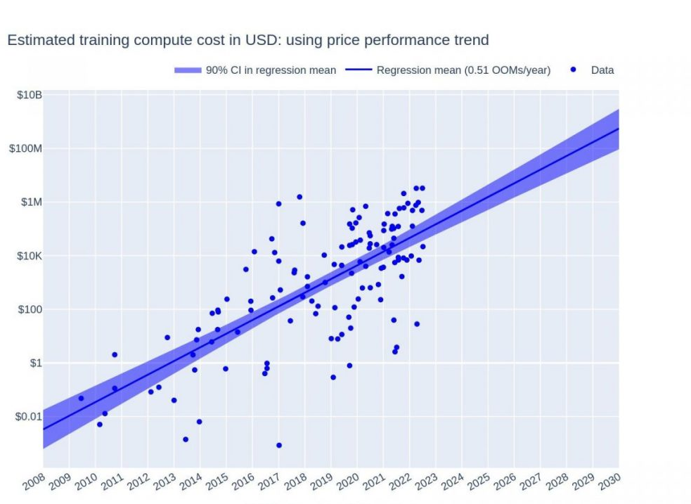
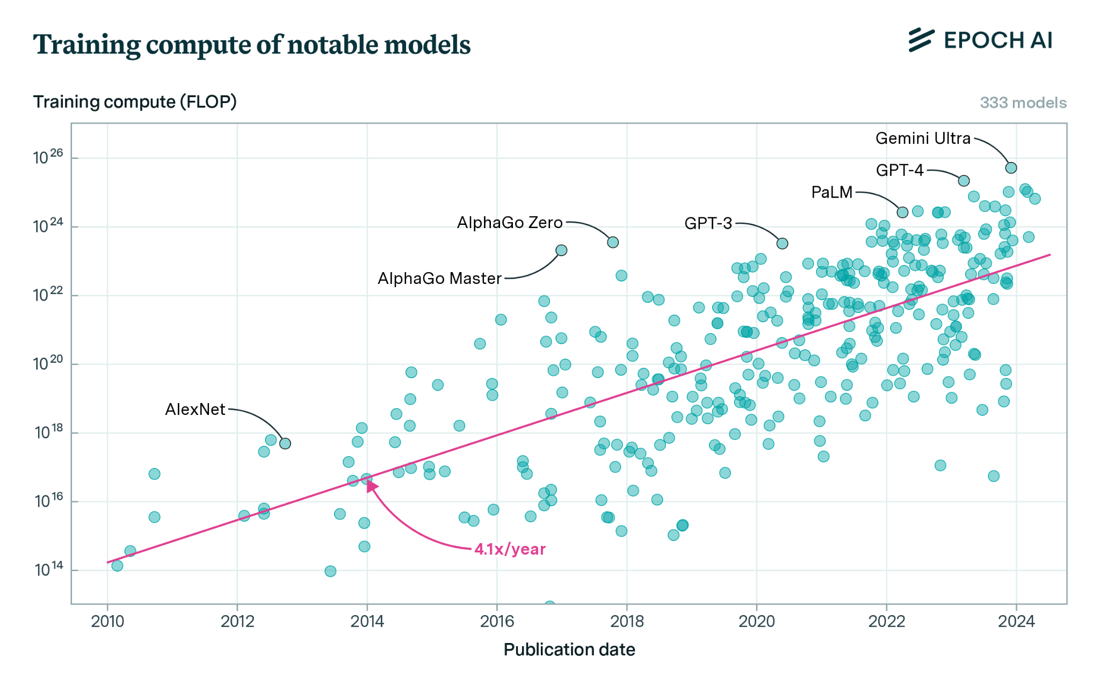
Deep Learning: Huge models, huge training cost
Training Compute
Training cost
Training compute (FLOP)
Training cost in USD
Publication date of ML system
10
Epoch AI 2023: Training Compute of Frontier AI Models Grows by 4-5x per Year
Yalalov 2023: AI Model Training Costs Are Expected to Rise from $100 Million to $500 Million by 2030
Notes:
the compute used to train recent models grew 4-5x yearly from 2010 to May 2024
AI Model Training Costs Are Expected to Rise from $100 Million to $500 Million by 2030

Slide 11
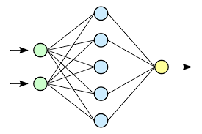
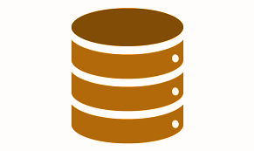
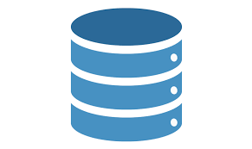
Save Costs with Pre-trained Models (PTMs)
PTM: A neural network that is already parameterized for an application
0.1
9.5
PTM =
. . .
Original application
(general dataset)
Example use: Transfer learning
PTM(s)
Predictions
New application
(specialized dataset)
General-purpose PTM
(feature extractor)
Custom model elements
(new head)
Notes:
PTNN: This parameterization – weights associated with the neural network – is also called a checkpoint, since it is taken during the training of the neural network model
They allow the user to focus on fine tuning which is arguably easier than training from scratch
PTNN's trained on large datasets are often good at generalizing to other domains, having access to these PTNN' is very convenient
An example use:
Transfer learning: The user starts with a pre-trained neural network for a GENERAL task, and specializes it to their specific task. The user can take the generic part of a network and add trainable layers specific to the new task. The PTNN is used as a backbone (baseline feature extractor). This approach supports innovation, since many different datasets and downstream model layers can be explored on top of the backbone.
============
PTNNs are also used for knowledge distillation. It essentially acts as a form of model compression, where the learned weights and biases of either the input layer, hidden layers, or the output layer is transferred to a smaller model. Unlike the previous two methods, the knowledge from the cumbersome model is now distilled and input into the smaller model. For smaller mobile applications and systems with limited computational capacity, knowledge distillation allows for a compressed model to learn from this larger network [1].
Finally, dataset labeling is a large benefit from pretrained neural networks. With the onset of these large models, accuracy and generalization become a large part of the equation. As such, specific PTNNs have the capability to help users with smaller models label datasets to a great degree of accuracy. Instead of having to go through thousands of images, it’s possible for input data to be quickly labeled and used for training.
[1] https://arxiv.org/pdf/2006.05525.pdf

Slide 12
Where are PTMs from…

Slide 13



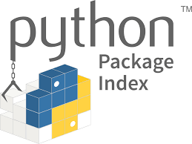






Software Packages Exchanging
Traditional
PTM
2016
2000
2004
2017
2017
2004
2010
2010
2018
2019

Slide 14
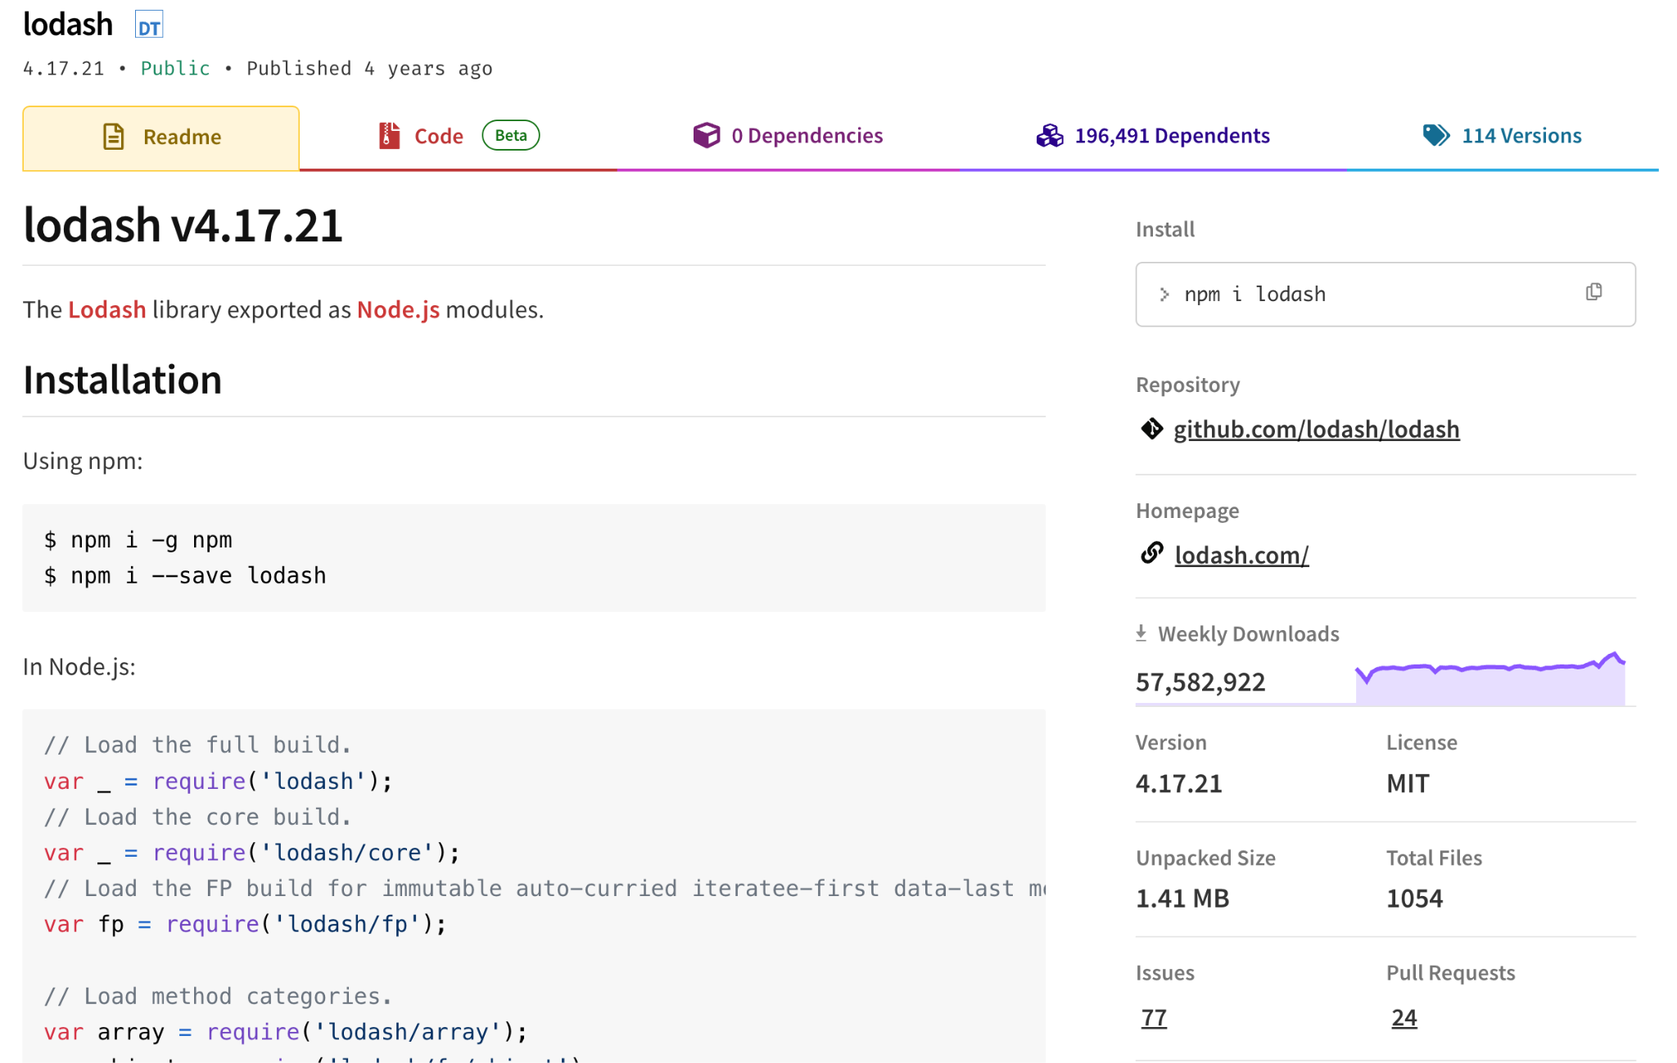
Traditional Software Packages

Slide 15
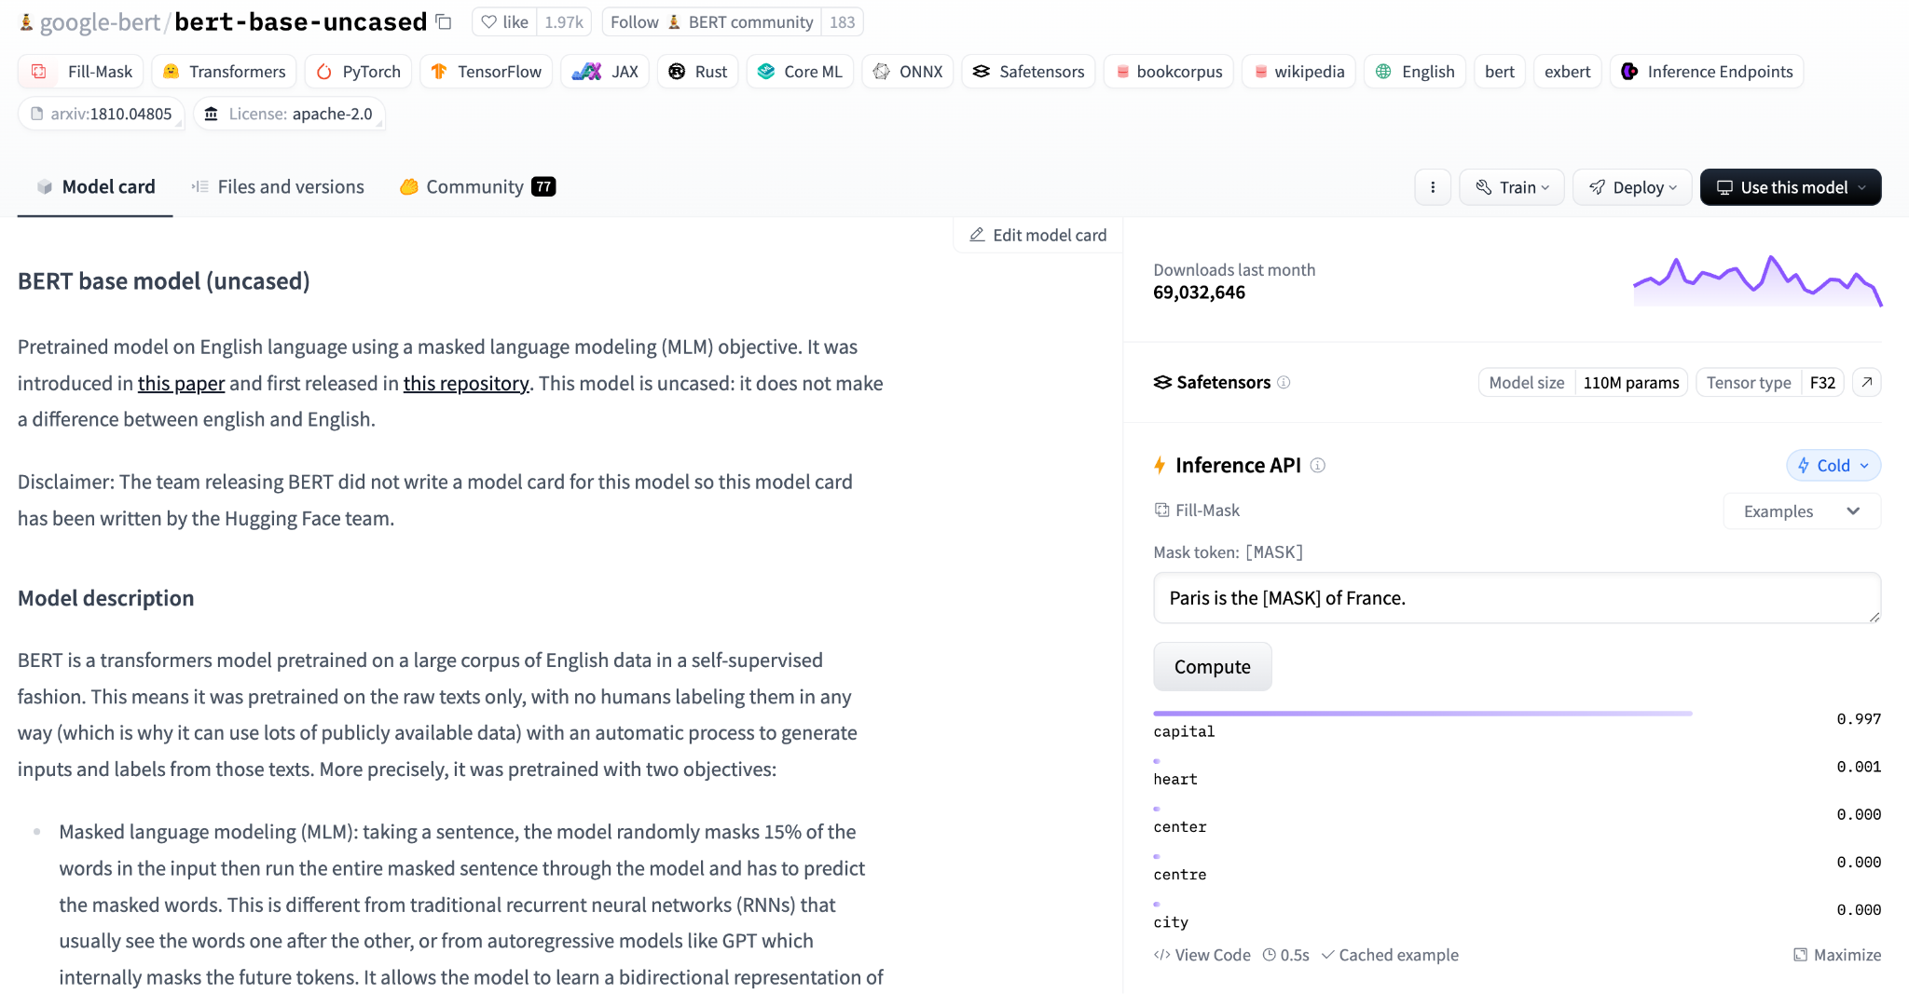
PTM Packages
Task
Libraries, Frameworks
Datasets
Architectures
Popularity
Demo
Documentation

Slide 16
Background
(Software) Engineering Reuse Process

Slide 17

Theoretical Engineering Reuse Process
What is prioritized?​
What is challenging?​
Integrate/Deploy
What is prioritized?​
Any risks?
Reengineer candidate(s)​
Evaluate candidates​
What is available?​
Identify candidates​
Specify requirement
[1] Sommerville, Ian. 2011: Software engineering. America: Pearson Education Inc.
[2] de Oliveira Barros, Márcio, Cláudia Maria Lima Werner, and Guilherme Horta Travassos. "Scenario Oriented Project Management Knowledge Reuse within a Risk Analysis Process." SEKE. 2001.
[3] Al-Badareen, Anas Bassam, et al. "An evaluation model for software reuse processes." Software Engineering and Computer Systems: Second International Conference, ICSECS 2011, Kuantan, Pahang, Malaysia, June 27-29, 2011, Proceedings, Part III 2. Springer Berlin Heidelberg, 2011.
[4] Ali, Nazakat, Horn Daneth, and Jang‐Eui Hong. "A hybrid DevOps process supporting software reuse: A pilot project." Journal of Software: Evolution and Process 32.7 (2020): e2248.
17

Slide 18
Background
Trust in (Software) Reuse

Slide 19
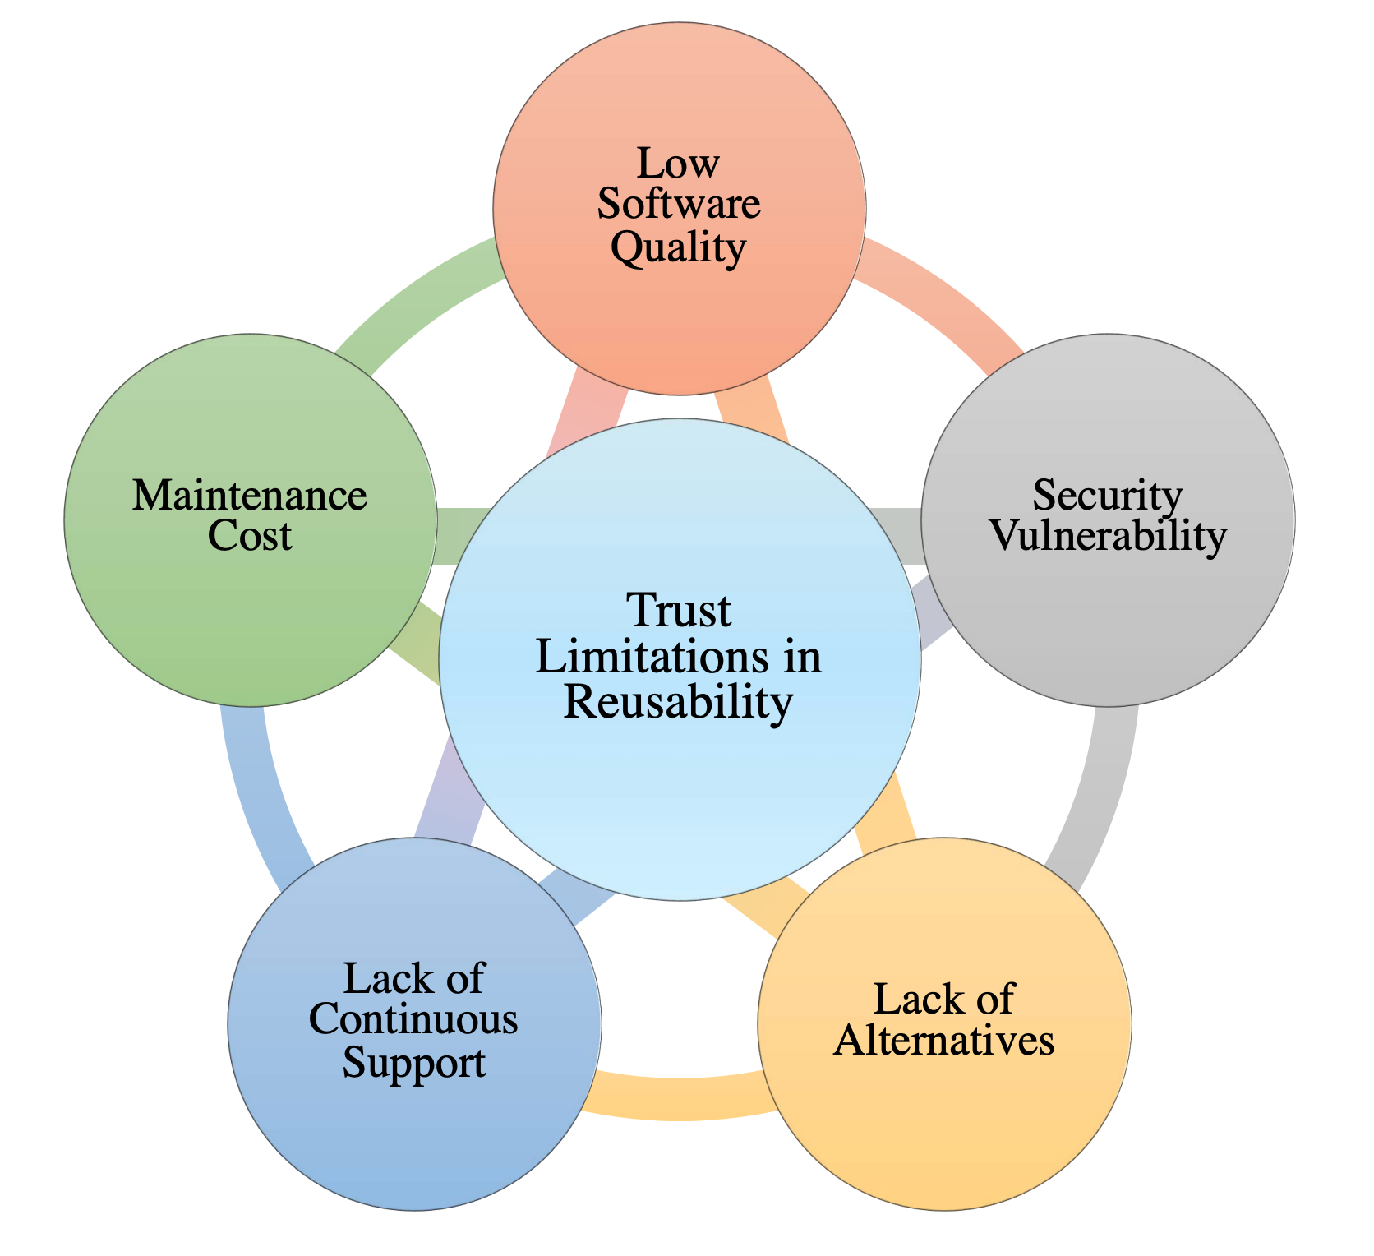

Trustworthiness in Software Reuse
How about trust in PTM reuse?
19
Ghofrani, etal. 2022: Trust challenges in reusing open source software: An interview-based initial study." Proceedings of the 26th ACM International Systems and Software Product Line Conference-Volume B.
Notes:
Low quality, malware, dependency risks, etc.

Slide 20
Putting together…
Reuse
Trad. Software
Background
Trust
PTMs

Slide 21
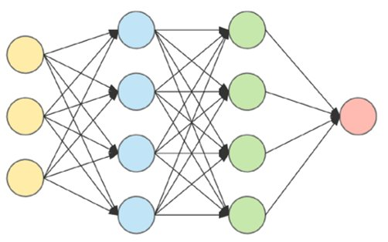




Trustworthy Reuse of PTMs
Reusability
What is prioritized?​
What is challenging?​
Integrate/Deploy
EMSE’24
What is prioritized?​
Any risks?
Reengineer candidate(s)​
Trust
Revised&Resubmitted at EMSE’25
Under Review at ICSE’26
Evaluate candidates​
What is available?​
MSR-Dataset’23,
MSR’24
Identify candidates​
PTM Supply Chain
ESEM’24, ICSE’23,
SCORED’22
Specify requirement
21

Slide 22
Part 1: Characterizing Trustworthiness of AI Model Reuse
22

Slide 23


What Do We Know So Far?
Reuse
Trad. Software
Background
Trust
PTMs
Reuse
Trust
Characterization

Slide 24
Topic 1
Challenges and Practices of Deep Learning Reengineering
[Presented in the Preliminary Exam]
[EMSE’24] Jiang, Banna, Vivek, Goel, Synovic, Klingensmith, Thiruvathukal, and Davis. Challenges and Practices of Deep Learning Model Reengineering: A Case Study on Computer Vision. Empirical Software Engineering (EMSE’24). 63 pages.
[arXiv’21] Banna, Chinnakotla, Yan, Vegesana, Vivek, Krishnappa, Jiang, Lu, Thiruvathukal, and Davis. An Experience Report on Machine Learning Reproducibility: Guidance for Practitioners and TensorFlow Model Garden Contributors. https://arxiv.org/abs/2107.00821. 2021.
[arXiv’24] Purohit, Jiang, Ravikiran, and Davis. A Partial Replication of MaskFormer in TensorFlow on TPUs for the TensorFlow Model Garden. https://arxiv.org/abs/2404.18801. 2024.

Slide 25
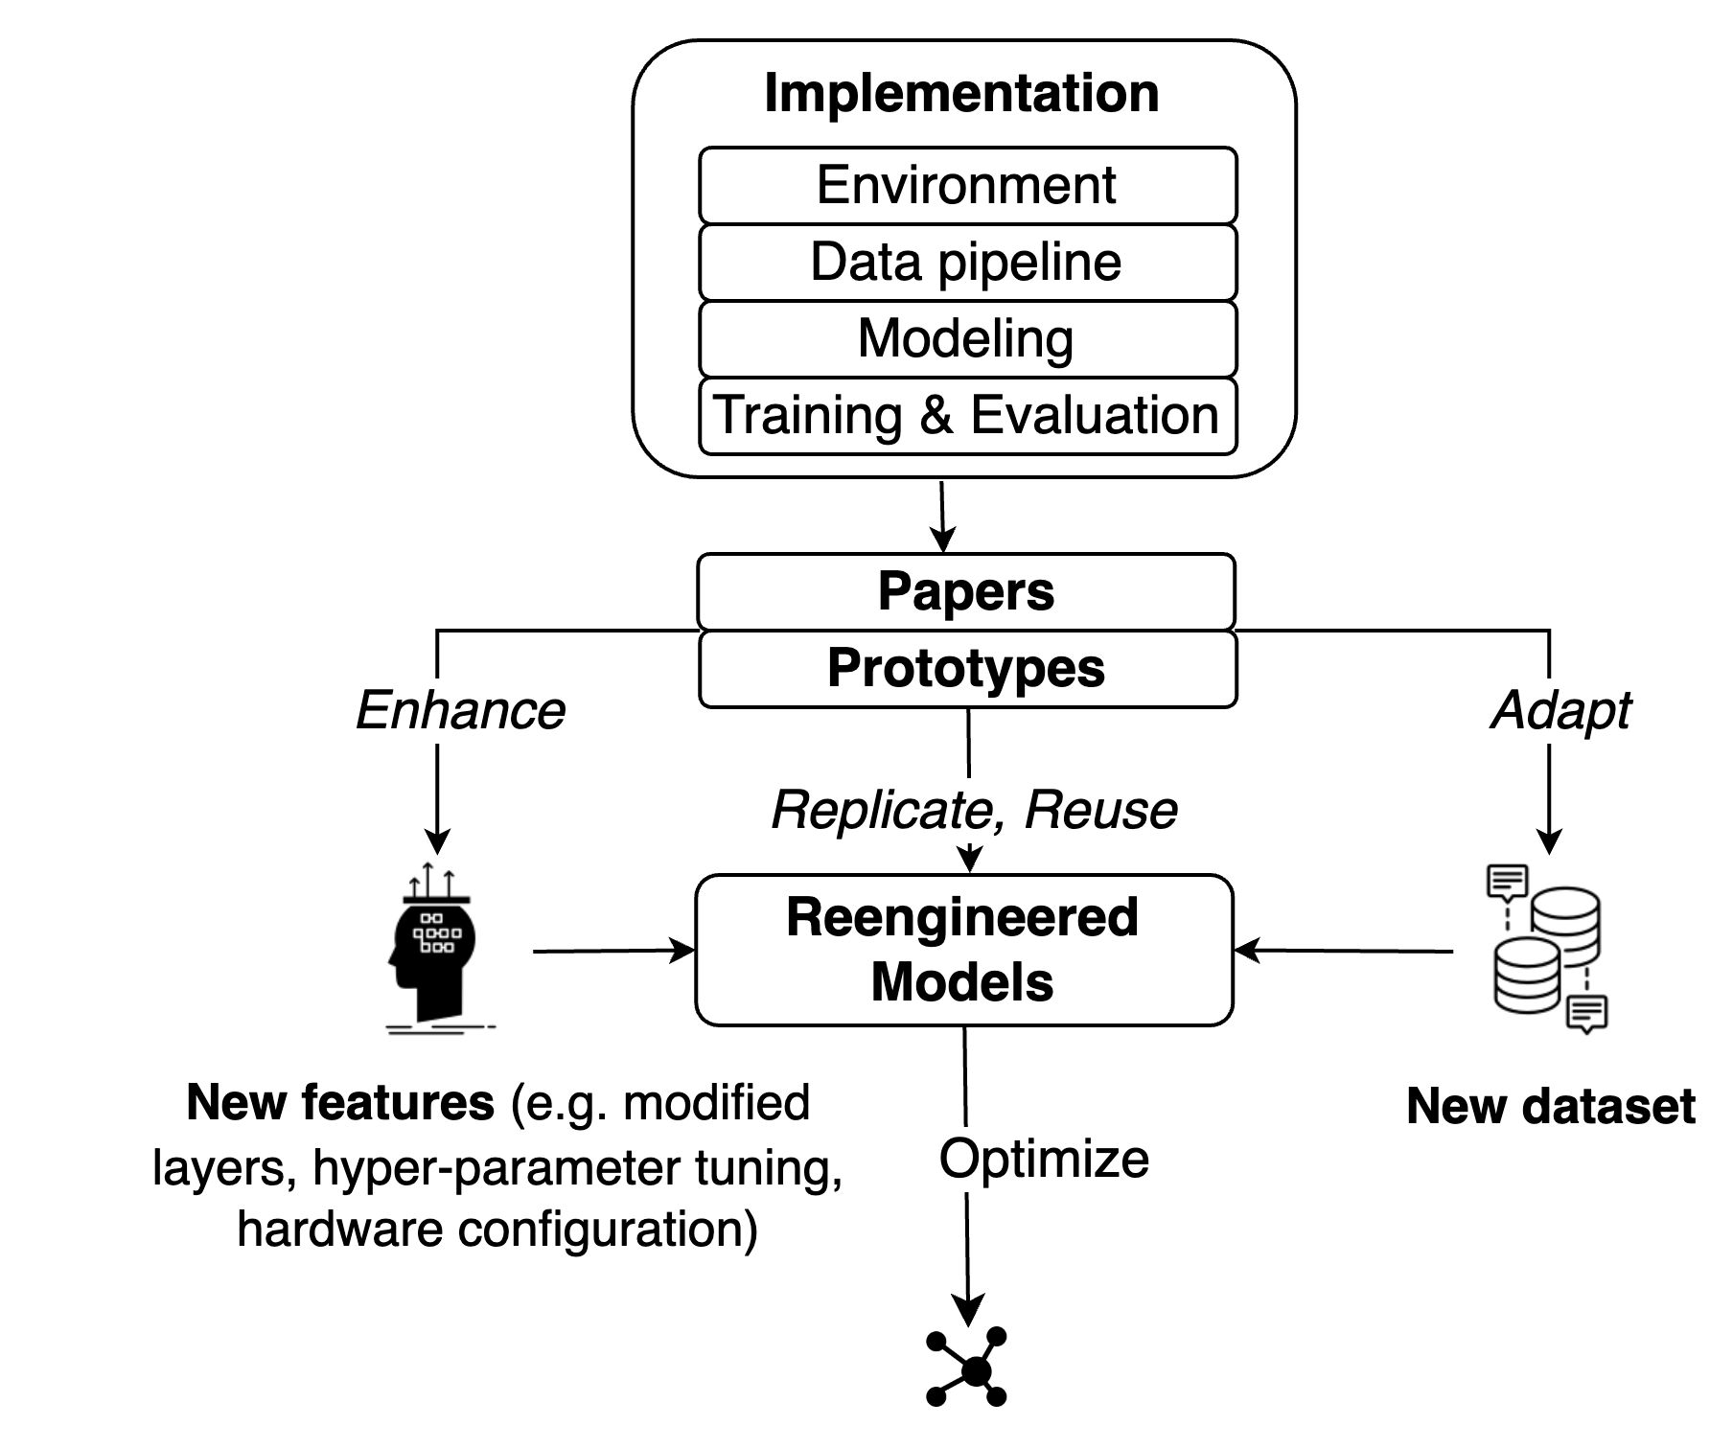
DL Model Engineering Life Cycle
Model engineering
(focus of prior work)
“Product” view
Model reengineering
(focus of our study)
“Process” view
“Beyond-the-product” interpretation of failures
→ better understanding how defects arise
25

Slide 26
Results – DL Reengineering Challenges
Model operationalization
“Understanding the previous work is often the most difficult part ...translating that information and transmitting that information in an efficient way can be very hard”
“The only way to validate that your model is correct is to...train it, but the pitfall is that many people only write the code for the model without any training code...That, in my opinion, is the biggest pitfall.”
Other challenges:
Performance Debugging, Portability of DL Operations*, and Customized Data Pipeline
We also asked about mitigations, one highlight was the difficulty in testing
26
[ISSTA’24] Jajal, Jiang, Tewari, Woo, Lu, Thiruvathukal, and Davis. Analysis of Failures and Risks in Deep Learning Model Converters: A Case Study in the ONNX Ecosystem. Proceedings of the 33rd ACM SIGSOFT International Symposium on Software Testing and Analysis (ISSTA’24). 13 pages.

Slide 27
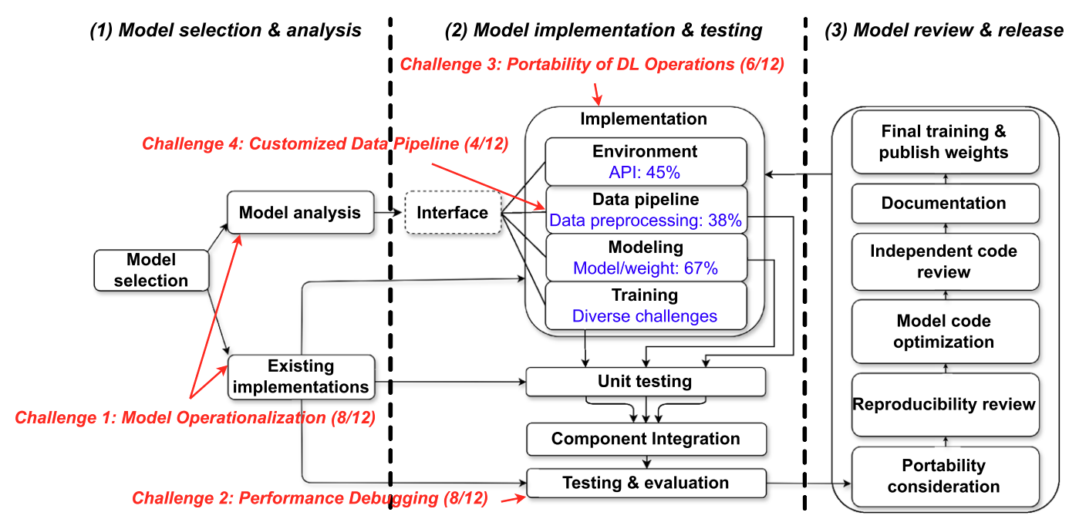
DL Reengineering Workflow
27

Slide 28
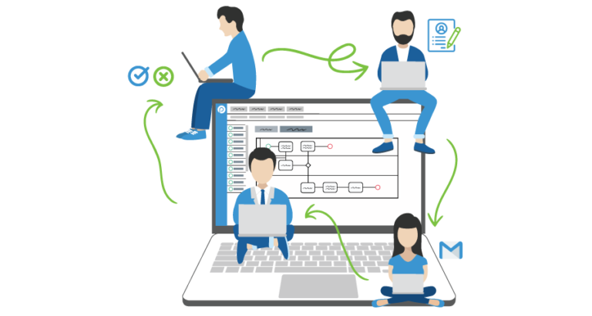

Takeaway Message
DL Reengineering is a challenging process…
Background
but could be more efficient with more work on standardization, validation, and automated tools!
Characterization
Reuse
Trust
28
Notes:
Standardized practices
Support for Reengineering Validation
Beyond manual reengineering
Further empirical work

Slide 29
Topic 2
Trustworthy Reuse of PTMs
[Presented in the Preliminary Exam]
[SCORED’22] Jiang, Synovic, Sethi, Indarapu, Hyatt, Schorlemmer, Thiruvathukal, Davis. An Empirical Study of Artifacts and Security Risks in the Pre-trained Model Supply Chain. Proceedings of the 1st ACM Workshop on Software Supply Chain Offensive Research and Ecosystem Defenses (SCORED) 2022.
[ICSE’23] Jiang, Synovic, Hyatt, Schorlemmer, Sethi, Lu, Thiruvathukal, Davis. An Empirical Study of Pre-Trained Model Reuse in the Hugging Face Deep Learning Model Registry. Proceedings of the 45th International Conference on Software Engineering (ICSE) 2023.
[JVA’23] Davis, Jajal, Jiang, Schorlemmer, N. Synovic, and G.K. Thiruvathukal. Reusing Deep Learning Models Challenges and Directions in Software Engineering. Proceedings of the IEEE John Vincent Atanasoff Symposium on Modern Computing (JVA) 2023.
[ESEM’24] Jones, Jiang, Synovic, Thiruvathukal, Davis. What do we know about Hugging Face? A systematic literature review and quantitative validation of qualitative claims. In Proceedings of the 18th ACM/IEEE International Symposium on Empirical Software Engineering and Measurement (ESEM) 2024.
Notes:
Consider the software engineer.
* What tasks do they perform?
- Lots of traditional activities such as computer programming, data management, data transmission, collaborative engineering, and deployment. More recently working with machine learning technologies such as neural networks.
What tools do they use to assist them in these tasks?
*Flip through some tool families
One aspect of software engineering research is to understand the ways that engineers use these tools, in order to
1.Identify problems with the tools
2.Identify ways we can improve these tools
3.Identify opportunities for new tools
When tools are used incorrectly, bad things happen.
The engineering process may be inefficient, or the quality of the engineering product may be affected.
TRANS
Today I’m going to talk about engineering practices and challenges for one of these domains: machine learning, and specifically, deep learning / neural networks.
=====
Editing:
-VSCode
-IntelliJ
-Eclipse
-Emacs
Interacting with data
-MySQL
-MongoDB (noSQL)
-GraphQL
Communication:
-JSON
-Protobuf
Working with other developers:
-Version control
-CI tools like Travis
Virtualization:
- Docker
- Kubernetes
Deployment, e.g. serverless frameworks like
- AWS lambda
- Google cloud functions
-Apache OpenWhisk
-
Neural networks:
- Development frameworks like PyTorch and TensorFlow; model hubs such as HuggingFace; exchange formats such as ONNX

Slide 30
Lack of Knowledge
How is this similar to / different from regular software packages?
Little literature about DL software packages (PTMs)
Reuse and trust are unexamined in DL model registries

Slide 31
Why PTM Reuse is hard?
Missing attributes:
•“Missing details of models”
•“Performances of the published models are unclear”
•“Different authors process data differently, so it cannot be easily compared”
Discrepancies:
•“Some of the models are over-promising”
•“Model names are not named correctly and sometimes the provided scripts are broken”
Security and Privacy Risks:
•“The model deployment and data transmission are not in their control”
•“It is hard to know what exactly generated the model because most training logs are missing”
•“If the model is trained with malicious intents. It could have a lot of consequences in the real world”
10/12, 83%
Transparency (Trust)
Comparability (Reuse)
9/12, 75%
Discrepancy (Trust + reuse)
Lack of maintenance (Reuse)
3/12, 25%
Privacy (Trust)
Security (Trust)
Notes:
TODO: Connect this to open/active/solved problems in DL. E.g “No scanner” is an open problem in DL.

Slide 32
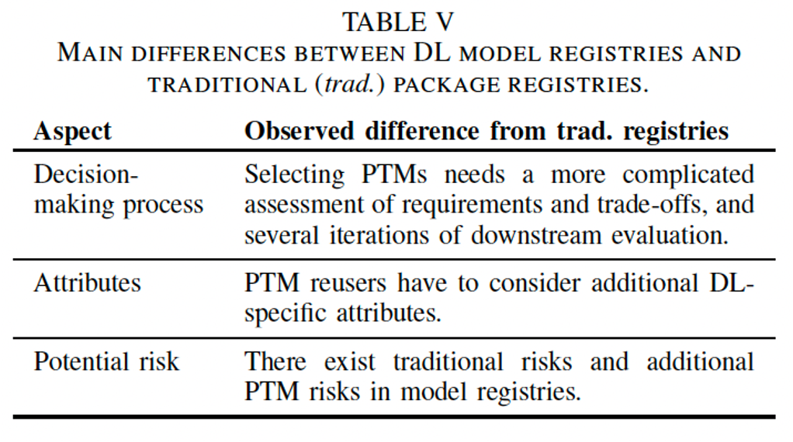
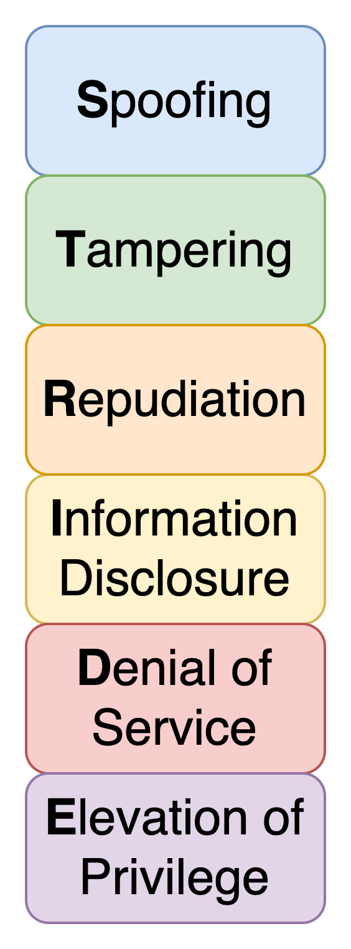
PTM Package vs. Traditional Package
STRIDE Analysis
Notes:
We substantiate our findings with a risk mitigation measurement in the HF ecosystem using STRIDE methodology for threat modeling and risks assessment
STRIDE analysis focuses on trust assumptions related to data, making it suitable for PTMs.
**STRIDE: Spoofing involves impersonating a user or system, Tampering involves unauthorized modification of data, Repudiation refers to denying involvement in an action, Information disclosure is the exposure of sensitive information, Denial of service disrupts normal operations, and Elevation of privilege allows unauthorized access to restricted resources.
Spoofing: Involves illegally accessing and then using another user's authentication information, such as username and password
Tampering: Involves the malicious modification of data.
Repudiation: Associated with users who deny performing an action without other parties having any way to prove otherwise
Information Disclosure: Involves the exposure of information to individuals who are not supposed to have access to it
Denial of Service: Denial of service (DoS) attacks deny service to valid users
Elevation of Privilege: An unprivileged user gains privileged access and thereby has sufficient access to compromise or destroy the entire system.

Slide 33

Takeaway Message
PTM reuse is an emerging (emerged?) form of software reuse, with novel characteristics
Aspects of PTM reuse are different from traditional software packages…
We have only scratched the surface of PTM reuse
Background
Characterization
Reuse
Trust
Notes:
Of course there's more work to do and I'll talk more about that at the end, but these studies have shed the first light on PTM reuse

Slide 34
Topic 3
Datasets of PTMs in Open-Source Software
[Presented in the Preliminary Exam]
[MSR’24] Jiang, Yasmin, Jones, Synovic, Kuo, Bielanski, Yuan, Thiruvathukal, and Davis. PeaTMOSS: Mining Pre-Trained Models in Open-Source Software. Proceedings of the 21th Annual Conference on Mining Software Repositories (MSR’24). 13 pages.
[MSR-Dataset’23] Jiang, Synovic, Jajal, Schorlemmer, Tewari, Pareek, Thiruvathukal, and Davis. PTMTorrent: A Dataset for Mining Open-source Pre-trained Model Packages. Proceedings of the 20th Annual Conference on Mining Software Repositories — Data and Tool Showcase Track (MSR-Dataset’23). 5 pages.
Notes:
Consider the software engineer.
* What tasks do they perform?
- Lots of traditional activities such as computer programming, data management, data transmission, collaborative engineering, and deployment. More recently working with machine learning technologies such as neural networks.
What tools do they use to assist them in these tasks?
*Flip through some tool families
One aspect of software engineering research is to understand the ways that engineers use these tools, in order to
1.Identify problems with the tools
2.Identify ways we can improve these tools
3.Identify opportunities for new tools
When tools are used incorrectly, bad things happen.
The engineering process may be inefficient, or the quality of the engineering product may be affected.
TRANS
Today I’m going to talk about engineering practices and challenges for one of these domains: machine learning, and specifically, deep learning / neural networks.
=====
Editing:
-VSCode
-IntelliJ
-Eclipse
-Emacs
Interacting with data
-MySQL
-MongoDB (noSQL)
-GraphQL
Communication:
-JSON
-Protobuf
Working with other developers:
-Version control
-CI tools like Travis
Virtualization:
- Docker
- Kubernetes
Deployment, e.g. serverless frameworks like
- AWS lambda
- Google cloud functions
-Apache OpenWhisk
-
Neural networks:
- Development frameworks like PyTorch and TensorFlow; model hubs such as HuggingFace; exchange formats such as ONNX

Slide 35
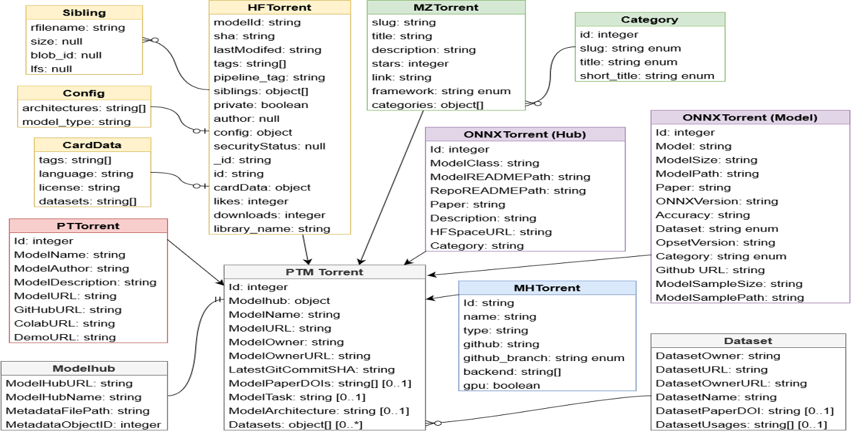
Dataset 1: PTMTorrent - Data Schema
[MSR’23-Dataset]

Slide 36
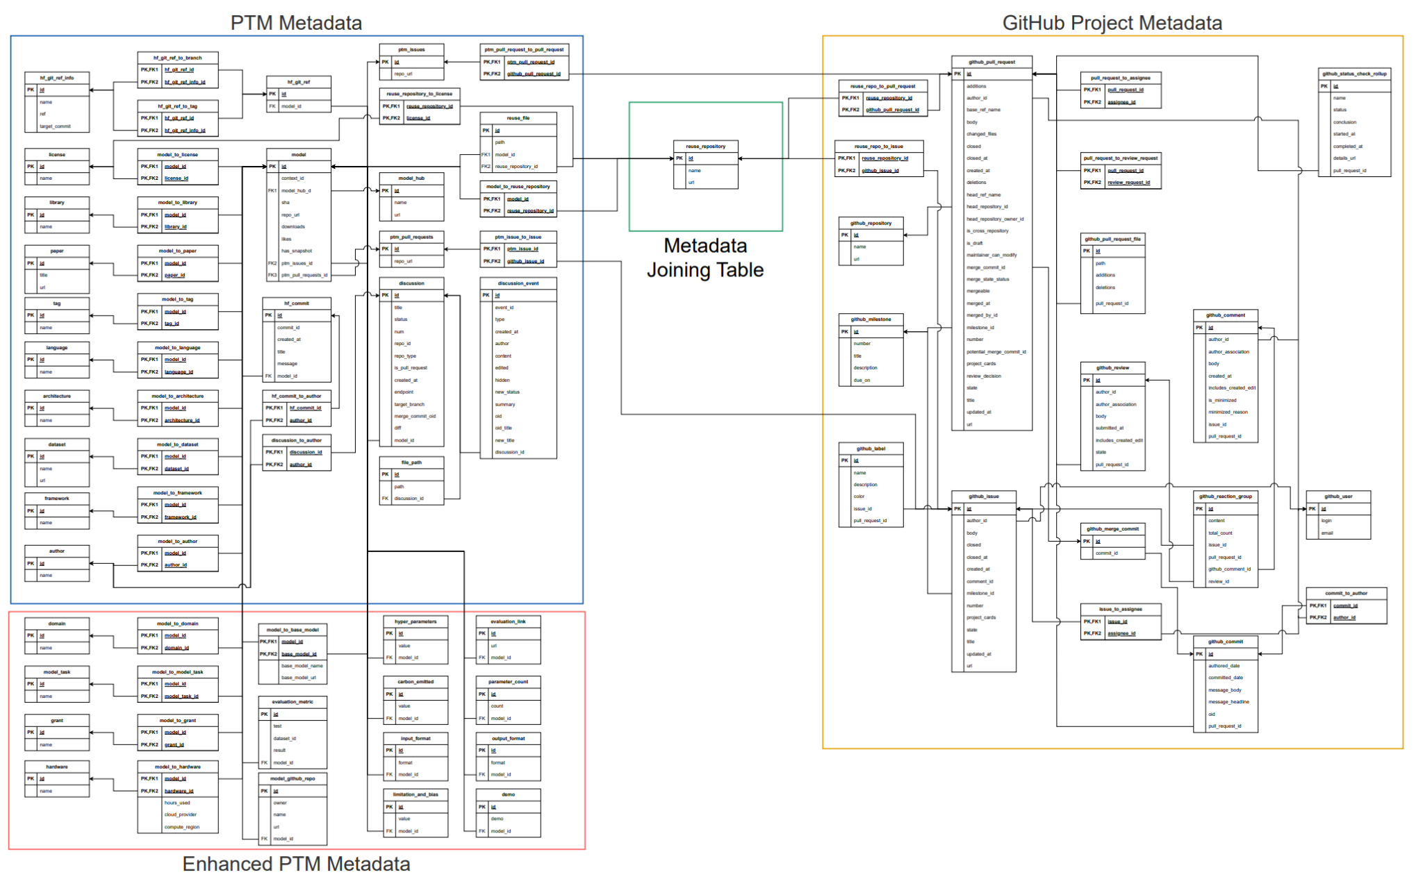
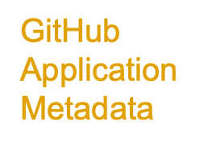
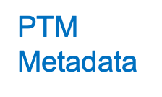



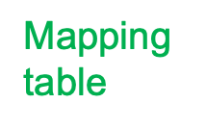
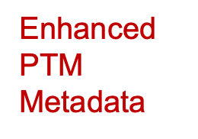

Dataset 2: PeaTMOSS - Data Schema
[MSR’24]
Notes:
Here is the overview of our database schema.
PTM Metadata, Mapping table connecting the upstream PTM package to downstream GitHub Applications, GitHub Application metadata, Enhanced PTM metadata.
I understand that this is hard to read… Let me give you more details.

Slide 37
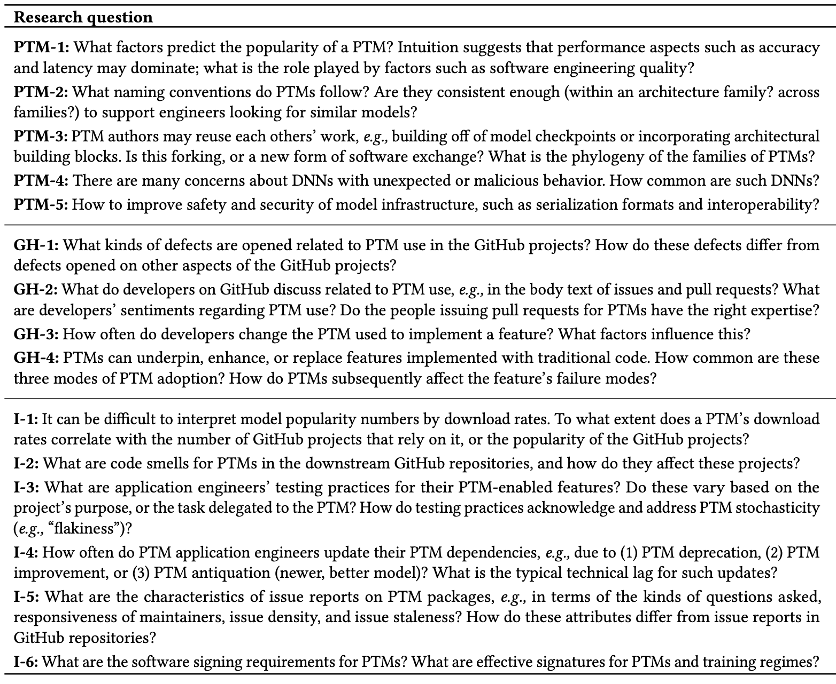

Takeaway Message
PTM reuse is still under discovered…
There are many directions to be work on!
PTM
GitHub
Proposed 15 future directions
Integration

Slide 38
Part 2: Improving Trustworthy Reuse in AI Model Supply Chain
38

Slide 39

What Do We Know So Far?
Reuse
Trad. Software
Trust
Background
PTMs
Characterization
Reuse
Trust
Enhancement

Slide 40
Topic 4
Enhancing PTM Naming Practices and Consistency
[Proposed in the Preliminary Exam]
[Revised&Resubmitted to EMSE’25] Jiang, Kim, Cheung, Kim, Thiruvathukal, and Davis. “I see models being a whole other thing”: An Empirical Study of Pre-Trained Model Naming Conventions and A Tool for Enhancing Naming Consistency. (Revised&Resubmitted to EMSE’25). 67 pages.
Notes:
Consider the software engineer.
* What tasks do they perform?
- Lots of traditional activities such as computer programming, data management, data transmission, collaborative engineering, and deployment. More recently working with machine learning technologies such as neural networks.
What tools do they use to assist them in these tasks?
*Flip through some tool families
One aspect of software engineering research is to understand the ways that engineers use these tools, in order to
1.Identify problems with the tools
2.Identify ways we can improve these tools
3.Identify opportunities for new tools
When tools are used incorrectly, bad things happen.
The engineering process may be inefficient, or the quality of the engineering product may be affected.
TRANS
Today I’m going to talk about engineering practices and challenges for one of these domains: machine learning, and specifically, deep learning / neural networks.
=====
Editing:
-VSCode
-IntelliJ
-Eclipse
-Emacs
Interacting with data
-MySQL
-MongoDB (noSQL)
-GraphQL
Communication:
-JSON
-Protobuf
Working with other developers:
-Version control
-CI tools like Travis
Virtualization:
- Docker
- Kubernetes
Deployment, e.g. serverless frameworks like
- AWS lambda
- Google cloud functions
-Apache OpenWhisk
-
Neural networks:
- Development frameworks like PyTorch and TensorFlow; model hubs such as HuggingFace; exchange formats such as ONNX

Slide 41
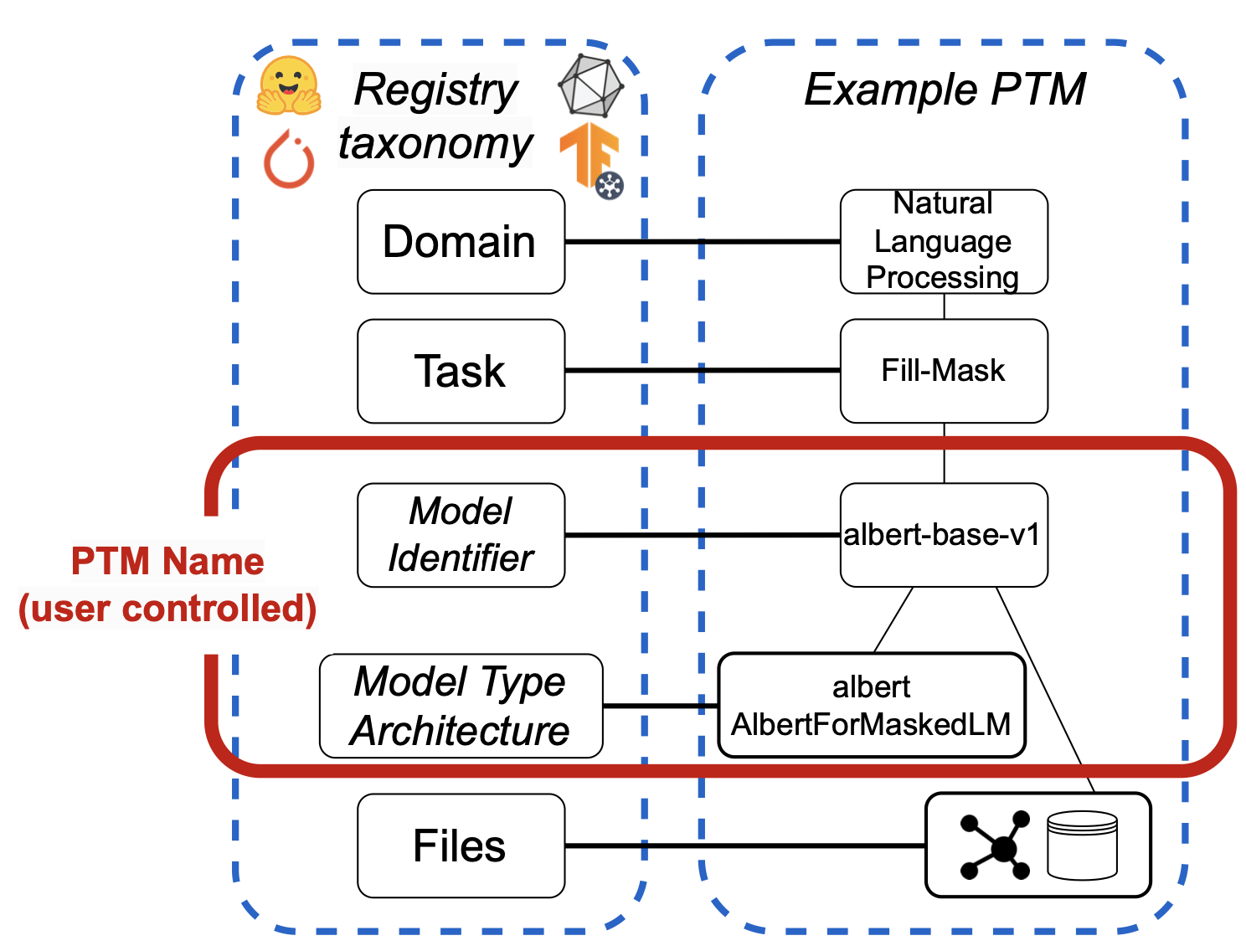
Hierarchy of PTM Naming Taxonomy

Slide 42

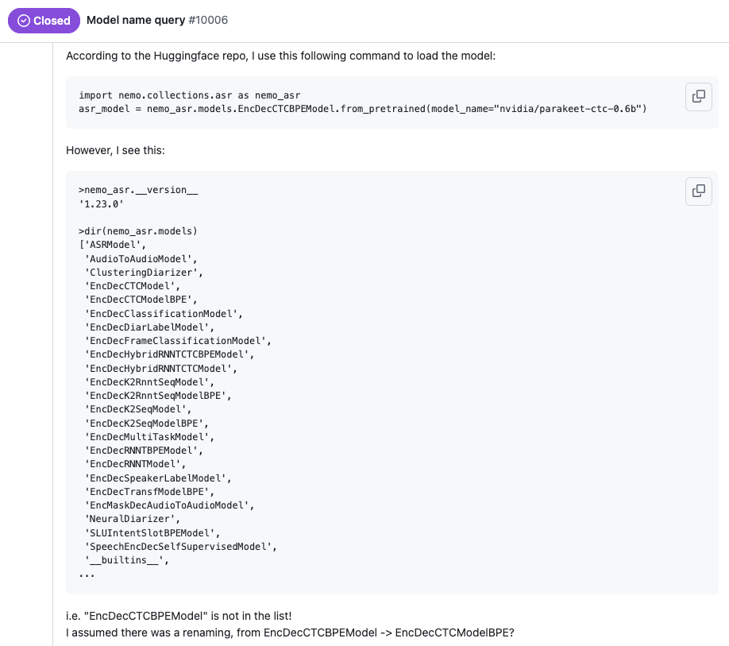
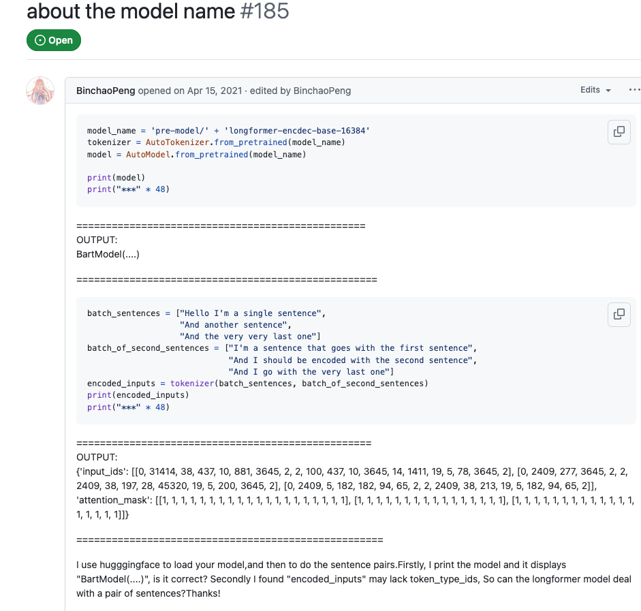
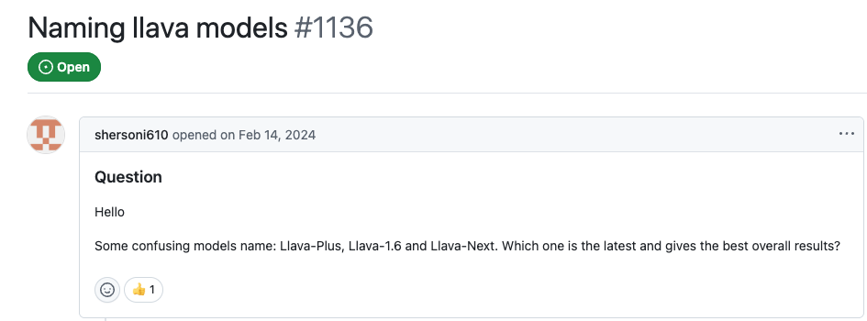
Inconsistent Naming Hinders Model Reuse
Notes:
- NVIDIA engineers made a typo in the model card of their speech recognition
model Parakeet (with 15K monthly downloads). The model_config incorrectly
specified EncDecCTCModel instead of EncDecRNNTModel. This inconsistent ar-
chitecture metadata caused users significant debugging effort and confusion
when attempting to load the model properly (NVIDIA 2024).
- Similarly, Longformer initially listed BartModel as its base architecture, which
confused users who expected to load it using LongformerModel. The issue was
later resolved when Hugging Face updated the configuration to correctly ref-
erence the LongformerModel class (Peng 2021).
– The LLaVA model also suffers from naming inconsistencies. For instance, users
have expressed confusion over similarly named models such as LLaVA-Plus,
LLaVA-1.6, and LLaVA-Next, with no clear guidance on which is the latest or
performs best overall (shersoni610 and Li 2024).chitecture, which
confused users who expected to load it using LongformerModel. The issue was
later resolved when Hugging Face updated the configuration to correctly ref-
erence the LongformerModel class (Peng 2021).

Slide 43
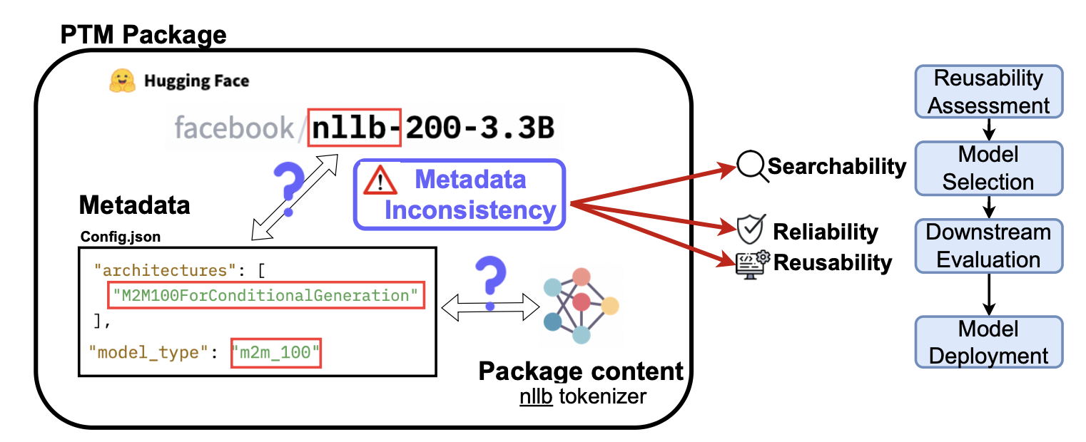
Importance of Accurate PTM Naming

Slide 44
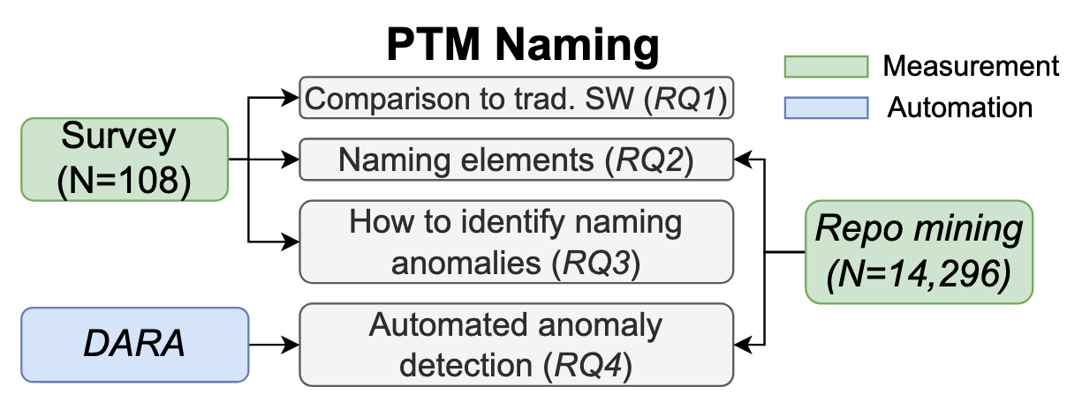
Overview of RQs and Methodologies
Notes:
This figure illustrates how PTM is involved in the research-to-practice pipeline in the Hugging Face PTM ecosystem [15]. Hugging Face is an open-gated model registry which means anyone can contribute models and package names to it [32]. This is in contrast to gated and commercial model hubs, where PTM packages are reviewed by registry staff or can only be submitted by authorized users such as employees. We highlight three kinds of users in the RTP pipeline in PTM ecosystem: researcher, reengineer, and adopter. These users are key components of the PTM supply chain [32]. The researchers are not only the new model contributors, but also the “name producer”. To support rapid model development and training, engineers (annotated as “reengineer” in Figure 1) can adapt existing deep learning models on downstream tasks or datasets through different reengineering approaches, including transfer learning, fine-tuning, and knowledge distillation [15, 24, 29].

Slide 45
Methodology - Survey
Demographics
Comparison to Traditional software
How is PTM naming similar/different from naming traditional packages?
Naming practices
Which naming convention do you prefer?
What naming elements are important?
What kind of modifications might necessitate a new model type/architecture?
Naming challenges
Do the PTMs accurately describe their behavior/content?
Do you think you would notice if a PTM had an incorrect name?
What process do you follow to find discrepancies?

Slide 46
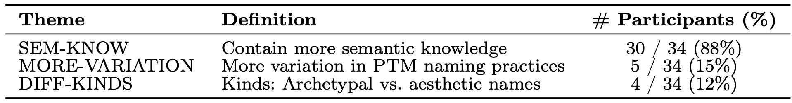
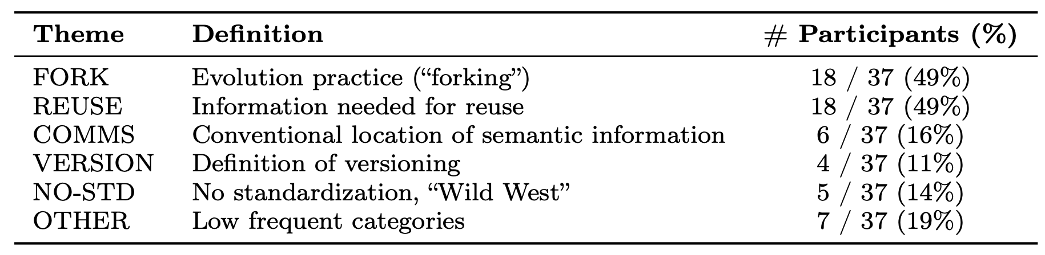
RQ1: PTM package vs. Traditional software packages
How PTM names differ?
Why PTM names differ?
Notes:
How: The primary difference
was in the greater amount of semantic knowledge in PTM names, as depicted
in Table 2. A representative answer was “Pre-trained model names often include
more specific information about the model’s architecture, training data, and per-
formance. This...detail is not typically included in traditional...package names.”
Other distinctions were that subjects observed greater variation in PTM name
Why:The two main explanations were
about evolution practices and reuse practices. One subject described the influence
of evolutionary practices on names as follows: “[Traditional] packages are not usu-
ally as directly built on previous ones, with small extensions added like for PTM.
Finetuning models generally means that the outputs are similar to the base, unlike
with traditional packages.” With respect to the information needed for reuse, a rep-
resentative quote was: “Traditional software packages are supposed to contain an
entire library...[with] various functions...and configuration...PTMs are generally
trained for a single objective...Therefore, [PTM] naming is critical for readability
and avoiding mistakes.”

Slide 47
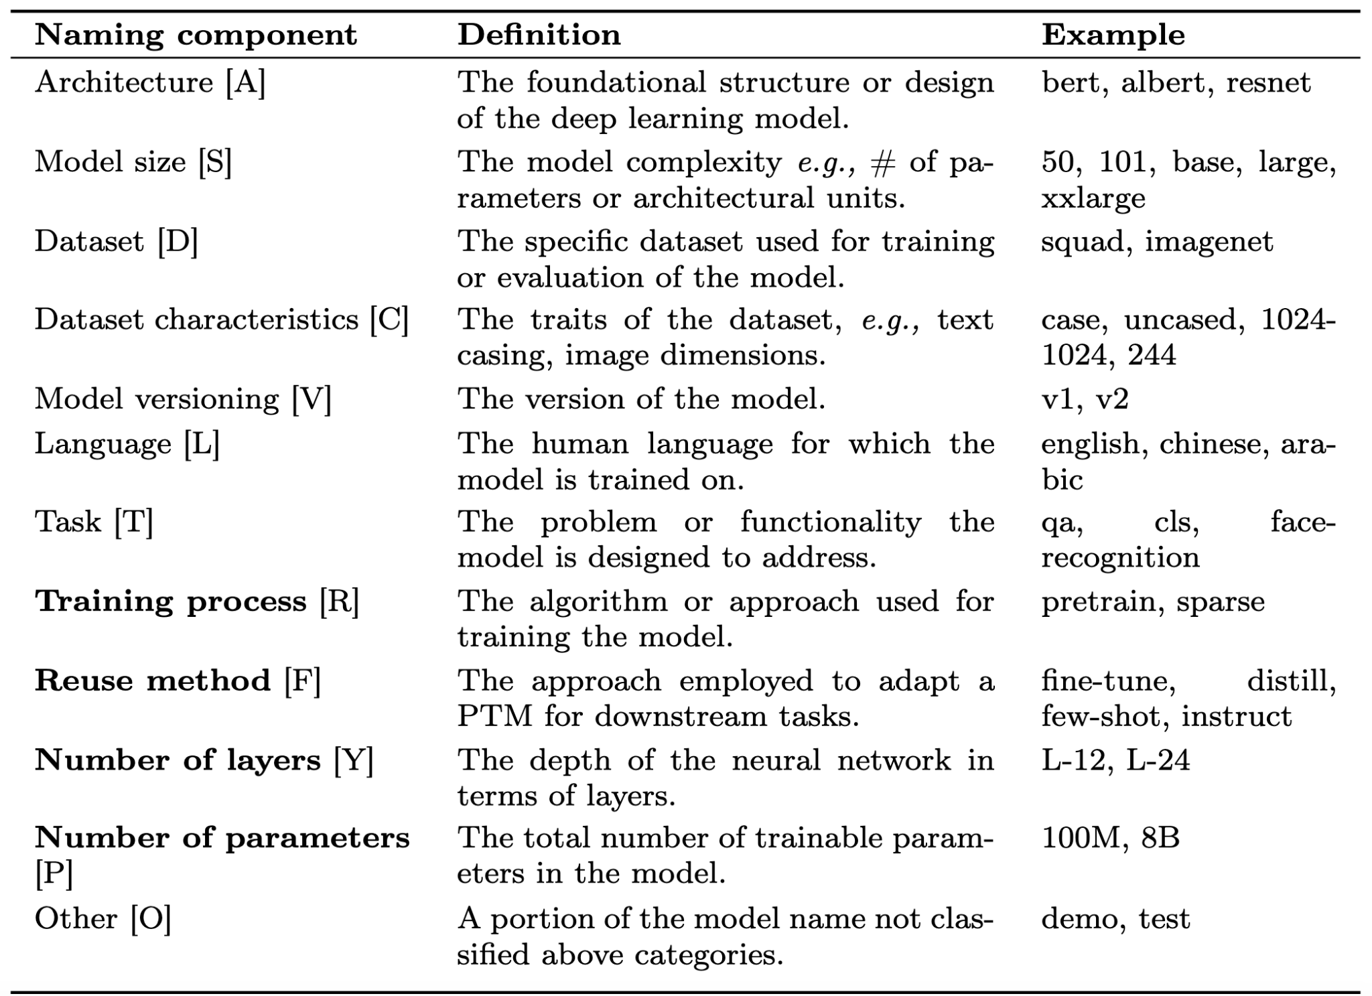
Methodology - Naming Elements

Slide 48
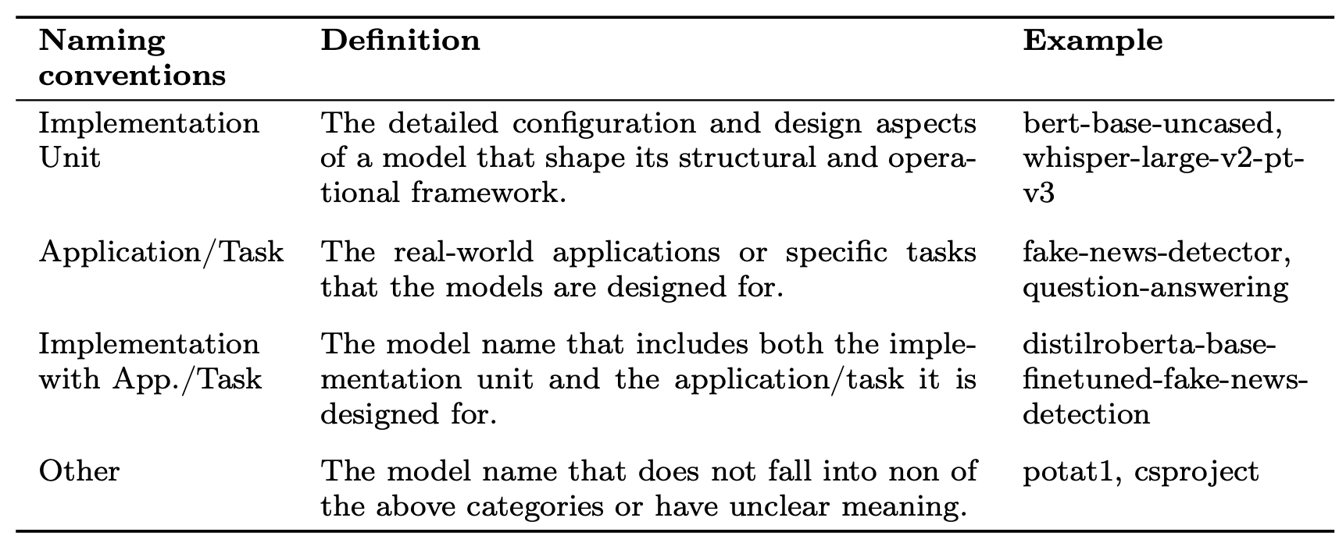
Methodology - Naming Conventions

Slide 49
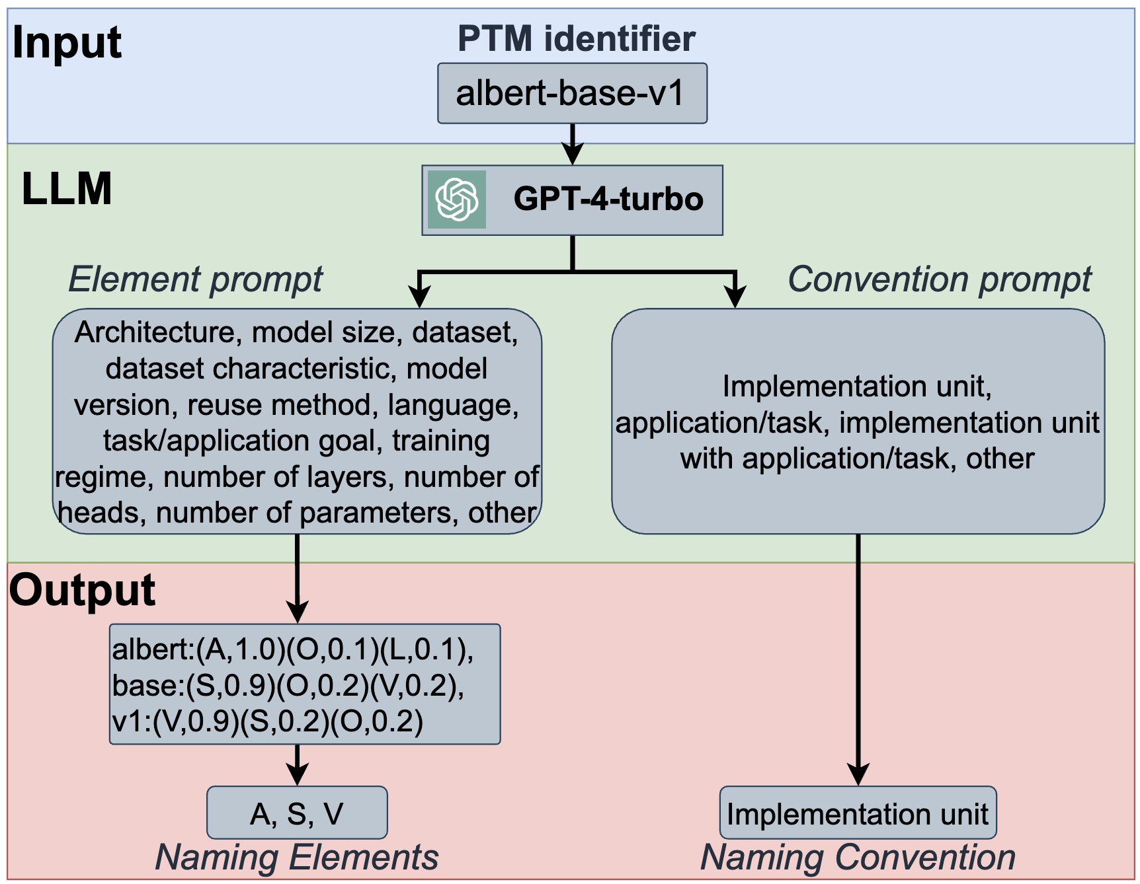
Methodology - Mining of PTM Names

Slide 50
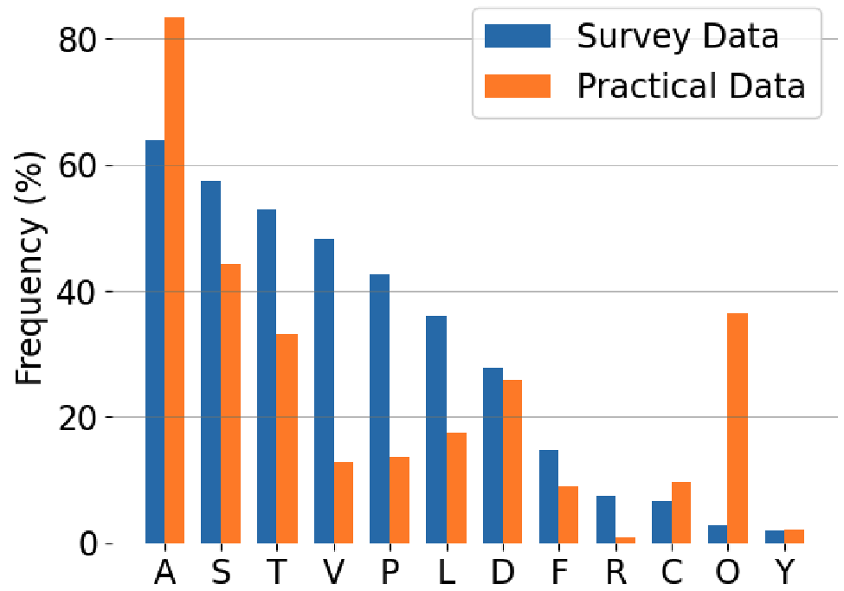
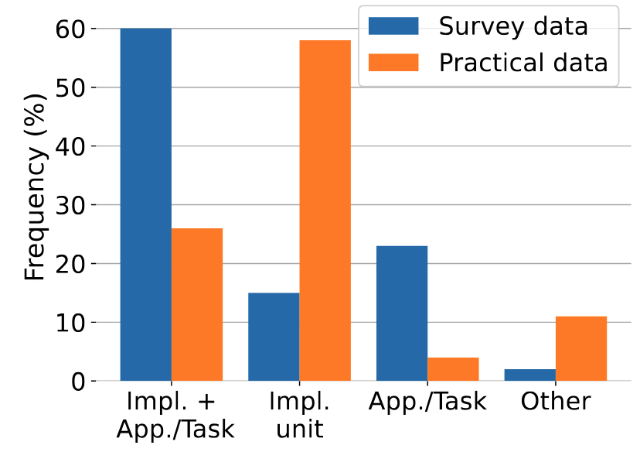
Results - PTM Name Analysis
RQ2: Survey vs. Practice
Naming elements:
Naming conventions:

Slide 51
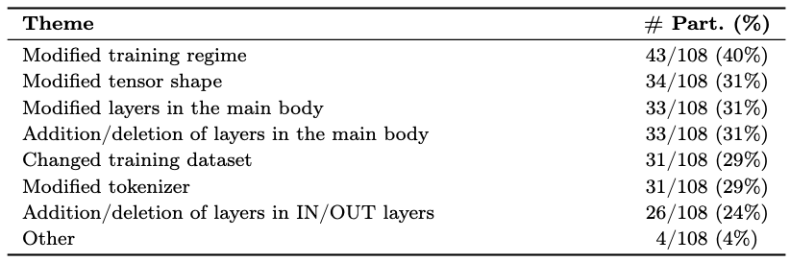
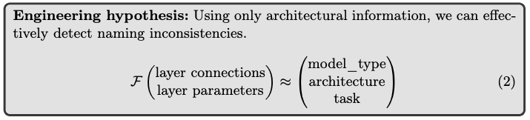
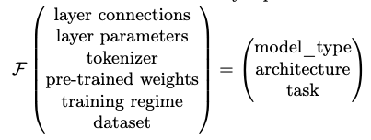
What kind of modifications might necessitate a new model type/architecture?
Can we automatically verify the correctness?

Slide 52
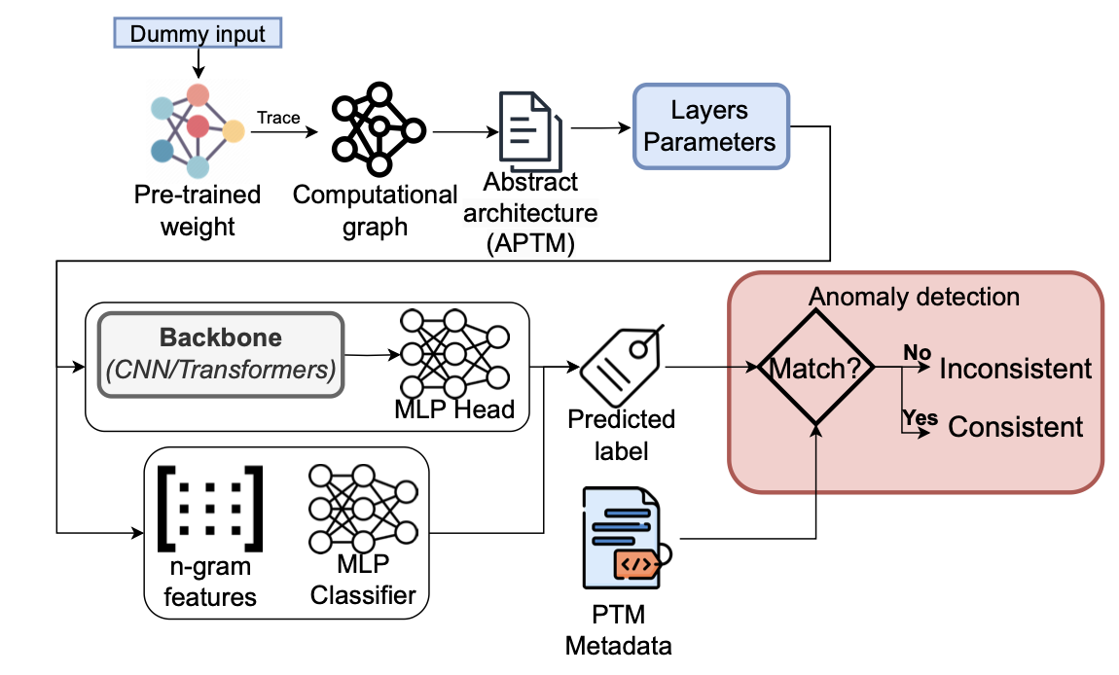
DNN ARchitecture Assessment (DARA) - Overview
Notes:
N-gram + MLP classifier (Multi‑Layer Perceptron)
CNN
Transformers (Vanilla finetuning)
Transformers (Continued Pretraining)
Transformers (Finetuning w/ CL)

Slide 53
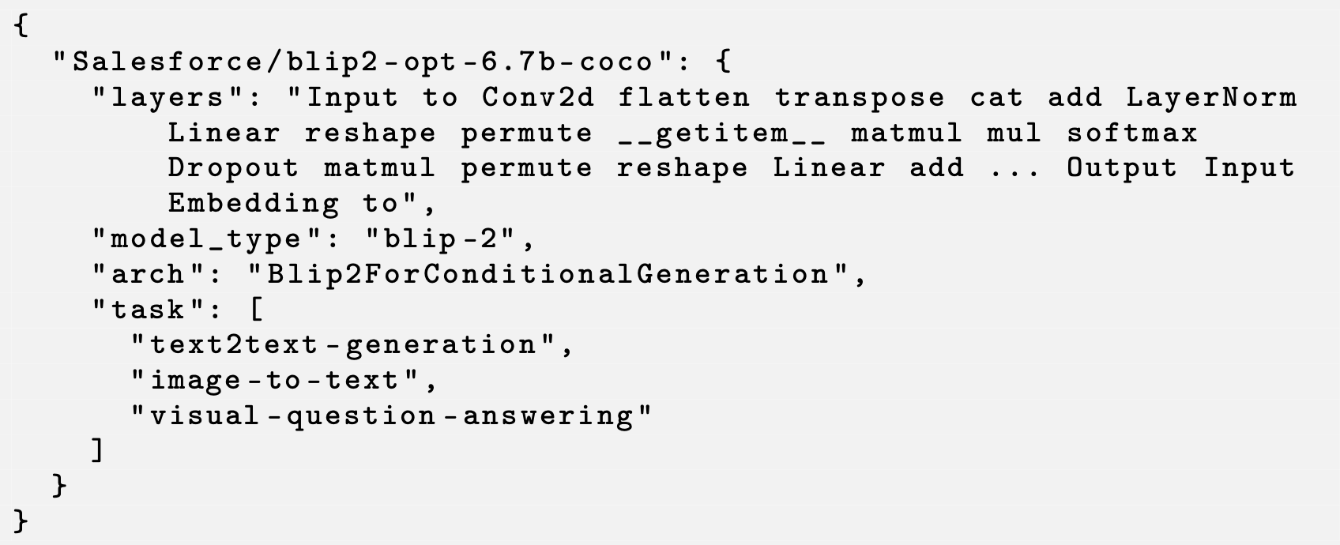
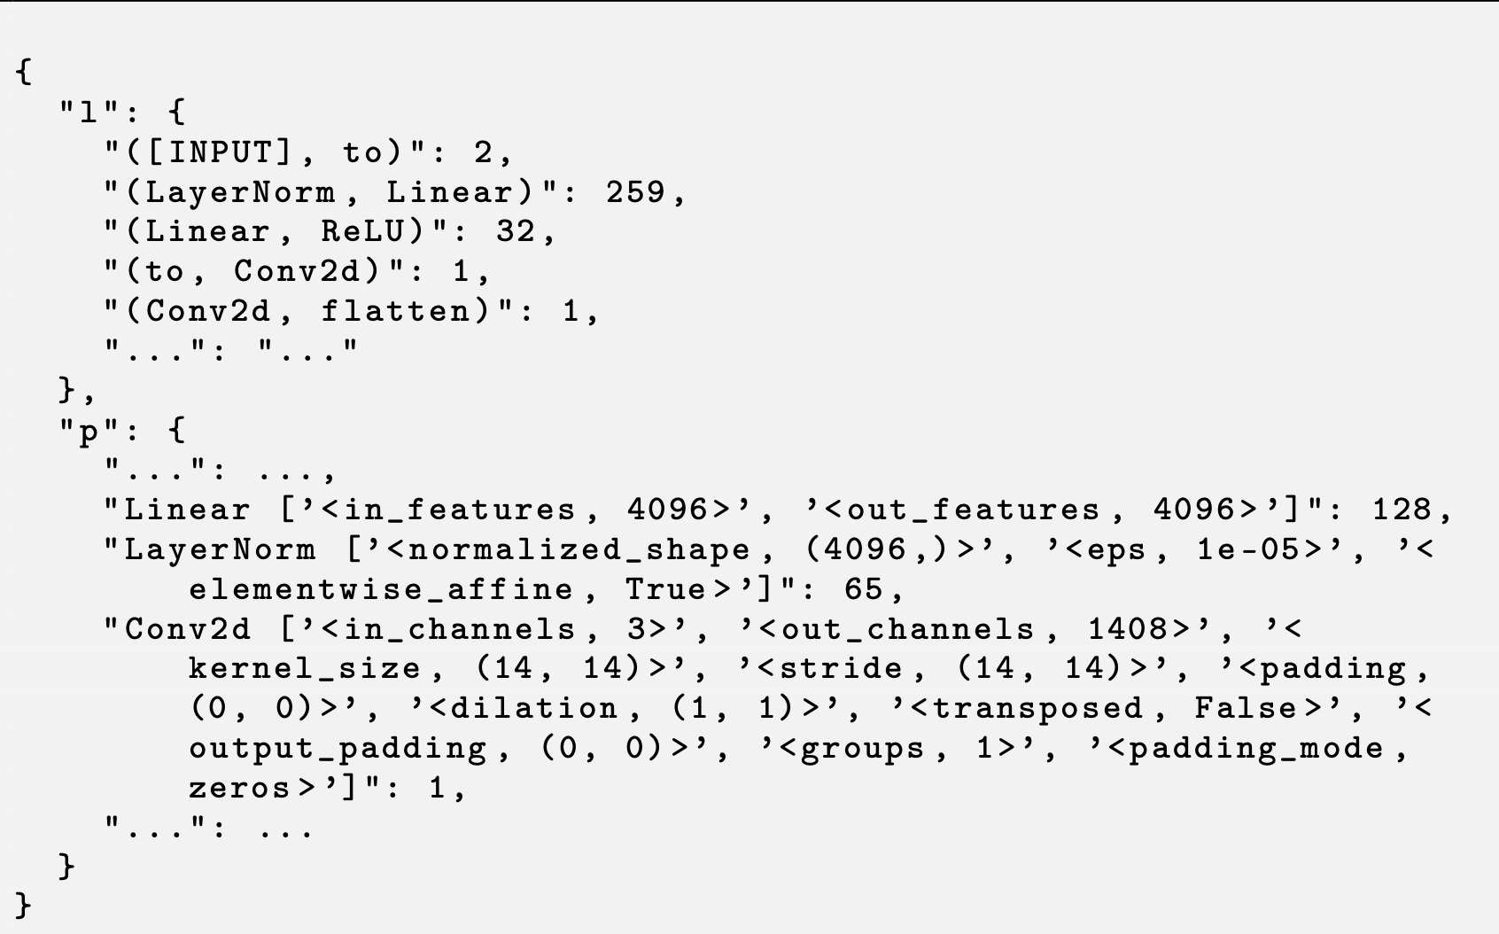
Design of DARA – Feature Extraction
1. N-gram features
2. Advanced sequential feature
Notes:
N-gram + MLP classifier (Multi‑Layer Perceptron)
CNN
Transformers (Vanilla finetuning)
Transformers (Continued Pretraining)
Transformers (Finetuning w/ CL)

Slide 54
Design of DARA – Anomaly Detection
BERT
GPT
Notes:
N-gram + MLP classifier (Multi‑Layer Perceptron)
CNN
Transformers (Vanilla finetuning)
Transformers (Continued Pretraining)
Transformers (Finetuning w/ CL)

Slide 55
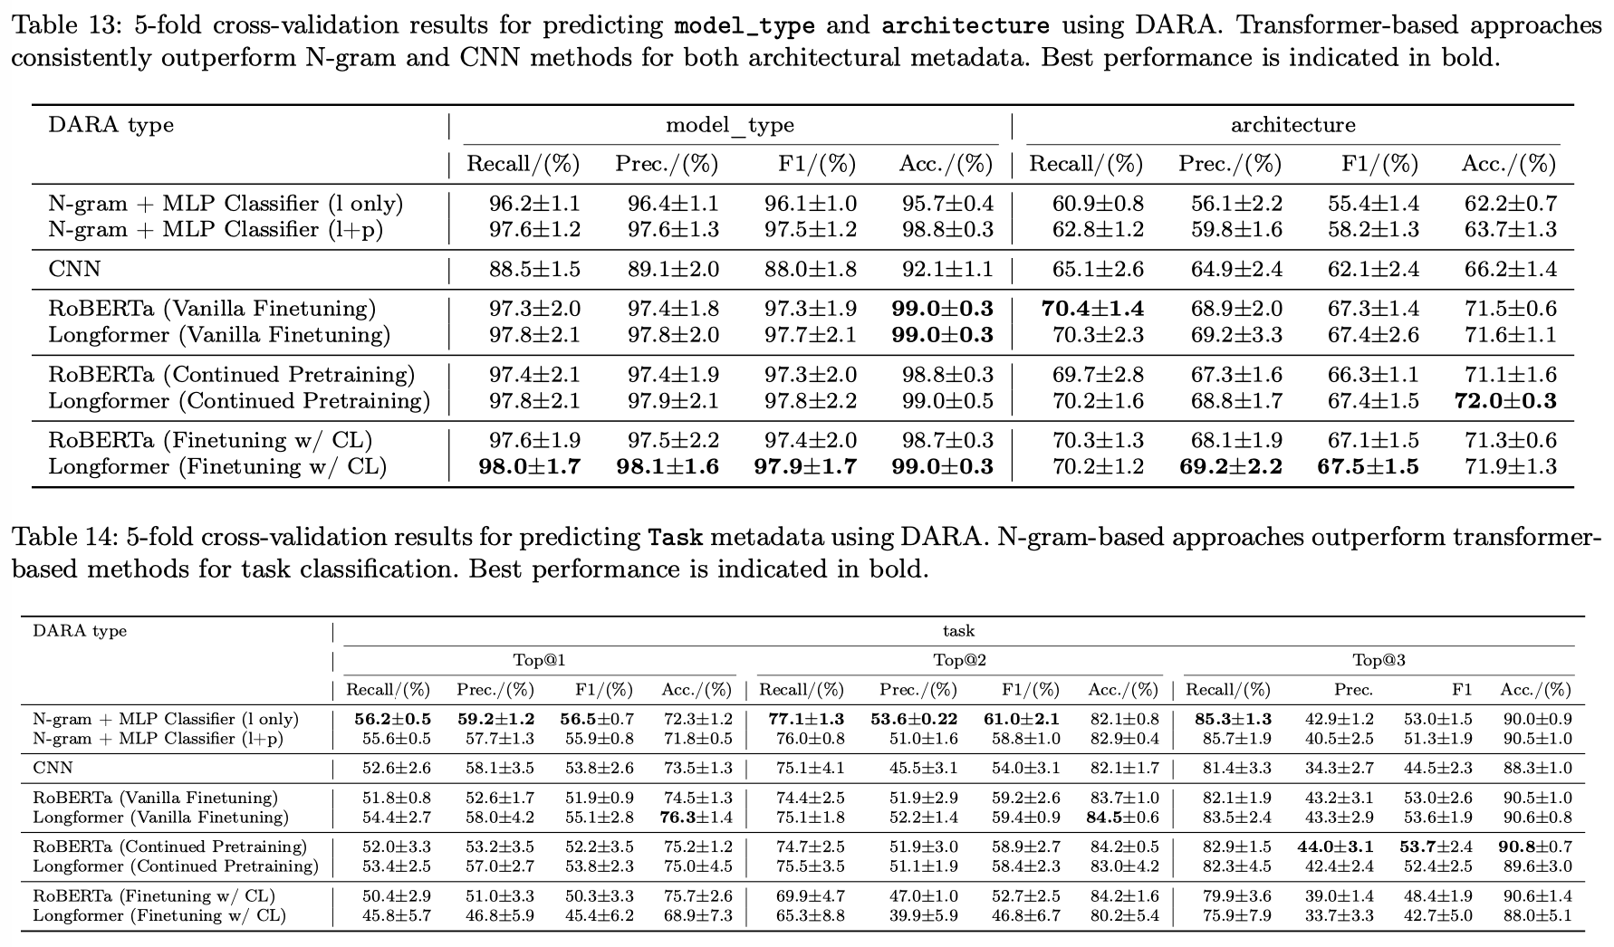
DARA Effectiveness: high accuracy for model_type
Notes:
Evaluation:
Overall, we collected 3443 PTM packages from 172 architectures, 78 model_types, and 27 tasks
High accuracy for model_type
Moderate accuracy for task and architecture

Slide 56
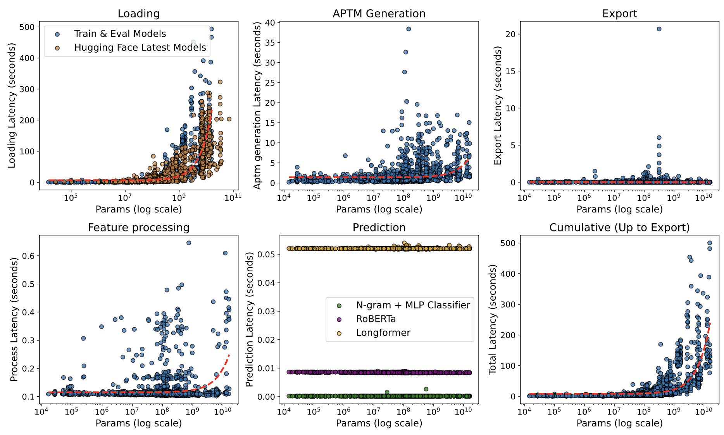
DARA Efficiency: Applicable to Practice
Notes:
Latency measurements for each stage of DARA, including APTM ex-
traction, feature export, feature processing, DARA prediction, model loading, and
total execution time. Red curves show fitted complexity trends based on our algo-
rithmic analysis: quadratic for APTM extraction and feature processing; linear for
feature export and prediction; and exponential for model loading. Orange mark-
ers indicate loading latencies of recent PTM/LLM models. The close alignment of
these points with our fitted distributions demonstrates that our results generalize
to newer models.

Slide 57
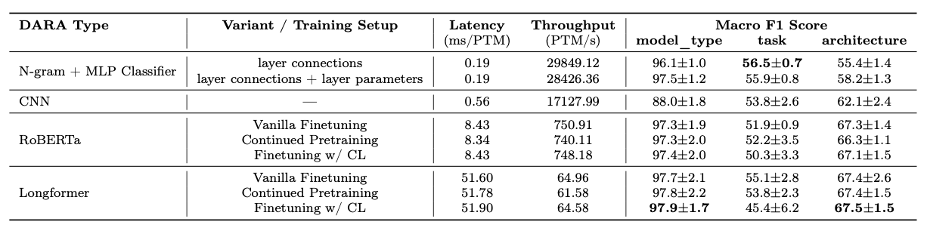
Evaluation of DARA – Comparing DARA Types
N-gram + MLP classifier: Lowest latency
Longformer (Finetuning w/ Contrastive Learning): Highest Accuracy
Notes:
N-gram approaches yield the lowest latency, while
transformer-based methods incur higher latency due to greater model complexity but offer better F1 performance.

Slide 58
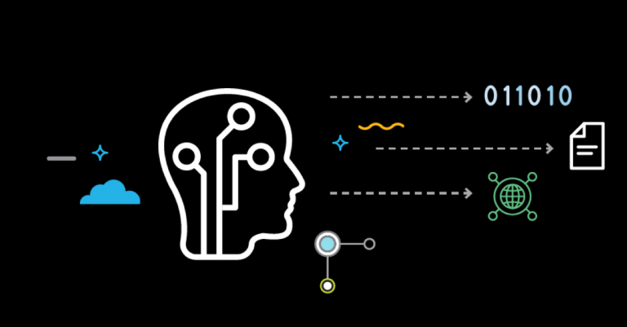


Use Cases of DARA in Practice
Reported anomaly → Inconsistency between the actual architecture and the metadata
If integrated by Hugging Face
Pre-upload verification
Warning system
Post-upload quality flagging
Other use cases
Model Validation
Label Generation and validation
Plagiarism Detection
Notes:
HF:
Pre-upload verification
DARA can analyze the model architecture in the background and suggest appropriate values for model_type, architecture, and task fields, potentially reducing manual errors
Warning system
When inconsistencies are detected, the platform can dis-
play non-blocking warnings to uploaders, allowing them to either confirm their
unusual configuration or correct potential errors before publication.
Post-upload quality flagging
For models already in the repository, identify and flag potential inconsistencies
Other use cases:
Model validation
Validate the architecture for better transparency and trust (avoid backdoors)
Label generation and validation
Better standardization
Plagiarism detection
Unethical behaviour detection

Slide 59
Future Directions
Improving naming standardization through automation
Improving package naming for better model selection and reuse
Securing supply chain by leveraging naming information

Slide 60
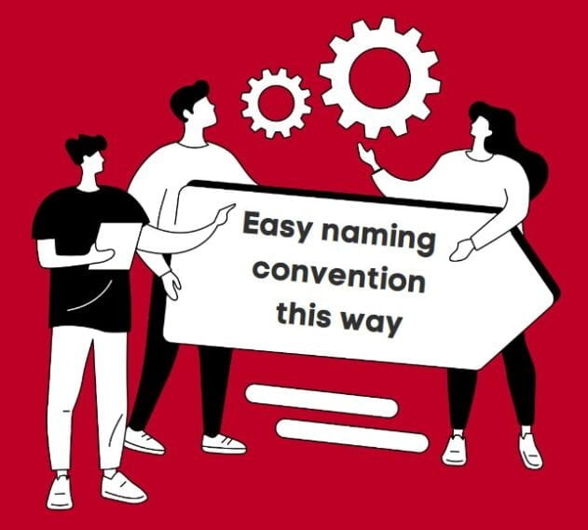
Takeaway Message
Traditional software names prioritize simplicity or branding;
PTM names encode meaningful architectural and functional details
-- more like a hardware spec sheet
Background
Characterization
Enhancement
We developed a DNN ARchitecture Assessment (DARA) System to mitigate naming inconsistencies.
Naming
Inconsistency
Detection
60

Slide 61

Topic 5
Adapting Package Confusion Detection System to AI Model Supply Chain
[Under Review at ICSE’26] Jiang, Çakar, Lysenko, and Davis. Detecting Active and Stealthy Typosquatting Threats in Package Registries. Under Submission at International Conference on Software Engineering (Under Review at ICSE’26), 12 pages.

Slide 62
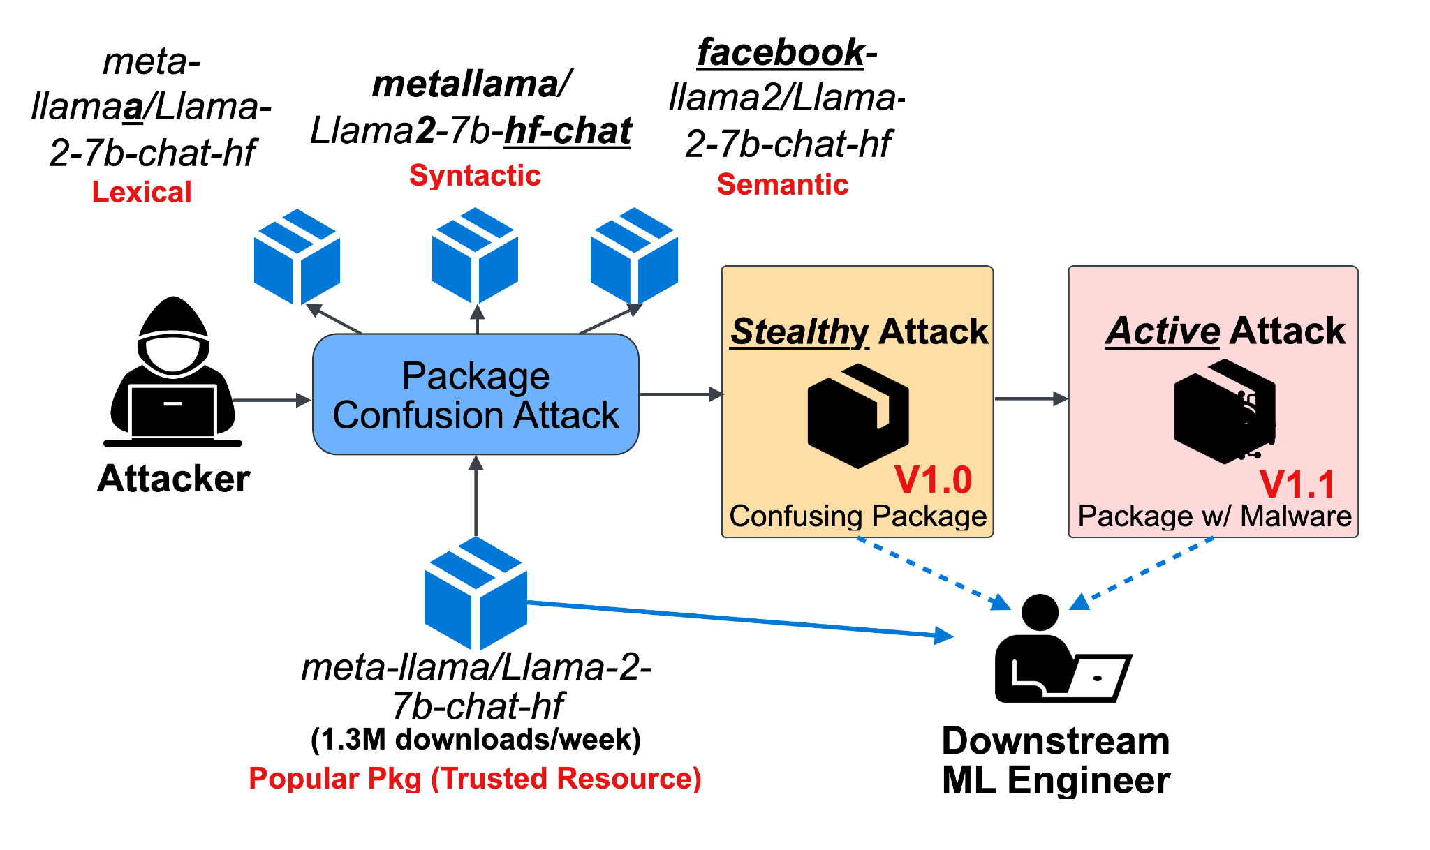
Background: Threat Model of Package Confusion Attack

Slide 63
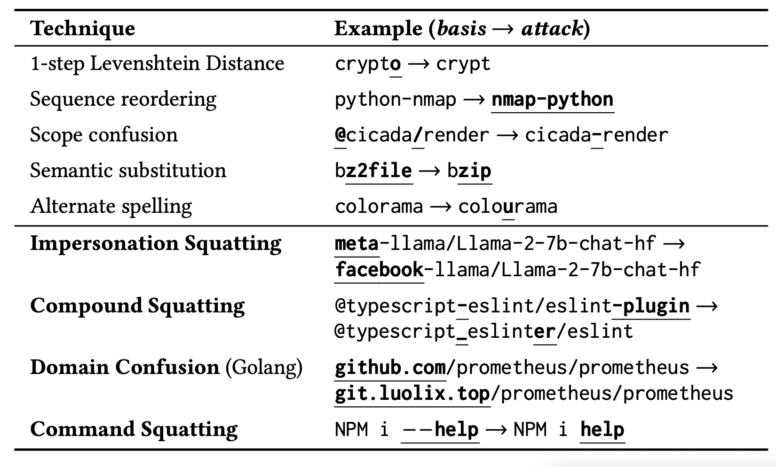
Background: Package Confusion Categories

Slide 64
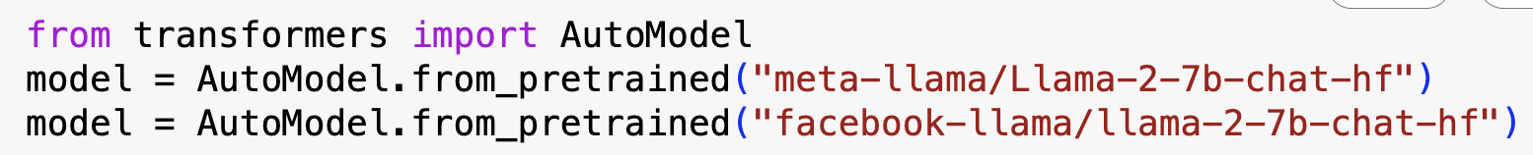
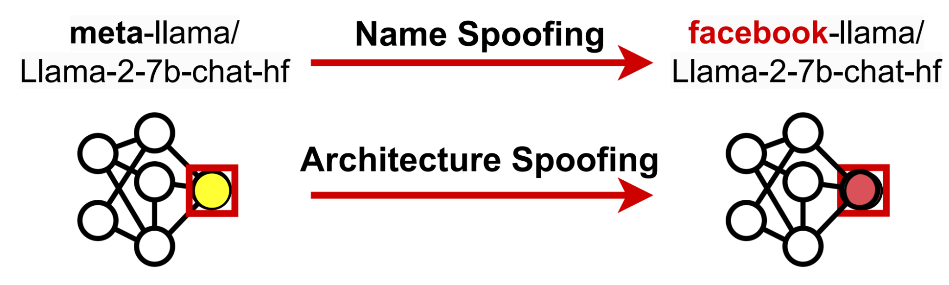
Illustration of Package Confusion Attacks

Slide 65







Organization Confusion
https://huggingface.co/deepseek
https://huggingface.co/deepseek-ai
https://huggingface.co/deepseek-r1
https://huggingface.co/deepseek-v3
✅
https://huggingface.co/meta-llama
https://huggingface.co/facebook-llama
https://huggingface.co/facebook-research
https://huggingface.co/meta-research
✅

Slide 66


Model Confusion Attack is Real

Slide 67


ConfuGuard: Package Confusion Attack Detection
Confuguard is the first system that works for hierarchical naming!
Hierarchical naming ecosystems: Hugging Face (my motivation) and also Maven & Golang

Slide 68








Results – Disclosure of Real Attacks
68

Slide 69
Adapting Confuguard to Hugging Face
Popularity threshold:
#monthly downloads > 1000
Out of ~800K PTMs (Nov, 2024)

Slide 70

Results
Popularity threshold:
#monthly downloads > 1000
Out of ~800K PTMs (Nov, 2024)
70

Slide 71
Takeaway Message
PTM supply chain is also vulnerable for package confusion attacks…
PTM package names have unique properties…which makes it complicated to defend…
More semantic information
More forking activities
Fast emergence of new model names
Background
Characterization
Enhancement
Package Confusion
Detection
Naming
Inconsistency
Detection
71
Notes:
unique properties:
semantic information
The rapid emergence of new models

Slide 72
Recommendations & Future Work
AI Supply Chain Analysis
Model Lineage
AI Bill of Material (AIBOM)
Simplify PTM Reengineering
Further analysis on reuse patterns and practices
Validation tools for better reproducibility and replicability
Enhanced Detection of Model Spoofing
Enhanced name spoofing detection
Architectural backdoor
Recommendation for PTM Selection and Reuse
Hardware-aware model recommendation
AutoML tailored for easier reuse
Background
Characterization
Enhancement
73

Slide 73
Discussion and Conclusion
72

Slide 74
Thesis Summary
Background
Trad. Software
Reuse
Trust
PTMs
Reuse
Characterization
Trust
This Thesis
Enhancement
Characterizing the open problems of trustworthy PTM reuse
Developing tools to improve PTM trustworthiness and reusability
Publishing datasets for the larger research community
74
Notes:
This thesis addresses this gap by understanding and improving the trustworthiness and reusability of open-source Pre-Trained AI Models (PTMs) through:

Slide 75






Acknowledgements
75

Slide 76
THANK YOU!
jiang784@purdue.edu

Slide 77
Bonus Slides
Notes:
Consider the software engineer.
* What tasks do they perform?
- Lots of traditional activities such as computer programming, data management, data transmission, collaborative engineering, and deployment. More recently working with machine learning technologies such as neural networks.
What tools do they use to assist them in these tasks?
*Flip through some tool families
One aspect of software engineering research is to understand the ways that engineers use these tools, in order to
1.Identify problems with the tools
2.Identify ways we can improve these tools
3.Identify opportunities for new tools
When tools are used incorrectly, bad things happen.
The engineering process may be inefficient, or the quality of the engineering product may be affected.
TRANS
Today I’m going to talk about engineering practices and challenges for one of these domains: machine learning, and specifically, deep learning / neural networks.
=====
Editing:
-VSCode
-IntelliJ
-Eclipse
-Emacs
Interacting with data
-MySQL
-MongoDB (noSQL)
-GraphQL
Communication:
-JSON
-Protobuf
Working with other developers:
-Version control
-CI tools like Travis
Virtualization:
- Docker
- Kubernetes
Deployment, e.g. serverless frameworks like
- AWS lambda
- Google cloud functions
-Apache OpenWhisk
-
Neural networks:
- Development frameworks like PyTorch and TensorFlow; model hubs such as HuggingFace; exchange formats such as ONNX

Slide 78
Summary of Contributions
My work addresses this gap by applying software engineering approaches to：
Characterize the open problems of trustworthy PTM reuse
Develop tools to improve PTM trustworthiness and reusability
Publish datasets for the larger research community
Research Methods:
Empirical research
Software repository analysis ("mining software repositories")
Automated tool development
Notes:
The engineering community faces a foundational gap in understanding challenges and best practices for reuse activities in the PTM supply chain.

Slide 79
Bonus Slides - Topic 1

Slide 80


Definition of DL Reengineering (4 kinds)
Reuse: same code + same dataset
Replicate: same algorithm, data, configuration, in distinct implementation
Adapt: different dataset
Enhance: add new feature
27

Slide 81

Why DL Reengineering?
Common practice but challenging!
Under-documented reference models
Changing requirements (SW, HW)
High cost of implementation and testing
Different specializations (e.g., software engineering, data science)
Liu et al. [FSE’20], Pham et al. [ASE’20], Pineau et al. [NeurIPS’21]
https://ai.meta.com/blog/how-the-ai-community-can-get-serious-about-reproducibility/
https://www.amazon.science/publications/on-challenges-in-machine-learning-model-management
83

Slide 82
Research Questions & Methods

Slide 83
Research questions
Theme 1: Quantitative - Understanding defect characteristics
RQ1: Common defect manifestation?
RQ2: Frequent general programming defects?
RQ3: Common symptoms?
RQ4: Common DL-specific defects?
Theme 2: Qualitative - Underlying challenges and practices
RQ5: Practices and challenges?

Slide 84


A Case Study on Computer Vision
Why Computer Vision?
Major application of DL
Techniques are shared between computer vision and other applications of deep learning
The engineering process is consistent across different domains
Generalizable?

Slide 85

Methodology - Overview

Slide 86
Theme 1 - Quantitative
Understanding defect characteristics

Slide 87



Relationship between Reengineering Repositories
Research
prototypes
1.2K forks
Replications
User “forks”
1.6K forks
4.1K forks

Slide 88



Methodology - Quantitative Study (RQ1-RQ4)
Repository Selection
+
19 Solo Repositories 8 Zoo Repositories
Issue Selection
334 issues → 348 defects
Reengineering Issue Examples:
Non-reengineering Issue Examples:
Non-defect Issue Examples:
Issue Analysis

Slide 89

Results – Symptoms: most defects in training didn’t result in crashes

Slide 90

Results – DL-Specific Defects: distinct root causes for the observed symptoms
DL-specific defect types
Symptoms

Slide 91
Theme 2 - Qualitative
Underlying challenges and practices

Slide 92








Method of Theme 2 - Qualitative Study (RQ5)
7 Internal interview subjects — Student Reengineering Team (2-year effort)
✖️
7,643 LOC
$105K total
$15K/model
“An Experience Report on Machine Learning Reproducibility: Guidance for Practitioners and TensorFlow Model Garden Contributors”
“A Partial Replication of MaskFormer in TensorFlow on TPUs for the TensorFlow Model Garden”
7 models

Slide 93




Method of Theme 2 - Qualitative Study (RQ5)
6 External Interview Subjects
2 open-source contributors recruited from theme 1 projects
4 practitioners recruited from social media platforms

Slide 94
Future Directions
Standardized Practices
Support for Reengineering Validation
Beyond manual reengineering
Further empirical work

Slide 95
Bonus Slides - Topic 2

Slide 96
Engineering reuse process
Integrate/Deploy
What is prioritized?​
What is challenging?​
What is prioritized?​
Any risks?
Reengineer candidate(s)​
Evaluate candidates​
What is available?​
Identify candidates​
PTM Supply Chain
Specify requirement

Slide 97
Topic 2
Trustworthy Reuse of PTMs
Selected Results
[SCORED’22, ICSE’23, ESEM’24]
Notes:
Consider the software engineer.
* What tasks do they perform?
- Lots of traditional activities such as computer programming, data management, data transmission, collaborative engineering, and deployment. More recently working with machine learning technologies such as neural networks.
What tools do they use to assist them in these tasks?
*Flip through some tool families
One aspect of software engineering research is to understand the ways that engineers use these tools, in order to
1.Identify problems with the tools
2.Identify ways we can improve these tools
3.Identify opportunities for new tools
When tools are used incorrectly, bad things happen.
The engineering process may be inefficient, or the quality of the engineering product may be affected.
TRANS
Today I’m going to talk about engineering practices and challenges for one of these domains: machine learning, and specifically, deep learning / neural networks.
=====
Editing:
-VSCode
-IntelliJ
-Eclipse
-Emacs
Interacting with data
-MySQL
-MongoDB (noSQL)
-GraphQL
Communication:
-JSON
-Protobuf
Working with other developers:
-Version control
-CI tools like Travis
Virtualization:
- Docker
- Kubernetes
Deployment, e.g. serverless frameworks like
- AWS lambda
- Google cloud functions
-Apache OpenWhisk
-
Neural networks:
- Development frameworks like PyTorch and TensorFlow; model hubs such as HuggingFace; exchange formats such as ONNX

Slide 98
What is available?
Three types of model hubs
[SCORED’22]

Slide 99

Model Hub Identification (as of 2022)
Keywords in major search engine
Selection criteria: definition, website, documentation
Result: 8 model hubs
Open
Anyone
Gated
Approved contributors
Commercial
Internal engineers
Notes:
-Keywords: ML model hub, DL model hub
-Selection criteria:
-Match our definition of model hub (i.e. a collection of models and datasets organized by problem domain)
-Should have a website -> instead of only have github repo
-The documentation should be accessible -> analyze
-Finally, we got 8 model hubs,
- We analyzed the #models, #dataset, and, how the PTMs are contributed and distributed.
-

Slide 100

What is in the hub?
Common property:
A model hub hosts PTMs. It may host other artifacts (e.g. dataset, code).
Model hubs function as a research-to-practice pipeline, more so than in the traditional software supply chain.
Notes:
To understand the typical structure of model hubs, we looked at each of them and collected
- the categories (e.g., computer vision, natural language processing)
- tasks (e.g., image classification, tokenization),
- and statistics of models and datasets
We found that all model hubs had similar categories to offer (e.g., Computer Vision, Natural
Language Processing, etc.), but the model hubs that offered the
greatest flexibility (i.e., Hugging Face) in community contributions
were found to have more tasks and models associated with each
category, a clear advantage of open source model hubs. For example
Hugging Face is an open hub that offers 60,904 models and tasks
while Modelhub is a gated hub that only offers 6 models and tasks.
The distribution of models by category is not uniform. For example, in HuggingFace there are 6 categories but 53% of the models are in one category, nlp category.
Common Property 1: A model hub hosts pre-trained models. It may host other artifacts (e.g., datasets, source code).
Common Property 2: Model hubs function as a research-topractice pipeline, more so than in the traditional software supply chain. Model contributors are either the authors of a model, or are maintaining or fine-tuning an existing model [21]. An author is the researcher(s) who created the original implementation of a model, typically released alongside an academic work [21]. A maintainer is the individual(s) who maintain and expand the properties of an author’s work [89]. This could be done through resolving bugs, improving model performance and accuracy, or providing alternative implementations of the model.

Slide 101


How are Model Hubs Structured for Contributions
Model Hubs
Three types: Open, gated, commercial
Contributing workflow: different Distribution workflow: similar
Model Distribution Workflow

Slide 102
What are the challenges of PTM reuse?
What is prioritized?
How do engineers select PTMs?
What PTM attributes facilitate PTM reuse?
[ICSE’23]
What is challenging?

Slide 103

Methodology - Overview
[ICSE’23]
Notes:
Method, sampling, bias

Slide 104



Methodology - Qualitative Study
[ICSE’23]
Interviews with PTM reusers
Four-step process
(framework analysis method)
•Framework Identification
•Interview Design
Interview protocol
•Recruitment
12 PTM users
•Analysis
Notes:
Method, sampling, bias

Slide 105
What is challenging of PTM Reuse?
Missing attributes 10/12 participants
Discrepancies 9/12 participants
Security concerns 3/12 participants

Slide 106

How do engineers select PTMs?

Slide 107
Methodology - Quantitative Study
[ICSE’23]
Risk Mitigation Measurement
Two-step process (STRIDE)
•Dataflow diagram
• HF’s public documentation
•Trust boundary → STRIDE threats
Notes:
Method, sampling, bias

Slide 108



Risks: low adoption of security features
Dataflow diagram for PTMs on Hugging Face:
Notes:
-
-Remind method: We used STRIDE analysis to measure the risks on HF. The frist step is to depict a dataflow based on HF documentation.
-The diagram include two sides, HF user workflow and HF components.
-Here we will show you an example:
-The users contribute models to HF.
-
-We examine the points where HF is mitigating threats. Let's talk about three of them:
-- TODO: This is to mitigate the ..., then the problem we observed.
-With verified organizations. out of 6K organizations, only 200 were verified. 3%.
-
-ClamAV: Out of all the packages, HF puts a warning label for the pacakges with a virus/malware. However, our measurement shows that none of them were flagged. No packages are actually flagged and we also know that this is only checked by traditional code, not neural network.
-
-Commit signing:
-Number: only 3% of all models adopted this feature.
-The limited usage of GPG commit signing exposes models hosted on Hugging Face to Tampering. These models face the risk of Tampering because attackers could contribute malicious code or edit commit history.
-
-
-
-====================
-
-Org verification -> The low adoption rate raises the risk of Spoofing: malicious users may masquerade as real organizations, similar to typosquatting
-ClamAV -> elevation of previledge
-Commit signing:
-The limited usage of GPG commit signing exposes models hosted on Hugging Face to Tampering. These models face the risk of Tampering because attackers could contribute malicious code or edit commit history.
-
-Title: Six Mitigations...(bold)not adopted
-==
-
-
-Although Hugging Face offers mitigations for many risks, these mitigations are incomplete or not widely adopted (Table IV)
-These risks make the existence of malicious models possible in the model registries.
-User permission model
-One shortcoming of the permission model is that Hugging Face organizations violate the principle of least privilege [81]: an organization member with Write privilege can modify any PTM owned by the organization. Therefore, an attacker could contribute malicious code, thereby raising the risk of Elevation of Privileges.
-Organization verification:
-We counted the number of verified organizations via web scraping. Out of 6,243 organizations, only 199 (3.19%) were verified.
-The low adoption rate raises the risk of Spoofing: malicious users may masquerade as real organizations, similar to typosquatting
-ClamAV
-
-Commit hash checkout:
-It is not easily measured (performed by users on their own machines), we measured the use and scope of the others within the Hugging Face ecosystem
-GPG commit signing
-The limited usage of GPG commit signing exposes models hosted on Hugging Face to Spoofing, Tampering, and Repudiation risks. First, unsigned Hugging Face models are vulnerable to Spoofing since attackers could make commits under the alias of a legitimate maintainer. Second, these models face the risk of Tampering because attackers could contribute malicious code or edit commit history. Finally, unsigned models could also risk repudiation since a lack of verified commit history allows an individual to deny actions within a repository.
-Model cards: I will talk more details in the next two slides.
-Dependencies
-Figure: Number of models trained on a specific dataset (blue) and trained with a specific model architecture (orange).
-**1,207 models were trained on the most popular dataset. 1,673 models depend on the most popular architecture.
-many models depend on the works of others that can be maliciously tampered with. In tampering with these dependencies, BadNets [59] and unethical models [77] can be created, which could affect downstream PTMs.
-PTM Documentation
-Figure: The proportion of models with standardized claims (Hugging Face’s YAML format) for each type of PTM

Slide 109
Bonus Slides - Topic 3

Slide 110


Dataset 1: PTMTorrent
[MSR-Dataset’23]

Slide 111
There are still gaps…
Lack of standardized PTM metadata across multiple hubs.
The downstream applications (GitHub) of PTM supply chain was missing in the existing datasets.

Slide 112


Dataset 2: PeaTMOSS
[MSR’24]
PTM supply chain:
PeaTMOSS:
Pre-Trained Models in Open-Source Software

Slide 113

Dataset 2: PeaTMOSS (Enhancement)

Slide 114

Dataset 2: PeaTMOSS (Enhancement)
Extracted metadata from model cards:

Slide 115

Dataset 2: PeaTMOSS - Example Usage
License Compatibility Measurement:
Notes:
1.Source: Linux Foundation’s OSS license compatibility table
a.Grey: not included in Linux table
b.Blue: compatible
c.Red: incompatible
2.In 25.61% cases, PTM-App licenses are identical
3.In 0.24% cases, the licenses are incompatible, where there is copyleft provisions in the PTM’s license that are not honored by the Application
1.Many downstream GitHub repositories (43.42%) choose not to define a license (“no license” in the figure), instead operating under the default posture of Hugging Face (full reuse [48]) and GitHub (much stricter — copyright reserved to author [40]). In 25.61% of cases, the PTM-Application licenses are identical.
0.24%: this is the result of copyleft provisions in the PTM’s license that are not honored by the Application

Slide 116
Bonus Slides - Topic 4

Slide 117
Bonus Slides - Topic 5

Slide 118

Design of DARA – Computational Graph Conversion
Notes:
Fig. 7: To improve PTM naming accuracies, we propose the DNN ARchitecture
Assessment pipeline (DARA), an anomaly detection algorithm designed to auto-
matically identify discrepancies in PTM names. The approach involves detecting
architectural variations across multiple PTMs, training a classifier, and using it to
spot naming inconsistencies. Metadata inconsistencies are defined as mismatches
between the actual architecture of a PTM and its corresponding metadata. In the
DARA pipeline, these inconsistencies manifest as differences between the classi-
fier’s prediction and the labels provided by the PTM creator. We evaluate DARA
using three key labels: model_type, task, and architecture (Figure 2).

Slide 119
Design of DARA – Abstract Architecture Generation
Notes:
Fig. 7: To improve PTM naming accuracies, we propose the DNN ARchitecture
Assessment pipeline (DARA), an anomaly detection algorithm designed to auto-
matically identify discrepancies in PTM names. The approach involves detecting
architectural variations across multiple PTMs, training a classifier, and using it to
spot naming inconsistencies. Metadata inconsistencies are defined as mismatches
between the actual architecture of a PTM and its corresponding metadata. In the
DARA pipeline, these inconsistencies manifest as differences between the classi-
fier’s prediction and the labels provided by the PTM creator. We evaluate DARA
using three key labels: model_type, task, and architecture (Figure 2).

Slide 120
Design of DARA – Feature Extraction
Notes:
Fig. 7: To improve PTM naming accuracies, we propose the DNN ARchitecture
Assessment pipeline (DARA), an anomaly detection algorithm designed to auto-
matically identify discrepancies in PTM names. The approach involves detecting
architectural variations across multiple PTMs, training a classifier, and using it to
spot naming inconsistencies. Metadata inconsistencies are defined as mismatches
between the actual architecture of a PTM and its corresponding metadata. In the
DARA pipeline, these inconsistencies manifest as differences between the classi-
fier’s prediction and the labels provided by the PTM creator. We evaluate DARA
using three key labels: model_type, task, and architecture (Figure 2).

Slide 121

Design of DARA – Anomaly Detection
Notes:
Fig. 7: To improve PTM naming accuracies, we propose the DNN ARchitecture
Assessment pipeline (DARA), an anomaly detection algorithm designed to auto-
matically identify discrepancies in PTM names. The approach involves detecting
architectural variations across multiple PTMs, training a classifier, and using it to
spot naming inconsistencies. Metadata inconsistencies are defined as mismatches
between the actual architecture of a PTM and its corresponding metadata. In the
DARA pipeline, these inconsistencies manifest as differences between the classi-
fier’s prediction and the labels provided by the PTM creator. We evaluate DARA
using three key labels: model_type, task, and architecture (Figure 2).

Slide 122



Evaluation of DARA – Confusion Matrix of Prediction
Notes:
Evaluation:
Overall, we collected 3443 PTM packages from 172 architectures, 78 model_types, and 27 tasks

Slide 123
Bonus Slides - Others

Slide 124
DIVIDER – BELOW IS OLD

Slide 125
DIVIDER – BELOW IS OLD

Slide 126
DIVIDER – BELOW IS OLD

Slide 127
Two primary kinds of (software engineering) research
Observations
Open problems
Solutions
Notes:
The purpose of research is to discover new knowledge. This knowledge (ideally) addresses open problems in the field.
Solving: Traditional engineering research. Apply techniques such as static and dynamic analysis to improve some aspect of software engineering.
Searching for code
Refactoring programs
Finding vulnerabilities
…
But equally important is continually recharging the pool of open problems. In computing, engineers are constantly needing to adapt to new technologies – hardware, operating systems, programming languages, etc. – and so if we only solve “old” problems we will lose touch with practitioners.
Discovering: Ensuring that the problems the research community solves are aligned with the problems that engineers actually have
Mining software repositories
Studying engineers’ behavior
“Empirical SWEng”
These two approaches are symbiotic.

Slide 128
Summary of Contributions
My work addresses this gap by applying software engineering approaches to：
Characterize the open problems of trustworthy PTM reuse
Develop datasets and tools to improve PTM trustworthiness and reusability
Research Methods:
Empirical research
Software repository analysis
Automated tool development
Notes:
The engineering community faces a foundational gap in understanding challenges and best practices for reuse activities in the PTM supply chain.

Slide 129

Outline
Background
Pre-Trained Model (PTM)
Engineering reuse process
Trust in software reuse
Topics I’ll discuss today
Trustworthy reuse of PTMs (ESEM’24, ICSE’23, SCORED’22)
PTM Naming Practices (Under review at EMSE 🤞)
Datasets of PTMs in open-source software (MSR’24, MSR-Dataset’23)
Discussion

Slide 130
Outline
Background
Pre-Trained Model (PTM)
Engineering reuse process
Trust in software reuse
Topics I’ll discuss today
Trustworthy reuse of PTMs (ESEM’24, ICSE’23, SCORED’22)
PTM Naming Practices (Under review at EMSE 🤞)
Datasets of PTMs in open-source software (MSR’24, MSR-Dataset’23)
Discussion

Slide 131

Outline
Background
Topics I’ll discuss today
Trustworthy reuse of PTMs (ESEM’24, ICSE’23, SCORED’22)
PTM Naming Practices (Under review at EMSE 🤞)
Datasets of PTMs in open-source software (MSR’24, MSR-Dataset’23)
Discussion
Notes:
Now I will go through substantially completed work. I am calling it substantially completed because one of the work is under revision at EMSE.
For each work I will give an overview, covering the knowledge gap/problem, method, main results.
Due to time limit I will not cover everything in each work, but I am happy to answer questions about them. Each of these works has co-authors but I am the lead author of these projects.

Slide 132
Topic 2
PTM Naming Practices
[Under Review at EMSE]
[4] Jiang, Kim, Cheung, Kim, Thiruvathukal, and Davis. “I see models being a whole other thing”: An Empirical Study of Pre-Trained Model Naming Conventions and A Tool for Enhancing Naming Consistency. Under revision at Empirical Software Engineering (Under revision at EMSE’25). 66 pages.

Slide 133
Topic 2
PTM Naming Practices
Problem Statement
What are good naming conventions for PTM package?
How to improve the quality of PTM naming?

Slide 134
Engineering reuse process
What is good?
Integrate/Deploy
Traditional vs. PTM?
Reengineer candidate(s)​
Naming convention
Evaluate candidates​
Identify candidates​
PTM Supply Chain
Specify requirement

Slide 135
Metadata Inconsistency
Measuring Naming Practices to Improve Standardization
Detecting Naming Inconsistencies to Improve Accuracy
[Under Review at EMSE]

Slide 136

Naming convention is important to PTM Reuse!
Notes:
Hierarchy of PTM registry naming taxonomy across representative open-source PTM
registries, including Hugging Face, ONNX Model Zoo, PyTorch Hub, and TensorFlow Hub.
Registries include multiple domains, such as natural language processing, computer vision,
and multimodal; multiple tasks, such as depth estimation (vision), text generation (NLP); and
many distinct models and model types/architectures for each task. The red box highlights the
package name (model identifier and model type/architecture) — this is the focus of our study.

Slide 137

Naming convention is important to PTM Reuse!
Notes:
This figure illustrates how PTM is involved in the research-to-practice pipeline in the Hugging Face PTM ecosystem [15]. Hugging Face is an open-gated model registry which means anyone can contribute models and package names to it [32]. This is in contrast to gated and commercial model hubs, where PTM packages are reviewed by registry staff or can only be submitted by authorized users such as employees. We highlight three kinds of users in the RTP pipeline in PTM ecosystem: researcher, reengineer, and adopter. These users are key components of the PTM supply chain [32]. The researchers are not only the new model contributors, but also the “name producer”. To support rapid model development and training, engineers (annotated as “reengineer” in Figure 1) can adapt existing deep learning models on downstream tasks or datasets through different reengineering approaches, including transfer learning, fine-tuning, and knowledge distillation [15, 24, 29].

Slide 138

Naming inconsistencies exist…
Notes:
Example of a PTM metadata inconsistency from Hugging Face. The top part shows
the PTM identifier, and the bottom part displays the PTM metadata (i.e., architecture and
model type) and the package content. Facebook named the model nllb due to the introduction
of a new tokenizer, while other models on Hugging Face typically name models based on
architecture changes. This mismatch between the identifier and the architecture metadata
may impact searchability, reliability, and reusability in the PTM reuse process (blue boxes).
The four-step reuse process is adapted from (Jiang et al. 2023b).

Slide 139
Topic 3
Datasets of PTMs in Open-Source Software
[MSR-Dataset’23, MSR’24]
[MSR-Dataset’23] Wenxin Jiang, Nicholas Synovic, Purvish Jajal, Taylor R Schorlemmer, Arav Tewari, Bhavesh Pareek, George K Thiruvathukal, and James C Davis. PTMTorrent: A Dataset for Mining Open-source Pre-trained Model Packages. Proceedings of the 20th International Conference on Mining Software Repositories (MSR’23) (2023).
[MSR’24] Wenxin Jiang, Jerin Yasmin, Jason Jones, Nicholas Synovic, Jiashen Kuo, Nathaniel Bielanski, Yuan Tian, George K. Thiruvathukal, James C. Davis. PeaTMOSS: A Dataset and Initial Analysis of Pre-Trained Models in Open-Source Software. arXiv preprint arXiv:2310.03620 (2023).

Slide 140
Topic 3
Datasets of PTMs in Open-Source Software
Knowledge Gap
[MSR-Dataset’23, MSR’24]

Slide 141
Engineering reuse process
What is prioritized?​
What is challenging?​
Integrate/Deploy
Reengineer candidate(s)​
What is prioritized?​
Any risks?
Evaluate candidates​
What is available?​
Identify candidates​
PTM Supply Chain
Specify requirement

Slide 142
What is available?
Dataset for further analysis
[MSR-Dataset’23, MSR’24]

Slide 143


Motivation for a Dataset
Lack of queryable PTM metadata.
Accessibility issues (git-lfs, rate limits, etc.)
Scientific replicability → long-term data
GHTorrent
Why do we need a PTM dataset?
Notes:
GHTorrent, SOTorrent: This is a common kind of conventional work in SWEng research
- “if all the PTM packages are available on these model hubs, why do we need a new dataset?”
-Here are three reasons that we created a new dataset:
(click x 3)
-The PTM are distributed in many places and the model hubs provide different APIs to facilitate model reuse. There is no one-stop shop to compare PTMs from different model hubs.
-PTMs can be really big! Some model hubs, they rate limits on accessing PTMs to prevent server overloads and service disruptions. This makes it harder to access a large amount of PTMs.
-We would like to keep long-term data to support the scientific replicability of our work
(click)
-We want researchers to have easy access to PTM packages.

Slide 144
Outline
Background
Topics I’ll discuss today
Discussion

Slide 145
Trustworthy Reuse in Open-Source AI Model Ecosystems
How Far Are We?

Slide 146
Theoretical Engineering Reuse Process
What is prioritized?​
What is challenging? Mitigation?​
Integrate/Deploy
What is prioritized?​
Any risks? Mitigations?
Reengineer candidate(s)​
Evaluate candidates​
What is available?​
MSR-Dataset’23,
MSR’24
Identify candidates​
PTM Supply Chain
ESEM’24,
ICSE’23,
SCORED’22
Specify requirement
Notes:
There are still a lot of unexplored directions, for example…
How to consider the engineering requirements into account in this reuse pipeline
How to evaluate the risks?
How to mitigate the risks during candidate evaluation and reengineering process?
Integration and deploy: What is prioritized? Risks? Mitigations?

Slide 147

What Do We Know? – Systematic Literature Review
[ESEM’24]
Notes:
: Consolidated themes and claims collected from our systematic literature review. Small-Scale measurements refer to measurements made on a selection of a population less than 10% of the overall size, Large-scale measurements are measurements made on a selection of a population that is more than 10%, Survey refers to a survey, Interviews refer to interviews, Case study refers to either an examination of a specific case or the creation of a model to verify the claim. † : The claim basis is not a large-scale quantification.

Slide 148

Future Directions on PTM

Slide 149

Future Directions on PTM - Examples

Slide 150
Summary
Discussion
PTM reuse is an emerging and novel form of software reuse
We have only scratched the surface of PTM trust and reuse…
How to make PTM more reusable?
How to make PTM reuse more trustworthy?
What are other considerations essential to this process?
Notes:
How to make PTM more reusable?
Discuss practices like consistent naming conventions, comprehensive documentation, and robust versioning.
Highlight the role of modular design, clear licensing, and dataset provenance in improving reuse.
Provide examples of successful reuse cases where these factors contributed.
How to make PTM reuse more trustworthy?
Address the need for transparency in training data and architecture.
Discuss reproducibility, security (e.g., typosquatting detection), and mechanisms for verifying model claims.
Emphasize evaluation metrics, bias mitigation, and certification of pretrained models.
What are other considerations essential to this process?
Introduce topics like model lifecycle management, intellectual property concerns, and community governance.
Highlight the importance of user education and standardization efforts across PTM ecosystems.
Discuss how tools like DARA or other automated validators could support the ecosystem.

Slide 151
Thank you!
Notes:
Consider the software engineer.
* What tasks do they perform?
- Lots of traditional activities such as computer programming, data management, data transmission, collaborative engineering, and deployment. More recently working with machine learning technologies such as neural networks.
What tools do they use to assist them in these tasks?
*Flip through some tool families
One aspect of software engineering research is to understand the ways that engineers use these tools, in order to
1.Identify problems with the tools
2.Identify ways we can improve these tools
3.Identify opportunities for new tools
When tools are used incorrectly, bad things happen.
The engineering process may be inefficient, or the quality of the engineering product may be affected.
TRANS
Today I’m going to talk about engineering practices and challenges for one of these domains: machine learning, and specifically, deep learning / neural networks.
=====
Editing:
-VSCode
-IntelliJ
-Eclipse
-Emacs
Interacting with data
-MySQL
-MongoDB (noSQL)
-GraphQL
Communication:
-JSON
-Protobuf
Working with other developers:
-Version control
-CI tools like Travis
Virtualization:
- Docker
- Kubernetes
Deployment, e.g. serverless frameworks like
- AWS lambda
- Google cloud functions
-Apache OpenWhisk
-
Neural networks:
- Development frameworks like PyTorch and TensorFlow; model hubs such as HuggingFace; exchange formats such as ONNX

Slide 152
Bonus Slides
Notes:
Consider the software engineer.
* What tasks do they perform?
- Lots of traditional activities such as computer programming, data management, data transmission, collaborative engineering, and deployment. More recently working with machine learning technologies such as neural networks.
What tools do they use to assist them in these tasks?
*Flip through some tool families
One aspect of software engineering research is to understand the ways that engineers use these tools, in order to
1.Identify problems with the tools
2.Identify ways we can improve these tools
3.Identify opportunities for new tools
When tools are used incorrectly, bad things happen.
The engineering process may be inefficient, or the quality of the engineering product may be affected.
TRANS
Today I’m going to talk about engineering practices and challenges for one of these domains: machine learning, and specifically, deep learning / neural networks.
=====
Editing:
-VSCode
-IntelliJ
-Eclipse
-Emacs
Interacting with data
-MySQL
-MongoDB (noSQL)
-GraphQL
Communication:
-JSON
-Protobuf
Working with other developers:
-Version control
-CI tools like Travis
Virtualization:
- Docker
- Kubernetes
Deployment, e.g. serverless frameworks like
- AWS lambda
- Google cloud functions
-Apache OpenWhisk
-
Neural networks:
- Development frameworks like PyTorch and TensorFlow; model hubs such as HuggingFace; exchange formats such as ONNX

Slide 153





Trustworthy Reuse in the Machine Learning Model Supply Chain
Wenxin Jiang
Ph.D. Candidate, ECE@Purdue
Advisor: Dr. James Davis

Slide 154

Trustworthiness in PTMs
Risks in software supply chain
Adversarial attacks
Indirectly:
data poisoning
Stealing attack
Directly:
backdoor/Trojan attacks, malware injection
Wenxin Jiang, Nicholas Synovic, Rohan Sethi, Aryan, Indarapu, Matt Hyatt, Taylor R Schorlemmer, George K Thiruvathukal, and James C Davis. An Empirical Study of Artifacts and Security Risks in the Pre-trained Model Supply Chain. Proceedings of the 1st ACM Workshop on Software Supply Chain Offensive Research and Ecosystem Defenses (SCORED) 2022.

Slide 155

Claim 1: Transformers increases the accessibility of PTM creation and downstream reuse
[ESEM’24]
Notes:
Method, sampling, bias

Slide 156


Claim 2: Popularity Affects PTM Selection and Reuse More than Other Traditional Attributes
[ESEM’24]
Notes:
Method, sampling, bias

Slide 157

Claim 3: Quality Impacts Model Selection?
[ESEM’24]
Notes:
We evaluated the impact of documentation quality on the popularity of PTMs.
Specifically, the top 1000 most popular models consistently exhibited significantly better documentation than the bottom 1000 models.
This finding supports the claim that documentation quality significantly influences model selection. If the relation is causative (documentation → popularity), then research can focus on developing tools and methods to enhance the documentation quality of models, supporting better usability and adoption

Slide 158





Outline
Background
Research Contributions
PTM Naming Practices
PTM Typosquatting Attack
MSR to Facilitate Model Selection
Future Directions

Slide 159


Methodology - Identifying Metadata Inconsistencies
Feature Extraction: N-gram
Hypothesis: N-gram feature is enough for identifying naming defects.
Evaluation (example cluster)
Need more sequential information!
Notes:
Our proposed algorithm provides a novel way to serialize PTMs, addressing the complexities of varying branch orders in the architectures. Our layer sorting algorithm takes a pre-trained weight as input and outputs a serialized list of its layers. The algorithm traverses the model layer-by-layer, assigning a unique sorting hash id to each layer based on its connections. This sorting hash id is computed recursively to ensure that connected layers are appropriately ordered, ultimately leading to a sorted list of layers in the model architecture. This algorithm can convert a model architecture into a list of layers following a specific order, ensuring that equivalent models with swapped branches yield identical ordered lists. Our method treats all neural network graphs as Directed Acyclic Graphs (DAGs), breaking cycles in models like LSTM [26] by removing redundant edges. This turns every network into a DAG with “complete reachability”, where each node exists along a path between an input and an output. This ensures that our algorithm captures all layers that contribute to the network’s function, making it both comprehensive and efficient. Our depth-first search (DFS)-based topological sorting algorithm uniquely identifies each node using a hash generated from its own information and that of its child nodes. This ensures consistent node priority across different neural network graphs and allows for deterministic ordering of PTMs. The unique identifier makes our sorting method robust and capable of meaningfully comparing different PTM architectures

Slide 160




Proposed Improvement on DARA
Goal: Stronger representation of PTM architecture
w/o finetune
w/ finetune
w/ finetune & contrastive learning
Notes:
Our proposed algorithm provides a novel way to serialize PTMs, addressing the complexities of varying branch orders in the architectures. Our layer sorting algorithm takes a pre-trained weight as input and outputs a serialized list of its layers. The algorithm traverses the model layer-by-layer, assigning a unique sorting hash id to each layer based on its connections. This sorting hash id is computed recursively to ensure that connected layers are appropriately ordered, ultimately leading to a sorted list of layers in the model architecture. This algorithm can convert a model architecture into a list of layers following a specific order, ensuring that equivalent models with swapped branches yield identical ordered lists. Our method treats all neural network graphs as Directed Acyclic Graphs (DAGs), breaking cycles in models like LSTM [26] by removing redundant edges. This turns every network into a DAG with “complete reachability”, where each node exists along a path between an input and an output. This ensures that our algorithm captures all layers that contribute to the network’s function, making it both comprehensive and efficient. Our depth-first search (DFS)-based topological sorting algorithm uniquely identifies each node using a hash generated from its own information and that of its child nodes. This ensures consistent node priority across different neural network graphs and allows for deterministic ordering of PTMs. The unique identifier makes our sorting method robust and capable of meaningfully comparing different PTM architectures

Slide 161
Substantially Proposed Work 1/2
Identifying PTM Naming and Arch Defects
Preliminary Results
What are good naming conventions for PTM package?
How to automatically detect naming defects?
Notes:
Consider the software engineer.
* What tasks do they perform?
- Lots of traditional activities such as computer programming, data management, data transmission, collaborative engineering, and deployment. More recently working with machine learning technologies such as neural networks.
What tools do they use to assist them in these tasks?
*Flip through some tool families
One aspect of software engineering research is to understand the ways that engineers use these tools, in order to
1.Identify problems with the tools
2.Identify ways we can improve these tools
3.Identify opportunities for new tools
When tools are used incorrectly, bad things happen.
The engineering process may be inefficient, or the quality of the engineering product may be affected.
TRANS
Today I’m going to talk about engineering practices and challenges for one of these domains: machine learning, and specifically, deep learning / neural networks.
=====
Editing:
-VSCode
-IntelliJ
-Eclipse
-Emacs
Interacting with data
-MySQL
-MongoDB (noSQL)
-GraphQL
Communication:
-JSON
-Protobuf
Working with other developers:
-Version control
-CI tools like Travis
Virtualization:
- Docker
- Kubernetes
Deployment, e.g. serverless frameworks like
- AWS lambda
- Google cloud functions
-Apache OpenWhisk
-
Neural networks:
- Development frameworks like PyTorch and TensorFlow; model hubs such as HuggingFace; exchange formats such as ONNX

Slide 162


Discovery on Naming Conventions

Slide 163

Discovery on Naming Defects
Notes:
Our proposed algorithm provides a novel way to serialize PTMs, addressing the complexities of varying branch orders in the architectures. Our layer sorting algorithm takes a pre-trained weight as input and outputs a serialized list of its layers. The algorithm traverses the model layer-by-layer, assigning a unique sorting hash id to each layer based on its connections. This sorting hash id is computed recursively to ensure that connected layers are appropriately ordered, ultimately leading to a sorted list of layers in the model architecture. This algorithm can convert a model architecture into a list of layers following a specific order, ensuring that equivalent models with swapped branches yield identical ordered lists. Our method treats all neural network graphs as Directed Acyclic Graphs (DAGs), breaking cycles in models like LSTM [26] by removing redundant edges. This turns every network into a DAG with “complete reachability”, where each node exists along a path between an input and an output. This ensures that our algorithm captures all layers that contribute to the network’s function, making it both comprehensive and efficient. Our depth-first search (DFS)-based topological sorting algorithm uniquely identifies each node using a hash generated from its own information and that of its child nodes. This ensures consistent node priority across different neural network graphs and allows for deterministic ordering of PTMs. The unique identifier makes our sorting method robust and capable of meaningfully comparing different PTM architectures

Slide 164
Future Direction – 2
Typosquatting Attack in the PTM Ecosystems
[Planned for USENIX Security’25]
Notes:
Consider the software engineer.
* What tasks do they perform?
- Lots of traditional activities such as computer programming, data management, data transmission, collaborative engineering, and deployment. More recently working with machine learning technologies such as neural networks.
What tools do they use to assist them in these tasks?
*Flip through some tool families
One aspect of software engineering research is to understand the ways that engineers use these tools, in order to
1.Identify problems with the tools
2.Identify ways we can improve these tools
3.Identify opportunities for new tools
When tools are used incorrectly, bad things happen.
The engineering process may be inefficient, or the quality of the engineering product may be affected.
TRANS
Today I’m going to talk about engineering practices and challenges for one of these domains: machine learning, and specifically, deep learning / neural networks.
=====
Editing:
-VSCode
-IntelliJ
-Eclipse
-Emacs
Interacting with data
-MySQL
-MongoDB (noSQL)
-GraphQL
Communication:
-JSON
-Protobuf
Working with other developers:
-Version control
-CI tools like Travis
Virtualization:
- Docker
- Kubernetes
Deployment, e.g. serverless frameworks like
- AWS lambda
- Google cloud functions
-Apache OpenWhisk
-
Neural networks:
- Development frameworks like PyTorch and TensorFlow; model hubs such as HuggingFace; exchange formats such as ONNX

Slide 165
Future Direction – 2
Typosquatting Attack in the PTM Ecosystems
Do open-source PTM packages experience typosquatting attacks?
How do these typosquatting attacks manifest? What are the attackers’ motivations?
Notes:
Consider the software engineer.
* What tasks do they perform?
- Lots of traditional activities such as computer programming, data management, data transmission, collaborative engineering, and deployment. More recently working with machine learning technologies such as neural networks.
What tools do they use to assist them in these tasks?
*Flip through some tool families
One aspect of software engineering research is to understand the ways that engineers use these tools, in order to
1.Identify problems with the tools
2.Identify ways we can improve these tools
3.Identify opportunities for new tools
When tools are used incorrectly, bad things happen.
The engineering process may be inefficient, or the quality of the engineering product may be affected.
TRANS
Today I’m going to talk about engineering practices and challenges for one of these domains: machine learning, and specifically, deep learning / neural networks.
=====
Editing:
-VSCode
-IntelliJ
-Eclipse
-Emacs
Interacting with data
-MySQL
-MongoDB (noSQL)
-GraphQL
Communication:
-JSON
-Protobuf
Working with other developers:
-Version control
-CI tools like Travis
Virtualization:
- Docker
- Kubernetes
Deployment, e.g. serverless frameworks like
- AWS lambda
- Google cloud functions
-Apache OpenWhisk
-
Neural networks:
- Development frameworks like PyTorch and TensorFlow; model hubs such as HuggingFace; exchange formats such as ONNX

Slide 166
Typosquatting Attack
Notes:
Our proposed algorithm provides a novel way to serialize PTMs, addressing the complexities of varying branch orders in the architectures. Our layer sorting algorithm takes a pre-trained weight as input and outputs a serialized list of its layers. The algorithm traverses the model layer-by-layer, assigning a unique sorting hash id to each layer based on its connections. This sorting hash id is computed recursively to ensure that connected layers are appropriately ordered, ultimately leading to a sorted list of layers in the model architecture. This algorithm can convert a model architecture into a list of layers following a specific order, ensuring that equivalent models with swapped branches yield identical ordered lists. Our method treats all neural network graphs as Directed Acyclic Graphs (DAGs), breaking cycles in models like LSTM [26] by removing redundant edges. This turns every network into a DAG with “complete reachability”, where each node exists along a path between an input and an output. This ensures that our algorithm captures all layers that contribute to the network’s function, making it both comprehensive and efficient. Our depth-first search (DFS)-based topological sorting algorithm uniquely identifies each node using a hash generated from its own information and that of its child nodes. This ensures consistent node priority across different neural network graphs and allows for deterministic ordering of PTMs. The unique identifier makes our sorting method robust and capable of meaningfully comparing different PTM architectures

Slide 167





Typosquat Examples of PTM Packages
Example 1:
Example 2:
Notes:
Our proposed algorithm provides a novel way to serialize PTMs, addressing the complexities of varying branch orders in the architectures. Our layer sorting algorithm takes a pre-trained weight as input and outputs a serialized list of its layers. The algorithm traverses the model layer-by-layer, assigning a unique sorting hash id to each layer based on its connections. This sorting hash id is computed recursively to ensure that connected layers are appropriately ordered, ultimately leading to a sorted list of layers in the model architecture. This algorithm can convert a model architecture into a list of layers following a specific order, ensuring that equivalent models with swapped branches yield identical ordered lists. Our method treats all neural network graphs as Directed Acyclic Graphs (DAGs), breaking cycles in models like LSTM [26] by removing redundant edges. This turns every network into a DAG with “complete reachability”, where each node exists along a path between an input and an output. This ensures that our algorithm captures all layers that contribute to the network’s function, making it both comprehensive and efficient. Our depth-first search (DFS)-based topological sorting algorithm uniquely identifies each node using a hash generated from its own information and that of its child nodes. This ensures consistent node priority across different neural network graphs and allows for deterministic ordering of PTMs. The unique identifier makes our sorting method robust and capable of meaningfully comparing different PTM architectures

Slide 168
Future Direction – 3
Mining Software Repositories to Facilitate Model Selection
Do open-source PTM packages experience typosquatting attacks?
How do these typosquatting attacks manifest? What are the attackers’ motivations?
Notes:
Consider the software engineer.
* What tasks do they perform?
- Lots of traditional activities such as computer programming, data management, data transmission, collaborative engineering, and deployment. More recently working with machine learning technologies such as neural networks.
What tools do they use to assist them in these tasks?
*Flip through some tool families
One aspect of software engineering research is to understand the ways that engineers use these tools, in order to
1.Identify problems with the tools
2.Identify ways we can improve these tools
3.Identify opportunities for new tools
When tools are used incorrectly, bad things happen.
The engineering process may be inefficient, or the quality of the engineering product may be affected.
TRANS
Today I’m going to talk about engineering practices and challenges for one of these domains: machine learning, and specifically, deep learning / neural networks.
=====
Editing:
-VSCode
-IntelliJ
-Eclipse
-Emacs
Interacting with data
-MySQL
-MongoDB (noSQL)
-GraphQL
Communication:
-JSON
-Protobuf
Working with other developers:
-Version control
-CI tools like Travis
Virtualization:
- Docker
- Kubernetes
Deployment, e.g. serverless frameworks like
- AWS lambda
- Google cloud functions
-Apache OpenWhisk
-
Neural networks:
- Development frameworks like PyTorch and TensorFlow; model hubs such as HuggingFace; exchange formats such as ONNX

Slide 169
Engineering reuse process
Model Selection is hard!
What is prioritized?​
What is challenging?​
Integrate/Deploy
What is prioritized?​
Reengineer candidate(s)​
Any risks?
Evaluate candidates​
What is available?​
Identify candidates​
Specify requirement

Slide 170
Model selection is hard!
How does the existing methods perform in real world PTMs?
How to use the PTM data to facilitate this?
[Planned for USENIX Security’25]

Slide 171

Low utilization
You, et al. 2022: Ranking and tuning pre-trained models: a new paradigm for exploiting model hubs., The Journal of Machine Learning Research (JMLR).
Notes:
Monthly download statistics (in millions) for top popular models in the Hugging Face transformer library (2022)
The most popular PTM (Bert) takes up more than a half downloads, while other PTMs are much less exploited.

Slide 172
Substantially Proposed Work 2/2
Mining Software Repositories to Facilitate Model Selection
Do open-source PTM packages experience typosquatting attacks?
How do these typosquatting attacks manifest? What are the attackers’ motivations?
Notes:
Consider the software engineer.
* What tasks do they perform?
- Lots of traditional activities such as computer programming, data management, data transmission, collaborative engineering, and deployment. More recently working with machine learning technologies such as neural networks.
What tools do they use to assist them in these tasks?
*Flip through some tool families
One aspect of software engineering research is to understand the ways that engineers use these tools, in order to
1.Identify problems with the tools
2.Identify ways we can improve these tools
3.Identify opportunities for new tools
When tools are used incorrectly, bad things happen.
The engineering process may be inefficient, or the quality of the engineering product may be affected.
TRANS
Today I’m going to talk about engineering practices and challenges for one of these domains: machine learning, and specifically, deep learning / neural networks.
=====
Editing:
-VSCode
-IntelliJ
-Eclipse
-Emacs
Interacting with data
-MySQL
-MongoDB (noSQL)
-GraphQL
Communication:
-JSON
-Protobuf
Working with other developers:
-Version control
-CI tools like Travis
Virtualization:
- Docker
- Kubernetes
Deployment, e.g. serverless frameworks like
- AWS lambda
- Google cloud functions
-Apache OpenWhisk
-
Neural networks:
- Development frameworks like PyTorch and TensorFlow; model hubs such as HuggingFace; exchange formats such as ONNX

Slide 173


Background - Two strategies for PTM selection
Forward-Based:
Representation/Specification-Based
Zhang, et al. 2023: MODEL SPIDER: Learning to Rank Pre-Trained Models Efficiently, NeurIPS’23.

Slide 174

Background - Related works
Evaluation method: Transferred accuracy vs. Ranking scores
Zhang, et al. 2023: MODEL SPIDER: Learning to Rank Pre-Trained Models Efficiently, NeurIPS’23.

Slide 175
Substantially Proposed Work 2/2
Mining Software Repositories to Facilitate Model Selection
How does the existing methods perform in real world PTMs?
How to use the PTM data to facilitate this?
Notes:
How to efficiently select the most suitable PTM from a model hub that fits the target task?

Slide 176

Proposed method - Benchmarking
Evaluation method: Transferred accuracy vs. Ranking scores
Real-world PTM ranking
Benchmarking !
11K

Slide 177
Proposed method - Applying PeaTMOSS Data
PeaTMOSS:
PTM-PTM dependency
Model arch
Model metadata
Dataset info
User
Recommended
PTM
Zhang, et al. 2023: MODEL SPIDER: Learning to Rank Pre-Trained Models Efficiently, NeurIPS’23.

Slide 178
Research Contribution – 3/3
Deep Learning Reengineering
[EMSE’24]
[EMSE] Wenxin Jiang, Vishnu Banna, Naveen Vivek, Abhinav Goel, Nicholas Synovic, George K. Thiruvathukal, and James C. Davis. "Challenges and practices of deep learning model reengineering: A case study on computer vision." arXiv preprint arXiv:2303.07476 (2023).
Notes:
Consider the software engineer.
* What tasks do they perform?
- Lots of traditional activities such as computer programming, data management, data transmission, collaborative engineering, and deployment. More recently working with machine learning technologies such as neural networks.
What tools do they use to assist them in these tasks?
*Flip through some tool families
One aspect of software engineering research is to understand the ways that engineers use these tools, in order to
1.Identify problems with the tools
2.Identify ways we can improve these tools
3.Identify opportunities for new tools
When tools are used incorrectly, bad things happen.
The engineering process may be inefficient, or the quality of the engineering product may be affected.
TRANS
Today I’m going to talk about engineering practices and challenges for one of these domains: machine learning, and specifically, deep learning / neural networks.
=====
Editing:
-VSCode
-IntelliJ
-Eclipse
-Emacs
Interacting with data
-MySQL
-MongoDB (noSQL)
-GraphQL
Communication:
-JSON
-Protobuf
Working with other developers:
-Version control
-CI tools like Travis
Virtualization:
- Docker
- Kubernetes
Deployment, e.g. serverless frameworks like
- AWS lambda
- Google cloud functions
-Apache OpenWhisk
-
Neural networks:
- Development frameworks like PyTorch and TensorFlow; model hubs such as HuggingFace; exchange formats such as ONNX

Slide 179
Research Contribution – 3/3
Deep Learning Reengineering
Knowledge Gap
Notes:
Consider the software engineer.
* What tasks do they perform?
- Lots of traditional activities such as computer programming, data management, data transmission, collaborative engineering, and deployment. More recently working with machine learning technologies such as neural networks.
What tools do they use to assist them in these tasks?
*Flip through some tool families
One aspect of software engineering research is to understand the ways that engineers use these tools, in order to
1.Identify problems with the tools
2.Identify ways we can improve these tools
3.Identify opportunities for new tools
When tools are used incorrectly, bad things happen.
The engineering process may be inefficient, or the quality of the engineering product may be affected.
TRANS
Today I’m going to talk about engineering practices and challenges for one of these domains: machine learning, and specifically, deep learning / neural networks.
=====
Editing:
-VSCode
-IntelliJ
-Eclipse
-Emacs
Interacting with data
-MySQL
-MongoDB (noSQL)
-GraphQL
Communication:
-JSON
-Protobuf
Working with other developers:
-Version control
-CI tools like Travis
Virtualization:
- Docker
- Kubernetes
Deployment, e.g. serverless frameworks like
- AWS lambda
- Google cloud functions
-Apache OpenWhisk
-
Neural networks:
- Development frameworks like PyTorch and TensorFlow; model hubs such as HuggingFace; exchange formats such as ONNX

Slide 180
Engineering reuse process
What is prioritized?​
What is challenging?​
Integrate/Deploy
Reengineer candidate(s)​
What is prioritized?​
Any risks?
Evaluate candidates​
What is available?​
Identify candidates​
Specify requirement

Slide 181


Slide 182
Research Contribution
Deep Learning Reengineering
Methods
Notes:
Consider the software engineer.
* What tasks do they perform?
- Lots of traditional activities such as computer programming, data management, data transmission, collaborative engineering, and deployment. More recently working with machine learning technologies such as neural networks.
What tools do they use to assist them in these tasks?
*Flip through some tool families
One aspect of software engineering research is to understand the ways that engineers use these tools, in order to
1.Identify problems with the tools
2.Identify ways we can improve these tools
3.Identify opportunities for new tools
When tools are used incorrectly, bad things happen.
The engineering process may be inefficient, or the quality of the engineering product may be affected.
TRANS
Today I’m going to talk about engineering practices and challenges for one of these domains: machine learning, and specifically, deep learning / neural networks.
=====
Editing:
-VSCode
-IntelliJ
-Eclipse
-Emacs
Interacting with data
-MySQL
-MongoDB (noSQL)
-GraphQL
Communication:
-JSON
-Protobuf
Working with other developers:
-Version control
-CI tools like Travis
Virtualization:
- Docker
- Kubernetes
Deployment, e.g. serverless frameworks like
- AWS lambda
- Google cloud functions
-Apache OpenWhisk
-
Neural networks:
- Development frameworks like PyTorch and TensorFlow; model hubs such as HuggingFace; exchange formats such as ONNX

Slide 183
What is prioritized?
What is challenging?
Defect distributions
Reengineering Challenges
[EMSE’24]

Slide 184

Mixed-methods approach
Notes:
Figure 1 illustrates how PTM naming is involved in the research-to-practice pipeline in the Hugging Face PTM ecosystem [14]. Hugging Face is an open-gated model registry which means anyone can contribute models and package names to it [32]. This is in contrast to gated and closed registries, where PTM packages are reviewed by registry staff or can only be submitted by authorized users such as employees. We highlight three kinds of users in the RTP pipeline in PTM ecosystem: researcher, reengineer, and adopter. These users are key components of the PTM supply chain [32]. The researchers are not only the new model contributors, but also the “name producer”. To support rapid model development and training, engineers (annotated as “reengineer” in Figure 1) can adapt existing deep learning models on downstream tasks or datasets through different reengineering approaches, including transfer learning, fine-tuning, and knowledge distillation [14, 24, 29]. For example, an engineer can adapt the model head, i.e., the fully connected output layer, to the target problem through model reengineering [52]. As the capability of PTMs keep growing in LLMs, researchers have identified more approaches to reuse these models, including zero/few-shot learning, prompt tuning [8, 39, 53]. PTM package registries offer a convenient method for PTM reuse [32]. Real practitioners (e.g., reengineers and adopters) can access PTM packages from Hugging Face by specifying the package names and invoking the API within their system. These practitioners need to search and compare different PTMs so they are also the “name consumer”

Slide 185
Research Contribution – 3/3
Deep Learning Reengineering
Selected Results
Notes:
Consider the software engineer.
* What tasks do they perform?
- Lots of traditional activities such as computer programming, data management, data transmission, collaborative engineering, and deployment. More recently working with machine learning technologies such as neural networks.
What tools do they use to assist them in these tasks?
*Flip through some tool families
One aspect of software engineering research is to understand the ways that engineers use these tools, in order to
1.Identify problems with the tools
2.Identify ways we can improve these tools
3.Identify opportunities for new tools
When tools are used incorrectly, bad things happen.
The engineering process may be inefficient, or the quality of the engineering product may be affected.
TRANS
Today I’m going to talk about engineering practices and challenges for one of these domains: machine learning, and specifically, deep learning / neural networks.
=====
Editing:
-VSCode
-IntelliJ
-Eclipse
-Emacs
Interacting with data
-MySQL
-MongoDB (noSQL)
-GraphQL
Communication:
-JSON
-Protobuf
Working with other developers:
-Version control
-CI tools like Travis
Virtualization:
- Docker
- Kubernetes
Deployment, e.g. serverless frameworks like
- AWS lambda
- Google cloud functions
-Apache OpenWhisk
-
Neural networks:
- Development frameworks like PyTorch and TensorFlow; model hubs such as HuggingFace; exchange formats such as ONNX

Slide 186


Reengineering Defect Distribution
Manifestation vs. Deep Learning Stages​
Manifestation vs. Reporter types. ​
Notes:
§90% defects are reported in environment, training, and data pipeline.
§The vast majority (67%) of reproducibility defects are in the training stage.
§Data pipeline and modeling are less likely to have reproducibility defects.
§Almost all reproducibility defects are reported by re-users.
§The absence of reproducibility defects from replicators was more surprising.

Slide 187

Reengineering workflow and challenges
Notes:
Figure 1 illustrates how PTM naming is involved in the research-to-practice pipeline in the Hugging Face PTM ecosystem [14]. Hugging Face is an open-gated model registry which means anyone can contribute models and package names to it [32]. This is in contrast to gated and closed registries, where PTM packages are reviewed by registry staff or can only be submitted by authorized users such as employees. We highlight three kinds of users in the RTP pipeline in PTM ecosystem: researcher, reengineer, and adopter. These users are key components of the PTM supply chain [32]. The researchers are not only the new model contributors, but also the “name producer”. To support rapid model development and training, engineers (annotated as “reengineer” in Figure 1) can adapt existing deep learning models on downstream tasks or datasets through different reengineering approaches, including transfer learning, fine-tuning, and knowledge distillation [14, 24, 29]. For example, an engineer can adapt the model head, i.e., the fully connected output layer, to the target problem through model reengineering [52]. As the capability of PTMs keep growing in LLMs, researchers have identified more approaches to reuse these models, including zero/few-shot learning, prompt tuning [8, 39, 53]. PTM package registries offer a convenient method for PTM reuse [32]. Real practitioners (e.g., reengineers and adopters) can access PTM packages from Hugging Face by specifying the package names and invoking the API within their system. These practitioners need to search and compare different PTMs so they are also the “name consumer”

Slide 188

Reengineering Defect Symptoms
Notes:
§85% defects result in crashes in three stages.
§71% of defects in the training stage do not result in crashes (34% affect accuracy).

Slide 189

Summary

Slide 190




Deep Learning Model Registry
Modeled on traditional software package registries
→ Enable reuse-driven DNN engineering
Compared to traditional package registries
1,000,000+
Notes:
DL Model Registries:
Goal: help engineers better reuse these costly artifacts
(click)
Compared to traditional package registries:
HuggingFace is the largest model hub. It mainly provides language models. In August 2022, it had over sixty thousand public PTMs. Now it has over 200 thousand PTMs.
(click)
The downloaded rates of HF are comparable to the popular packages in npm and Pypi which are two of the most traditional software package registries.
(click) The most popular PTMs has over 1 million monthly downloads.

Slide 191
Trustworthiness in Software Reuse
Ghofrani, etal. 2022: Trust challenges in reusing open source software: An interview-based initial study." Proceedings of the 26th ACM International Systems and Software Product Line Conference-Volume B.
Notes:
A recent study performed an interview-based initial study with software developers to get an understanding of the trust issue and limitations among the practitioners.
Interconnected limitations of trust in reusing open source software from the point of view of developers.
Security is only one concern in this framing

Slide 192
Two primary kinds of (software engineering) research
Observations
Open problems
Solutions
Notes:
The purpose of research is to discover new knowledge. This knowledge (ideally) addresses open problems in the field.
Solving: Traditional engineering research. Apply techniques such as static and dynamic analysis to improve some aspect of software engineering.
Searching for code
Refactoring programs
Finding vulnerabilities
…
But equally important is continually recharging the pool of open problems. In computing, engineers are constantly needing to adapt to new technologies – hardware, operating systems, programming languages, etc. – and so if we only solve “old” problems we will lose touch with practitioners.
Discovering: Ensuring that the problems the research community solves are aligned with the problems that engineers actually have
Mining software repositories
Studying engineers’ behavior
“Empirical SWEng”
These two approaches are symbiotic.

Slide 193
Two primary kinds of (software engineering) research
Notes:
Consider the software engineer.
* What tasks do they perform?
- Lots of traditional activities such as computer programming, data management, data transmission, collaborative engineering, and deployment. More recently working with machine learning technologies such as neural networks.
What tools do they use to assist them in these tasks?
*Flip through some tool families
One aspect of software engineering research is to understand the ways that engineers use these tools, in order to
1.Identify problems with the tools
2.Identify ways we can improve these tools
3.Identify opportunities for new tools
When tools are used incorrectly, bad things happen.
The engineering process may be inefficient, or the quality of the engineering product may be affected.
TRANS
Today I’m going to talk about engineering practices and challenges for one of these domains: machine learning, and specifically, deep learning / neural networks.
=====
Editing:
-VSCode
-IntelliJ
-Eclipse
-Emacs
Interacting with data
-MySQL
-MongoDB (noSQL)
-GraphQL
Communication:
-JSON
-Protobuf
Working with other developers:
-Version control
-CI tools like Travis
Virtualization:
- Docker
- Kubernetes
Deployment, e.g. serverless frameworks like
- AWS lambda
- Google cloud functions
-Apache OpenWhisk
-
Neural networks:
- Development frameworks like PyTorch and TensorFlow; model hubs such as HuggingFace; exchange formats such as ONNX

Slide 194
Overview
My research approach
Background
Research products
Research and results
Future directions

Slide 195


What is a neural network?
https://srnghn.medium.com/deep-learning-overview-of-neurons-and-activation-functions-1d98286cf1e4
Notes:
Neural networks can learn complex patterns using layers of neurons which mathematically transform the data​
The layers between the input and output are referred to as “hidden layers”​
A neural network can learn relationships between the features that other algorithms cannot easily discover​
​
* An artificial neuron (also referred to as a perceptron) is a mathematical function. It takes one or more inputs that are multiplied by values called “weights” and added together. This value is then passed to a non-linear function, known as an activation function, to become the neuron’s output. The weights are parameters of the network – if you change the weights, you will change its behavior.​
​
This is the simplest form of neural network: it’s a fully connected multi-layer perception. The design of a neural network appropriate for a given task has been a longstanding area of research, with new proposals every year that are made both manually and with the help of computer-aided design (NAS).​
​
*​
Once you have your network, you need a task for it to accomplish. Typically this task is encoded in a dataset, with lots of examples of inputs and expected outputs.​
​
*​
Then you need to identify the parameters (weight assignments) that will make the network perform well on the task. This is commonly implemented using an algorithm called gradient descent, where the network tries a candidate set of weights, scores its performance using a loss function, and then tweaks some of the weights in a way that will make it perform better next time. If you do that for a large amount of times, the network will eventually get pretty good at the task –potentially better than a human.​
​
This simple neural network might be capable of guessing your home’s property value, or estimating your grade in a class. But it is small (relatively few parameters) and it probably won’t outperform a human expert thinking about many aspects of those tasks. However, over the past 20 years or so researchers have shown that large models can outperform human experts in tasks as diverse as playing Chess and Go, converting audio to text, translating prose from one language to another, and making medical diagnoses.​

Slide 196
Huge models, huge training cost
Gholami et al. 2021: https://medium.com/riselab/ai-and-memory-wall-2cb4265cb0b8​
Notes:
The computational cost of training recent SOTA Transformer models in NLP has been scaling at a rate of 750x/2yrs, and the model parameter size has been scaling at 240x/2yrs.
In contrast, the hardware development is still following Moore’s Law which has been scaling at 2x/2yrs.
​
Computation isn’t free.​
-The direct financial cost of the requisite GPUs and compute servers, whether owned or rented through the cloud, is $100Ks and up.​
-As of 2019, the approximate carbon footprint of training and optimizing one state-of-the-art DNN model is comparable to flying a full jet from NY to SF.​
Costs are correlated with number of parameters to be trained​
AlexNet: 60M parameters​
BERT: 110M parameters​
GPT-3: 175B parameters​
​
​

Slide 197

Huge models, huge training cost
GPT-4
110M
175B
1.76T
60M
2023
Gholami et al. 2021: https://medium.com/riselab/ai-and-memory-wall-2cb4265cb0b8​
Notes:
The computational cost of training recent SOTA Transformer models in NLP has been scaling at a rate of 750x/2yrs, and the model parameter size has been scaling at 240x/2yrs.
In contrast, the hardware development is still following Moore’s Law which has been scaling at 2x/2yrs.
​
Computation isn’t free.​
-The direct financial cost of the requisite GPUs and compute servers, whether owned or rented through the cloud, is $100Ks and up.​
-As of 2019, the approximate carbon footprint of training and optimizing one state-of-the-art DNN model is comparable to flying a full jet from NY to SF.​
Costs are correlated with number of parameters to be trained​
AlexNet: 60M parameters​
BERT: 110M parameters​
GPT-3: 175B parameters​
​
​

Slide 198
Pre-trained Model (PTM): Definition and Use
PTM: A neural network that is already parameterized for an application
0.1
9.5
PTNN =
. . .
Original application
(general dataset)
Example use: Transfer learning
PTNN(s)
Predictions
New application
(specialized dataset)
General-purpose PTNN
(feature extractor)
Custom model elements
(new head)
Notes:
PTNN: This parameterization – weights associated with the neural network – is also called a checkpoint, since it is taken during the training of the neural network model
They allow the user to focus on fine tuning which is arguably easier than training from scratch
PTNN's trained on large datasets are often good at generalizing to other domains, having access to these PTNN' is very convenient
An example use:
Transfer learning: The user starts with a pre-trained neural network for a GENERAL task, and specializes it to their specific task. The user can take the generic part of a network and add trainable layers specific to the new task. The PTNN is used as a backbone (baseline feature extractor). This approach supports innovation, since many different datasets and downstream model layers can be explored on top of the backbone.
============
PTNNs are also used for knowledge distillation. It essentially acts as a form of model compression, where the learned weights and biases of either the input layer, hidden layers, or the output layer is transferred to a smaller model. Unlike the previous two methods, the knowledge from the cumbersome model is now distilled and input into the smaller model. For smaller mobile applications and systems with limited computational capacity, knowledge distillation allows for a compressed model to learn from this larger network [1].
Finally, dataset labeling is a large benefit from pretrained neural networks. With the onset of these large models, accuracy and generalization become a large part of the equation. As such, specific PTNNs have the capability to help users with smaller models label datasets to a great degree of accuracy. Instead of having to go through thousands of images, it’s possible for input data to be quickly labeled and used for training.
[1] https://arxiv.org/pdf/2006.05525.pdf

Slide 199
Landscape of Pre-trained Model Re-use
PTM → Same task or novel applications
PTM
Notes:
-Pre-trained model reuse
-Definition: Pre-trained DL models/Neural networks, including model checkpoints, configuration and data pipeline.
-A PTM can be used in either the same task or novel applications.
-This figure shows different methods for PTM reuse, including model compression, transfer learning, dataset labeling, and knowledge distillation.
-Initially, a PTM provider trains a DL model on a dataset to create a model checkpoint. A PTM user can implement one of the methods below to transfer information to the new model.
-The new models can be smaller, more manageable, and resource-efficient.
-These different reuse methods make the PTM reuse as a kind of software supply chain.
-

Slide 200

Landscape of Pre-trained Model Re-use
PTM → Same task or novel applications
Notes:
-Pre-trained model reuse
-Definition: Pre-trained DL models/Neural networks, including model checkpoints, configuration and data pipeline.
-A PTM can be used in either the same task or novel applications.
-This figure shows different methods for PTM reuse, including model compression, transfer learning, dataset labeling, and knowledge distillation.
-Initially, a PTM provider trains a DL model on a dataset to create a model checkpoint. A PTM user can implement one of the methods below to transfer information to the new model.
-The new models can be smaller, more manageable, and resource-efficient.
-These different reuse methods make the PTM reuse as a kind of software supply chain.
-

Slide 201
Two primary kinds of (software engineering) research
Notes:
Consider the software engineer.
* What tasks do they perform?
- Lots of traditional activities such as computer programming, data management, data transmission, collaborative engineering, and deployment. More recently working with machine learning technologies such as neural networks.
What tools do they use to assist them in these tasks?
*Flip through some tool families
One aspect of software engineering research is to understand the ways that engineers use these tools, in order to
1.Identify problems with the tools
2.Identify ways we can improve these tools
3.Identify opportunities for new tools
When tools are used incorrectly, bad things happen.
The engineering process may be inefficient, or the quality of the engineering product may be affected.
TRANS
Today I’m going to talk about engineering practices and challenges for one of these domains: machine learning, and specifically, deep learning / neural networks.
=====
Editing:
-VSCode
-IntelliJ
-Eclipse
-Emacs
Interacting with data
-MySQL
-MongoDB (noSQL)
-GraphQL
Communication:
-JSON
-Protobuf
Working with other developers:
-Version control
-CI tools like Travis
Virtualization:
- Docker
- Kubernetes
Deployment, e.g. serverless frameworks like
- AWS lambda
- Google cloud functions
-Apache OpenWhisk
-
Neural networks:
- Development frameworks like PyTorch and TensorFlow; model hubs such as HuggingFace; exchange formats such as ONNX

Slide 202
Overview
My research approach
Background
Research products
Research and results
Future directions

Slide 203





PTM Reuse
Algorithm
Applications
Pre-train
Reuse
What are engineers doing?
Best practice? Challenges?
Solutions?
Fine-tune
Model compression
Notes:
* Deep neural networks are widely used in computing systems, from image recognition in autonomous vehicles to chatbot.
* Creating and specializing neural networks is growing more difficult as state-of-the-art architectures grow more complex.
* Following the path of traditional software engineering, machine learning engineers have begun to exchange and reuse pre-trained neural networks (PTNNs). When re-using a PTNN, an engineer can focus on fine-tuning it for downstream tasks. Understanding this software engineering process is the first step to optimizing and securing it, e.g. through model search engines for reuse, improved testing techniques for validation, and better definitions for PTNN packaging. However, the details of real-world PTNN reuse remain unknown.

Slide 204
Research products
* Equal Contribution
Peer-reviewed Conference Papers
Jiang, et al. “An Empirical Study of Pre-Trained Model Reuse in the HuggingFace Deep Learning Model Registry”. Proceedings of the 45th International Conference on Software Engineering (ICSE’23).
Jiang*, Synovic*, et al. "PTMTorrent: A Dataset for Mining Open-source Pre-trained Model Packages”. 20th International Conference on Mining Software Repositories – Datasets/Tools track (MSR’23-Dataset).
Davis*, Jajal*, Jiang*, Schorlemmer*, Synovic*, and Thiruvathukal*. “Reusing Deep Learning Models: Challenges and Directions in Software Engineering.” Proceedings of the 2023 IEEE John Vincent Atanasoff Symposium on Modern Computing (JVA’23).
Montes, Peerapatanapokin, Schultz, Guo, Jiang, Davis. “Discrepancies among pre-trained deep neural networks: a new threat to model zoo reliability.” Proceedings of the 30th ACM Joint European Software Engineering Conference and Symposium on the Foundations of Software Engineering – Ideas, Visions, & Reflections Track. (ESEC/FSE’22-IVR)
Peer-reviewed Workshop Papers
Jiang, et al. "An Empirical Study of Artifacts and Security Risks in the Pre-trained Model Supply Chain." Proceedings of the 2022 ACM Workshop on Software Supply Chain Offensive Research and Ecosystem Defenses. (SCORED’22).
Technical Report
Banna, Chinnakotla, Yan, Vegesana, Vivek, Krishnappa, Jiang, et al. "An experience report on machine learning reproducibility: Guidance for practitioners and TensorFlow model garden contributors." arXiv preprint arXiv:2107.00821 (2021).
Under Submission
Jiang, et al., “Exploring Naming Conventions (and Defects) of Pre-trained Deep Learning Models in Hugging Face and Other Model Hubs”. (arXiv; submitted for peer review)
Jiang, Banna, Vivek, Goel, Synovic, Thiruvathukal, Davis. "Challenges and practices of deep learning model reengineering: A case study on computer vision." (arXiv; submitted for peer review)
Jajal, Jiang, et al., “Interoperability Failures in Deep Learning Model Converters: A Case Study in the ONNX Ecosystem”. (arXiv; submitted for peer review).
Jiang*, Jones*, et al. "PeaTMOSS: Mining Pre-Trained Models in Open-Source Software." (arXiv; in preparation)
(Manuscripts available: https://wenxin-jiang.github.io/publications/)

Slide 205
Overview
My research approach
Background
Research products
Research and results
Future directions

Slide 206
Engineering reuse process
What is prioritized?​
What is challenging?​
Deploy
Reengineer candidate(s)​
What is prioritized?​
What is challenging?​
Any risks?
Evaluate candidates​
What is available?​
Identify candidates​
What if we fail to reengineer?
Specify problem

Slide 207
What is available?
Characterizing model hubs

Slide 208
What is a hub? What hubs are there?
Model hub: collection of PTMs and datasets organized by problem domain
Open
Anyone
Gated
Approved contributors
Commercial
Internal engineers
Jiang, Synovic, Schorlemmer et al. "An Empirical Study of Artifacts and Security Risks in the Pre-trained Model Supply Chain." Proceedings of the 2022 ACM Workshop on Software Supply Chain Offensive Research and Ecosystem Defenses. (SCORED’22).
Notes:
Model hub: collection of PTMs and datasets organized by problem domain
We define a Model Hub Ecosystem as: the interaction of a set of actors on top of the model hub that results in a number of machine learning solutions or services .
We search in a major search engine (Google). We use three criteria to filter the resulted pages: (1) There is a model hub matching our definition; (2) The model hub should have a website. (3) The documentation should be accessible. Finally, we got 8 model hubs: Hugging Face [19], TensorFlow Hub [75], Pytorch Hub [62], MATLAB Model Hub [52], ONNX Model Zoo [57], NVIDIA NGC [55], Modelhub [46], model zoo [41].
Among these, we identify three different types: open, gated, commercial.
-The types are determined by how the PTMs are contributed.
-For example, in HuggingFace, anyone can upload and publish a PTM there. For TensorFlow Hub, only those PTMs approved by tensorflow team will be published there. In commercial model hubs, the PTMs are only offered by internal engineers.
-

Slide 209
What is in the hub?
Jiang, Synovic, Schorlemmer et al. "An Empirical Study of Artifacts and Security Risks in the Pre-trained Model Supply Chain." Proceedings of the 2022 ACM Workshop on Software Supply Chain Offensive Research and Ecosystem Defenses. (SCORED’22).
Notes:
To understand the typical structure of model hubs, we looked at each of them and collected
- the categories (e.g., computer vision, natural language processing)
- tasks (e.g., image classification, tokenization),
- and statistics of models and datasets
We found that all model hubs had similar categories to offer (e.g., Computer Vision, Natural
Language Processing, etc.), but the model hubs that offered the
greatest flexibility (i.e., Hugging Face) in community contributions
were found to have more tasks and models associated with each
category, a clear advantage of open source model hubs. For example
Hugging Face is an open hub that offers 60,904 models and tasks
while Modelhub is a gated hub that only offers 6 models and tasks.
The distribution of models by category is not uniform. For example, in HuggingFace there are 6 categories but 53% of the models are in one category, computer vision category.
Common Property 1: A model hub hosts pre-trained models. It
may host other artifacts (e.g., datasets, source code).

Slide 210
Deep Learning Model Registry
Modeled on traditional software package registries
→ Enable reuse-driven DNN engineering
Compared to traditional package registries
1,000,000+
Notes:
DL Model Registries:
Goal: help engineers better reuse these costly artifacts
(click)
Compared to traditional package registries:
HuggingFace is the largest model hub. It mainly provides language models. In August 2022, it had over sixty thousand public PTMs. Now it has over 200 thousand PTMs.
(click)
The downloaded rates of HF are comparable to the popular packages in npm and Pypi which are two of the most traditional software package registries.
(click) The most popular PTMs has over 1 million monthly downloads.

Slide 211
Research-to-Practice Pipeline in Model Hubs
Jiang, et al., “Exploring Naming Conventions (and Defects) of Pre-trained Deep Learning Models in Hugging Face and Other Model Hubs”. (arXiv; submitted for peer review)
Notes:
This figure illustrates how PTM is involved in the research-to-practice pipeline in the Hugging Face PTM ecosystem [15]. Hugging Face is an open-gated model registry which means anyone can contribute models and package names to it [32]. This is in contrast to gated and commercial model hubs, where PTM packages are reviewed by registry staff or can only be submitted by authorized users such as employees. We highlight three kinds of users in the RTP pipeline in PTM ecosystem: researcher, reengineer, and adopter. These users are key components of the PTM supply chain [32]. The researchers are not only the new model contributors, but also the “name producer”. To support rapid model development and training, engineers (annotated as “reengineer” in Figure 1) can adapt existing deep learning models on downstream tasks or datasets through different reengineering approaches, including transfer learning, fine-tuning, and knowledge distillation [15, 24, 29].

Slide 212
How are Model Hubs Structured for Contributions
Model Hubs
Three types: Open, gated, commercial
Contributing workflow: different Distribution workflow: similar
Model Distribution Workflow
Jiang, Synovic, Schorlemmer et al. "An Empirical Study of Artifacts and Security Risks in the Pre-trained Model Supply Chain." Proceedings of the 2022 ACM Workshop on Software Supply Chain Offensive Research and Ecosystem Defenses. (SCORED’22).

Slide 213
Engineering reuse process
What is prioritized?​
What is challenging?​
Deploy
Reengineer candidate(s)​
What is prioritized?​
What is challenging?​
Any risks?
Evaluate candidates​
What is available?​
Identify candidates​
What if we fail to reengineer?
Specify problem

Slide 214
Any risks?
Some trust issues
in the PTM supply chain!

Slide 215

Risk 1: Model is not what is claimed
Do discrepancies exist between the accuracy, latency, and architecture of PTNNs across different model zoos?​
Measurements highlighting important qualities of a DNN​
4 model zoos after PTNN availability analysis​
36 PTNN
image classification architectures​
Montes, Jiang, et al. "Discrepancies among pre-trained deep neural networks: a new threat to model zoo reliability." Proceedings of the 30th ACM Joint European Software Engineering Conference and Symposium on the Foundations of Software Engineering – Ideas, Visions, & Reflections Track. (ESEC/FSE’22-IVR)
Notes:
Figure 1 illustrates how PTM naming is involved in the research-to-practice pipeline in the Hugging Face PTM ecosystem [14]. Hugging Face is an open-gated model registry which means anyone can contribute models and package names to it [32]. This is in contrast to gated and closed registries, where PTM packages are reviewed by registry staff or can only be submitted by authorized users such as employees. We highlight three kinds of users in the RTP pipeline in PTM ecosystem: researcher, reengineer, and adopter. These users are key components of the PTM supply chain [32]. The researchers are not only the new model contributors, but also the “name producer”. To support rapid model development and training, engineers (annotated as “reengineer” in Figure 1) can adapt existing deep learning models on downstream tasks or datasets through different reengineering approaches, including transfer learning, fine-tuning, and knowledge distillation [14, 24, 29]. For example, an engineer can adapt the model head, i.e., the fully connected output layer, to the target problem through model reengineering [52]. As the capability of PTMs keep growing in LLMs, researchers have identified more approaches to reuse these models, including zero/few-shot learning, prompt tuning [8, 39, 53]. PTM package registries offer a convenient method for PTM reuse [32]. Real practitioners (e.g., reengineers and adopters) can access PTM packages from Hugging Face by specifying the package names and invoking the API within their system. These practitioners need to search and compare different PTMs so they are also the “name consumer”

Slide 216

Risk 1: Model is not what is claimed (Accuracy)
10 of 35 PTNN architectures with top-1 accuracies differences greater than 1%​ ​
5 of 32 PTNN architectures with top-5 accuracy differences greater than 1%
​ResNet V1 152 from Keras, 76.6% top-1, less accurate than ResNet V1 101 from Torchvision, 77.3% top-1​
ResNet V1 101 was originally reported to be 0.32% less accurate than ResNet V1 152​
Montes, Jiang, et al. "Discrepancies among pre-trained deep neural networks: a new threat to model zoo reliability." Proceedings of the 30th ACM Joint European Software Engineering Conference and Symposium on the Foundations of Software Engineering – Ideas, Visions, & Reflections Track. (ESEC/FSE’22-IVR)
Notes:
Figure 1 illustrates how PTM naming is involved in the research-to-practice pipeline in the Hugging Face PTM ecosystem [14]. Hugging Face is an open-gated model registry which means anyone can contribute models and package names to it [32]. This is in contrast to gated and closed registries, where PTM packages are reviewed by registry staff or can only be submitted by authorized users such as employees. We highlight three kinds of users in the RTP pipeline in PTM ecosystem: researcher, reengineer, and adopter. These users are key components of the PTM supply chain [32]. The researchers are not only the new model contributors, but also the “name producer”. To support rapid model development and training, engineers (annotated as “reengineer” in Figure 1) can adapt existing deep learning models on downstream tasks or datasets through different reengineering approaches, including transfer learning, fine-tuning, and knowledge distillation [14, 24, 29]. For example, an engineer can adapt the model head, i.e., the fully connected output layer, to the target problem through model reengineering [52]. As the capability of PTMs keep growing in LLMs, researchers have identified more approaches to reuse these models, including zero/few-shot learning, prompt tuning [8, 39, 53]. PTM package registries offer a convenient method for PTM reuse [32]. Real practitioners (e.g., reengineers and adopters) can access PTM packages from Hugging Face by specifying the package names and invoking the API within their system. These practitioners need to search and compare different PTMs so they are also the “name consumer”

Slide 217

Risk 1: Model is not what is claimed (Latency)
Montes, Jiang, et al. "Discrepancies among pre-trained deep neural networks: a new threat to model zoo reliability." Proceedings of the 30th ACM Joint European Software Engineering Conference and Symposium on the Foundations of Software Engineering – Ideas, Visions, & Reflections Track. (ESEC/FSE’22-IVR)
Notes:
For a PTNN architecture, the FLOP count of the PTNN with the most FLOPs is divided by the FLOPs of the PTNN with the fewest.

Slide 218

Risk 1: Model is not what is claimed (Latency)
Misadvertising SqueezeNet 1.1 as SqueezeNet 1.0 by ONNX Model Zoo
All these models are Squeezenet 1.1!
Montes, Jiang, et al. "Discrepancies among pre-trained deep neural networks: a new threat to model zoo reliability." Proceedings of the 30th ACM Joint European Software Engineering Conference and Symposium on the Foundations of Software Engineering – Ideas, Visions, & Reflections Track. (ESEC/FSE’22-IVR)

Slide 219



Risk 1: Model is not what is claimed (Architecture)
ResNet V2 50:​
Keras PTNNs contains Max Pool skip connections not present in research paper​
​
AlexNet:​
Torchvision implements different paper by the same author but calls PTNN "AlexNet".​
Montes, Jiang, et al. "Discrepancies among pre-trained deep neural networks: a new threat to model zoo reliability." Proceedings of the 30th ACM Joint European Software Engineering Conference and Symposium on the Foundations of Software Engineering – Ideas, Visions, & Reflections Track. (ESEC/FSE’22-IVR)

Slide 220

Risk 2: Maintainer gone bad
1 maintainer → 1000+ PTMs
Vulnerability
Jiang, Synovic, Schorlemmer et al. "An Empirical Study of Artifacts and Security Risks in the Pre-trained Model Supply Chain." Proceedings of the 2022 ACM Workshop on Software Supply Chain Offensive Research and Ecosystem Defenses. (SCORED’22).

Slide 221


Risk–Maintainer gone bad → Similar to other package registries
Jiang, Synovic, Schorlemmer et al. "An Empirical Study of Artifacts and Security Risks in the Pre-trained Model Supply Chain." Proceedings of the 2022 ACM Workshop on Software Supply Chain Offensive Research and Ecosystem Defenses. (SCORED’22).
Zimmermann, Markus, et al. "Small world with high risks: A study of security threats in the npm ecosystem." 28th USENIX Security Symposium (USENIX Security 19). 2019.

Slide 222
Risk 3: Usefulness of security features
Dataflow diagram for PTMs on Hugging Face:
Jiang, Synovic, Schorlemmer, et al. "An Empirical Study of Pre-Trained Model Reuse in the HuggingFace Deep Learning Model Registry”. Proceedings of the 45th International Conference on Software Engineering (ICSE’23).

Slide 223

Risk 3: Usefulness of security features
STRIDE analysis of these security features:
Jiang, Synovic, Schorlemmer, et al. "An Empirical Study of Pre-Trained Model Reuse in the HuggingFace Deep Learning Model Registry”. Proceedings of the 45th International Conference on Software Engineering (ICSE’23).
Notes:
Organization verification:
Out of 6,243 organizations, only 199 (3.19%) were verified. The low adoption rate raises the risk of Spoofing: malicious users may masquerade as real organizations, similar to typosquatting
Dependencies
many models depend on the works of others that can be maliciously tampered with. In tampering with these dependencies, adversarial attacks or unethical models [77] can be created, which could affect downstream PTMs.
PTM Documentation
The missing attributes and unstructured documentations reduce the transparency of the PTMs, which also reduces the trustworthiness of the models and increase the potential risks of malicious models
GPG Commit Signing
The limited usage of GPG commit signing exposes models hosted on Hugging Face to Spoofing, Tampering, and Repudiation risks.
** First, unsigned Hugging Face models are vulnerable to Spoofing since attackers could make commits under the alias of a legitimate maintainer. Second, these models face the risk of Tampering because attackers could contribute malicious code or edit commit history. Finally, unsigned models could also risk repudiation since a lack of verified commit history allows an individual to deny actions within a repository.
User Permission Model
One shortcoming of the permission model is that Hugging Face organizations violate the principle of least privilege [81]: an organization member with Write privilege can modify any PTM owned by the organization. Therefore, an attacker could contribute malicious code, thereby raising the risk of Elevation of Privileges.
ClamAV:
It is a tool used to detect malware. But zero package were flagged and it doesn’t really work for PTM packages.

Slide 224

Risk 4: Naming Defects (Background)
PTM package naming:
Jiang, et al., “Exploring Naming Conventions (and Defects) of Pre-trained Deep Learning Models in Hugging Face and Other Model Hubs”. (arXiv; in preparation)

Slide 225

Risk 4: Naming Defects (Example)
Naming defect example:
Jiang, et al., “Exploring Naming Conventions (and Defects) of Pre-trained Deep Learning Models in Hugging Face and Other Model Hubs”. (arXiv; in preparation)

Slide 226


Risk 4: Naming Defects (Patterns)
Semantic naming patterns:
Syntactic naming patterns:
Jiang, et al., “Exploring Naming Conventions (and Defects) of Pre-trained Deep Learning Models in Hugging Face and Other Model Hubs”. (arXiv; in preparation)

Slide 227

Risk 4: Naming Defects (Measurement)
DNN ARchitecture Assessment Pipeline (DARA)
Naming defects:
Jiang, et al., “Exploring Naming Conventions (and Defects) of Pre-trained Deep Learning Models in Hugging Face and Other Model Hubs”. (arXiv; in preparation)
Notes:
Our proposed algorithm provides a novel way to serialize PTMs, addressing the complexities of varying branch orders in the architectures. Our layer sorting algorithm takes a pre-trained weight as input and outputs a serialized list of its layers. The algorithm traverses the model layer-by-layer, assigning a unique sorting hash id to each layer based on its connections. This sorting hash id is computed recursively to ensure that connected layers are appropriately ordered, ultimately leading to a sorted list of layers in the model architecture. This algorithm can convert a model architecture into a list of layers following a specific order, ensuring that equivalent models with swapped branches yield identical ordered lists. Our method treats all neural network graphs as Directed Acyclic Graphs (DAGs), breaking cycles in models like LSTM [26] by removing redundant edges. This turns every network into a DAG with “complete reachability”, where each node exists along a path between an input and an output. This ensures that our algorithm captures all layers that contribute to the network’s function, making it both comprehensive and efficient. Our depth-first search (DFS)-based topological sorting algorithm uniquely identifies each node using a hash generated from its own information and that of its child nodes. This ensures consistent node priority across different neural network graphs and allows for deterministic ordering of PTMs. The unique identifier makes our sorting method robust and capable of meaningfully comparing different PTM architectures

Slide 228
Engineering reuse process
What is prioritized?​
What is challenging?​
Deploy
Reengineer candidate(s)​
What is prioritized?​
What is challenging?​
Any risks?
Evaluate candidates​
What is available?​
Identify candidates​
What if we fail to reengineer?
Specify problem

Slide 229
What is prioritized?
How do engineers select PTMs?
What PTM attributes facilitate PTM reuse?
What are the challenges of PTM reuse?
What is challenging?

Slide 230
Lack of Knowledge
How is this similar to / different from regular packages?
Little literature about DL software packages (PTMs)
Reuse and trust are unexamined in DL model registries
No dataset available for conducting further analysis

Slide 231
To whom did we talk?
Jiang, Synovic, Schorlemmer, et al. "An Empirical Study of Pre-Trained Model Reuse in the HuggingFace Deep Learning Model Registry”. Proceedings of the 45th International Conference on Software Engineering (ICSE’23).

Slide 232
How do engineers select PTMs?
Jiang, Synovic, Schorlemmer, et al. "An Empirical Study of Pre-Trained Model Reuse in the HuggingFace Deep Learning Model Registry”. Proceedings of the 45th International Conference on Software Engineering (ICSE’23).

Slide 233


What attributes facilitate PTM reuse?
Jiang, Synovic, Schorlemmer, et al. "An Empirical Study of Pre-Trained Model Reuse in the HuggingFace Deep Learning Model Registry”. Proceedings of the 45th International Conference on Software Engineering (ICSE’23).

Slide 234
What is challenging of PTM Reuse?
Missing attributes 10/12 participants
Discrepancies 9/12 participants
Security concerns 3/12 participants
Jiang, Synovic, Schorlemmer, et al. "An Empirical Study of Pre-Trained Model Reuse in the HuggingFace Deep Learning Model Registry”. Proceedings of the 45th International Conference on Software Engineering (ICSE’23).

Slide 235
Why PTM Reuse is hard?
Missing attributes:
•“Missing details of models”
•“Performances of the published models are unclear”
•“Different authors process data differently, so it cannot be easily compared”
Discrepancies:
•“Some of the models are over-promising”
•“Model names are not named correctly and sometimes the provided scripts are broken”
Security and Privacy Risks:
•“The model deployment and data transmission are not in their control”
•“It is hard to know what exactly generated the model because most training logs are missing”
•“If the model is trained with malicious intents. It could have a lot of consequences in the real world”
Jiang, Synovic, Schorlemmer, et al. "An Empirical Study of Pre-Trained Model Reuse in the HuggingFace Deep Learning Model Registry”. Proceedings of the 45th International Conference on Software Engineering (ICSE’23).

Slide 236
What attributes facilitate PTM reuse?

Slide 237

How often are PTM attributes missing?

Slide 238
Any risks?
Some trust issues
in the PTM supply chain!
[SCORED’22, ICSE’23]

Slide 239
Risk 1: Maintainer gone bad
1 maintainer → 1000+ PTMs
Vulnerability
Jiang, Synovic, Schorlemmer et al. "An Empirical Study of Artifacts and Security Risks in the Pre-trained Model Supply Chain." Proceedings of the 2022 ACM Workshop on Software Supply Chain Offensive Research and Ecosystem Defenses. (SCORED’22).

Slide 240
Risk: Maintainer gone bad → Similar to other package registries
Zimmermann, Markus, et al. "Small world with high risks: A study of security threats in the npm ecosystem." 28th USENIX Security Symposium (USENIX Security 19). 2019.

Slide 241
How often are PTM attributes missing?
Jiang, Synovic, Schorlemmer, et al. "An Empirical Study of Pre-Trained Model Reuse in the HuggingFace Deep Learning Model Registry”. Proceedings of the 45th International Conference on Software Engineering (ICSE’23).

Slide 242
PTM Package vs. Traditional Package
Jiang, Synovic, Schorlemmer, et al. "An Empirical Study of Pre-Trained Model Reuse in the HuggingFace Deep Learning Model Registry”. Proceedings of the 45th International Conference on Software Engineering (ICSE’23).

Slide 243
Overview
My research approach
Background
Research products
Research and results
Future directions

Slide 244
Proposed Additional Work
Observations
Open problems
Solutions
Notes:
The purpose of research is to discover new knowledge. This knowledge (ideally) addresses open problems in the field.
Solving: Traditional engineering research. Apply techniques such as static and dynamic analysis to improve some aspect of software engineering.
Searching for code
Refactoring programs
Finding vulnerabilities
…
But equally important is continually recharging the pool of open problems. In computing, engineers are constantly needing to adapt to new technologies – hardware, operating systems, programming languages, etc. – and so if we only solve “old” problems we will lose touch with practitioners.
Discovering: Ensuring that the problems the research community solves are aligned with the problems that engineers actually have
Mining software repositories
Studying engineers’ behavior
“Empirical SWEng”
These two approaches are symbiotic.

Slide 245
Proposed Additional Work
Challenges
Risks
Reusability
Trust
Notes:
The purpose of research is to discover new knowledge. This knowledge (ideally) addresses open problems in the field.
Solving: Traditional engineering research. Apply techniques such as static and dynamic analysis to improve some aspect of software engineering.
Searching for code
Refactoring programs
Finding vulnerabilities
…
But equally important is continually recharging the pool of open problems. In computing, engineers are constantly needing to adapt to new technologies – hardware, operating systems, programming languages, etc. – and so if we only solve “old” problems we will lose touch with practitioners.
Discovering: Ensuring that the problems the research community solves are aligned with the problems that engineers actually have
Mining software repositories
Studying engineers’ behavior
“Empirical SWEng”
These two approaches are symbiotic.

Slide 246
Topics we will discuss today
Audit:
Analysing PTM architecture variations and naming conventions
Extending PTM Dataset (PTMTorrent)
Standardization: Testing ONNX model properties

Slide 247


Audit: PTM Dataset Extension

Slide 248


Pre-Trained Models in Open-Source Software (PeaTMOSS)

Slide 249
Standardization: Testing model properties

Slide 250
Engineering reuse process of PTM Packages
Deploy
Any danger?
What is prioritized?​
What is challenging?​
Adapt candidate(s)​
Any risks?
Evaluate candidates​
What is available?​
Identify candidates​
Specify problem
What if we fail to reuse?

Slide 251

Model Converters Property Testing
Summary: Model conversion is often part of DNN and PTM deployment. The popular ONNX conversion framework has a surprisingly high silent failure rate. Should we try to address it?

Slide 252

Background and Motivation
After development, must deploy DNN
Model Converters interoperate
Open Neural Network Exchange (ONNX) is a specification and the standard means of conversion
Converter failures compromise re-use
Silently-incorrect models occur often.
Notes:
Deployment may need special runtime
Model converters convert deep learning models from development framework to runtime environment

Slide 253

Proposed Solution
Converter Testing: Testing if conversion maintains DL model properties.
Properties:
Correctness, are models being converted correctly.
Robustness, are converted models robust.
Localization: Determine the cause of errors (in the case of incorrectness).

Slide 254
Conversion Testing
Tested PyTorch converter with 1800 models.
Models are systematically generated.
54/1800 (3%) models had mismatch between ONNX and PyTorch models.
Type Mismatch – Issues with typecasting Float64 vs. Float32 (still investigating).
Tensor or Scalar Value Mismatch – Output differences between nodes.
Notes:
Deployment may need special runtime
Model converters convert deep learning models from development framework to runtime environment

Slide 255
Conversion Testing
Tensor or Scalar Value Mismatch – Offending nodes:
aten::mul – multiplication
aten::upsample_linear1d – linear interpolation
aten::mean – mean
aten::upsample_trilinear3d – cubic interpolation
Historically, not many problems with these nodes.
Nodes convert correctly in isolation.
Issues are caused by specific node patterns – investigating.
Notes:
Deployment may need special runtime
Model converters convert deep learning models from development framework to runtime environment

Slide 256
Bonus slides

Slide 257

How do engineers decide which PTNN to reuse?
Notes:
Among the four PTM reuse scenarios in the research literature, our participants only reported employ- ing transfer learning and quantization techniques. When reusing, participants find PTMs from DL model registries easier to adopt than PTMs from GitHub projects, because of usability features. The participants share a similar four- stage decision-making process (Figure 4).
Commonly, they select PTMs from leading technology companies (e.g., Google, Meta) because “the datasets are carefully cleaned and really easy to take and put into the fine-tuning or transfer learning algorithms”.
For example, three participants (P8, P9, P11) reuse PTMs because they “do not have enough computational resources”. In a similar manner, participants (P2, P5, P8, P9, P11) note that DL model registries provide inference APIs to simplify reuse — PTMs are “easy to use and test”.
Most of our study participants prefer to search through model registries. For example, participants (P1, P4, P6) said they can “easily find a model” in model registries due to clear classification at the domain (e.g., computer vision, natural language processing) and task (e.g., text generation, image classification) levels.

Slide 258

What DL-specific attributes are key for PTNN reuse?
Notes:
For Traditional attributes, Popularity is most helpful. Provenance, Reproducibility, and Portability are the three DL-specific attributes we should consider.
Some participants think that maintenance and quality are less useful. Recall from §V that most reuse scenarios are fine-tuning on new datasets or tasks. So as long as the model is fine-tunable, some subjects mentioned that maintenance and quality metrics are “less useful in down- stream tasks”. P12 suggested that maintenance may be less relevant because of the cost of making changes — “it is really hard to modify the PTM...there were some issues during pre- training” in a large language model, but the model has not been retrained “because it is too large”

Slide 259

What are the main challenges of PTNN reuse?

Slide 260

Security risks in existing public PTNN registry
“PTMTorrent” dataset
Notes:
Verified organizations: Hugging Face allows for orga- nizations to verify their identity for the greater community. This is done through Hugging Face manually vetting the legitimacy of an organizations domain name. We count the number of repositories that have the verified tag by utilizing web scraping techniques.
The result shows that out of 6,243 organizations, 199 (3.188%) were verified. with such a small percentage of verified organizations, there currently does not exist a way to trust the legitimacy of an unverified organization. Thus, there is a greater risk of users squatting on organization names, in a variation on typosquatting.
This lack of adoption is concerning because organizational reputation was cited as a factor under the Provenance attribute. We conjecture that the risk of such squatting attacks is greater for PTM packages than for traditional ones, because new niches in the ecosystem accompany every new state- of-the-art model. A malicious actor could identify missing PTMs in the cross product of (architecture, dataset) and provide EvilModels in that niche, pretending to be a legitimate organization
Permission model: Hugging Face has a standard approach of users and organizations. The only shortcoming of the permission model is that Hugging Face “Organizations” violate the principle of least privilege; an organization member with Write privilege can modify any PTM owned by the organization.
ClamAV: We examined all PTM packages in HuggingFace. Zero PTM packages are flagged by ClamAV.
Commit signing/verification: Out of 63,182 model repositories, we found 132 (0.208%) repositories within the dataset implemented signed commits. Additionally, only 2 verified organizations have at least one repository with signed commits. This indicates that potential attackers can be contributing malicious code, implementing a BadNet [69] or EvilModel [72] under a psuedonym, or manipulating the git commit history to hide malicious activity
Model card: On the next slide, we show the distribution of missing documentation claims in Hugging Face. The highest proportion of models that make performance claims in machine-parseable documentation (YAML) was from the automatic-speech-recognition task; 23% of models meeting the criteria. We found that 23,428 models belong to various tasks (represented by other) where less than 0.1% provide machine-parseable claims about the PTM. Only 10 (0.04%) PTMs in other are found to make claims this way. Some models report their performance in plain texts or tables, and are hard to identify by the users. It is also common for documentation to be void of any performance claims or to refer the user to read an associated research paper for more information about performance, without assurance that this is the same model tested in the research paper. Even popular PTMs are not documented as well as they should be. The language model SpanBERT/spanbert-large-cased is the 9th most downloaded PTM on Hugging Face and received 6.9 million monthly downloads, but has no README file. Figure 6 supports that missing attributes is a real challenge existing in the Hugging Face DL model registries. The lack of transparency reduces the trustworthiness of the models and increase the potential risks of malicious models.

Slide 261

How often are PTNN attributes missing?
Fig. 6 The proportion of models with standardized claims (Hugging Face’s YAML format) for each type of PTM

Slide 262

Security: High-value targets for compromise?
Fig. 7 Number of models trained on a specific dataset (blue) and trained with a specific model architecture (orange)

Slide 263
Enhance PTM Registries
via
Automated Metadata Extraction
(Early idea for discussion)

Slide 264
Motivation – Measurements
No data!
Fig. 1 Number of models trained on a specific dataset (blue) and trained with a specific model architecture (orange)
Fig. 2 The proportion of models with standardized claims (Hugging Face’s YAML format) for each type of PTM
Missing metadata and standardized claims for PTMs in Hugging Face.
Jiang, Synovic, Schorlemmer, et al. "An Empirical Study of Pre-Trained Model Reuse in the HuggingFace Deep Learning Model Registry”. Proceedings of the 45th International Conference on Software Engineering (ICSE’23).
Notes:
This new idea is motivated by our measurements on HF which has been reported in ICSE paper.
Left: Number of models trained on a specific dataset and trained with a specific model architecture
Right: The proportion of models with standardized claims for each type of PTM. Here for the standardized claims we mean the HF yaml format
Problem: These missing metadata and claims are all helpful to engineers who want to reuse the PTMs

Slide 265
Motivation – Engineers’ experiences
Lack of clear documentation
P4: “It is annoying not to know anything about how it was trained. I had a little bit of trouble trying to find some hyper parameters to get the results that the paper said.”
P9: “We need more documentation about fine-tuning.”
P11: “We are not able to reveal those sufficient information directly, it may be difficult to use this model”
Unstructured documentation
P3: “There's no like predefined sections. The model documentations are not comparable.”
P11: “It would be hard to modify a model. Every author put their hyper-parameter setting in the model architecture in different ways. It's really annoying to search the params or the architecture in each paper.”
Observations from the MSR dataset project (1st part of this talk):
Unstructured data are hard to measure and put into a structured data schema
Jiang, Synovic, Jajal, Schorlemmer, et al. "PTMTorrent: A Dataset for Mining Open-source Pre-trained Model Packages”. 20th International Conference on Mining Software Repositories (MSR’23).
Jiang, Synovic, Schorlemmer, et al. "An Empirical Study of Pre-Trained Model Reuse in the HuggingFace Deep Learning Model Registry”. Proceedings of the 45th International Conference on Software Engineering (ICSE’23).

Slide 266

Background: Naming Defects and Patterns
Semantic Naming Pattern:
Notes:
Figure 1 illustrates how PTM naming is involved in the research-to-practice pipeline in the Hugging Face PTM ecosystem [14]. Hugging Face is an open-gated model registry which means anyone can contribute models and package names to it [32]. This is in contrast to gated and closed registries, where PTM packages are reviewed by registry staff or can only be submitted by authorized users such as employees. We highlight three kinds of users in the RTP pipeline in PTM ecosystem: researcher, reengineer, and adopter. These users are key components of the PTM supply chain [32]. The researchers are not only the new model contributors, but also the “name producer”. To support rapid model development and training, engineers (annotated as “reengineer” in Figure 1) can adapt existing deep learning models on downstream tasks or datasets through different reengineering approaches, including transfer learning, fine-tuning, and knowledge distillation [14, 24, 29]. For example, an engineer can adapt the model head, i.e., the fully connected output layer, to the target problem through model reengineering [52]. As the capability of PTMs keep growing in LLMs, researchers have identified more approaches to reuse these models, including zero/few-shot learning, prompt tuning [8, 39, 53]. PTM package registries offer a convenient method for PTM reuse [32]. Real practitioners (e.g., reengineers and adopters) can access PTM packages from Hugging Face by specifying the package names and invoking the API within their system. These practitioners need to search and compare different PTMs so they are also the “name consumer”

Slide 267

Background: Research-to-Practice (RTP) Pipeline
Notes:
Figure 1 illustrates how PTM naming is involved in the research-to-practice pipeline in the Hugging Face PTM ecosystem [14]. Hugging Face is an open-gated model registry which means anyone can contribute models and package names to it [32]. This is in contrast to gated and closed registries, where PTM packages are reviewed by registry staff or can only be submitted by authorized users such as employees. We highlight three kinds of users in the RTP pipeline in PTM ecosystem: researcher, reengineer, and adopter. These users are key components of the PTM supply chain [32]. The researchers are not only the new model contributors, but also the “name producer”. To support rapid model development and training, engineers (annotated as “reengineer” in Figure 1) can adapt existing deep learning models on downstream tasks or datasets through different reengineering approaches, including transfer learning, fine-tuning, and knowledge distillation [14, 24, 29]. For example, an engineer can adapt the model head, i.e., the fully connected output layer, to the target problem through model reengineering [52]. As the capability of PTMs keep growing in LLMs, researchers have identified more approaches to reuse these models, including zero/few-shot learning, prompt tuning [8, 39, 53]. PTM package registries offer a convenient method for PTM reuse [32]. Real practitioners (e.g., reengineers and adopters) can access PTM packages from Hugging Face by specifying the package names and invoking the API within their system. These practitioners need to search and compare different PTMs so they are also the “name consumer”

Slide 268

Background: Naming Defects and Patterns
Defect Example:
Syntactic Naming Pattern:
Jiang, et al., “Exploring Naming Conventions (and Defects) of Pre-trained Deep Learning Models in Hugging Face and Other Model Hubs”. (arXiv; in preparation)
Notes:
Figure 1 illustrates how PTM naming is involved in the research-to-practice pipeline in the Hugging Face PTM ecosystem [14]. Hugging Face is an open-gated model registry which means anyone can contribute models and package names to it [32]. This is in contrast to gated and closed registries, where PTM packages are reviewed by registry staff or can only be submitted by authorized users such as employees. We highlight three kinds of users in the RTP pipeline in PTM ecosystem: researcher, reengineer, and adopter. These users are key components of the PTM supply chain [32]. The researchers are not only the new model contributors, but also the “name producer”. To support rapid model development and training, engineers (annotated as “reengineer” in Figure 1) can adapt existing deep learning models on downstream tasks or datasets through different reengineering approaches, including transfer learning, fine-tuning, and knowledge distillation [14, 24, 29]. For example, an engineer can adapt the model head, i.e., the fully connected output layer, to the target problem through model reengineering [52]. As the capability of PTMs keep growing in LLMs, researchers have identified more approaches to reuse these models, including zero/few-shot learning, prompt tuning [8, 39, 53]. PTM package registries offer a convenient method for PTM reuse [32]. Real practitioners (e.g., reengineers and adopters) can access PTM packages from Hugging Face by specifying the package names and invoking the API within their system. These practitioners need to search and compare different PTMs so they are also the “name consumer”

Slide 269

Research Questions
What are the common naming patterns and frequencies in Hugging Face?​
What are the common naming defects and frequencies in Hugging Face?​
Do findings on naming patterns and defects in Hugging Face generalize to other PTM hubs?

Slide 270



Results: Semantic Naming Patterns
Open model hub (Hugging Face)
Architecture is the basic semantic component
Most of the model names include arch size, dataset, and task.

Slide 271


Results: Semantic Naming Patterns
Gated model hub
Architecture is the basic semantic component
Most of the model names include arch size, dataset, and task.

Slide 272

Results: Syntactic Naming Patterns
Open model hub (Hugging Face)
Kebab-case is the most common syntactic pattern. There are some mix_ed-case and snake_case. We did not identify PascalCase and camelCase in open PTM packages.
mix_ed-Case are more widely used in gated model hubs.

Slide 273
Observations → Problems
A Naming Convention for PTMs​
What is a good naming convention for PTMs?​
Naming Conventions as Signal of RTP Relationships​
Whether package names can be used to infer upstream/downstream relationships between packages​
Leveraging meta-features for PTMs​
How to improve PTM search and reuse?​
How to recommend good PTM names?​
​
​
Notes:
Our proposed algorithm provides a novel way to serialize PTMs, addressing the complexities of varying branch orders in the architectures. Our layer sorting algorithm takes a pre-trained weight as input and outputs a serialized list of its layers. The algorithm traverses the model layer-by-layer, assigning a unique sorting hash id to each layer based on its connections. This sorting hash id is computed recursively to ensure that connected layers are appropriately ordered, ultimately leading to a sorted list of layers in the model architecture. This algorithm can convert a model architecture into a list of layers following a specific order, ensuring that equivalent models with swapped branches yield identical ordered lists. Our method treats all neural network graphs as Directed Acyclic Graphs (DAGs), breaking cycles in models like LSTM [26] by removing redundant edges. This turns every network into a DAG with “complete reachability”, where each node exists along a path between an input and an output. This ensures that our algorithm captures all layers that contribute to the network’s function, making it both comprehensive and efficient. Our depth-first search (DFS)-based topological sorting algorithm uniquely identifies each node using a hash generated from its own information and that of its child nodes. This ensures consistent node priority across different neural network graphs and allows for deterministic ordering of PTMs. The unique identifier makes our sorting method robust and capable of meaningfully comparing different PTM architectures

